Slide 1
VEIN OF LABBE’
________________________
Michela Rosso

Slide 2
VEIN OF LABBE’
The inferior anastomotic vein, also known as vein of Labbé, is part of the superficial venous system of the brain.
It is named after French surgeon Charles Labbé (1851-1889) who described it in his 3rd year of medical school in 1879
Surgically it is of importance in planning temporal lobectomy for refractory temporal epilepsy, as the vein should be preserved, often requiring some cortical tissue to be left behind.

Slide 3
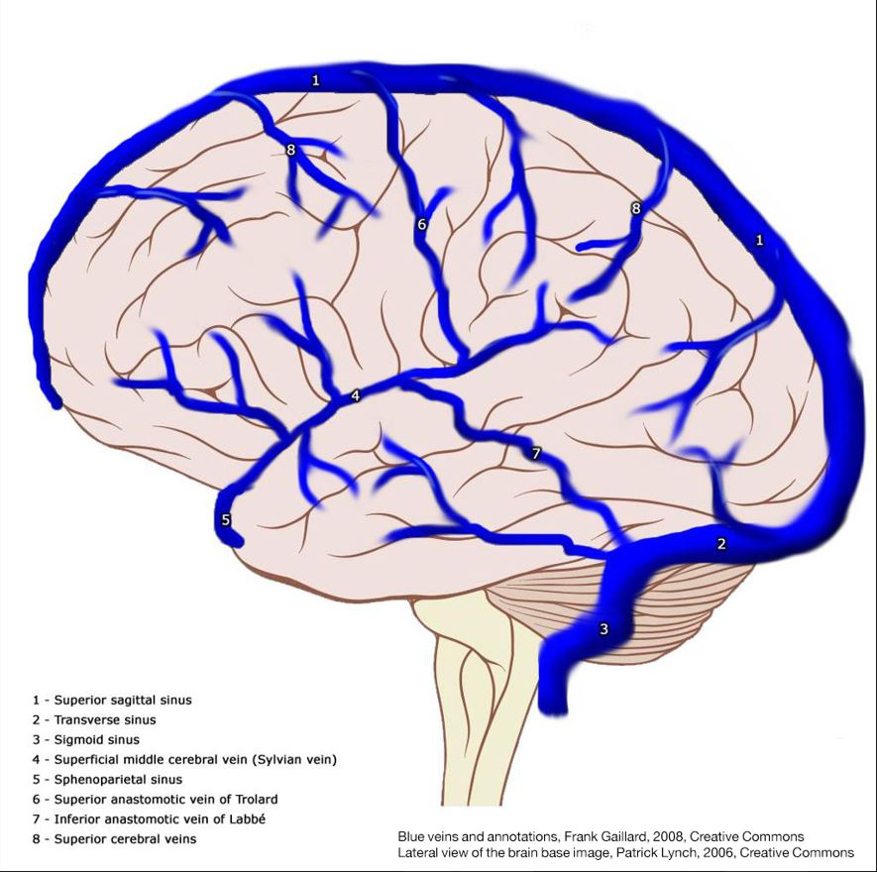
VEIN OF LABBE’
It is the largest venous channel on the lateral surface of the brain that crosses the temporal lobe between the Sylvian fissure and the transverse sinus. It courses postero-inferiorly from the mid-Sylvian fissure connecting the superficial middle cerebral vein to the anterolateral portion of the transverse sinus.

Slide 4
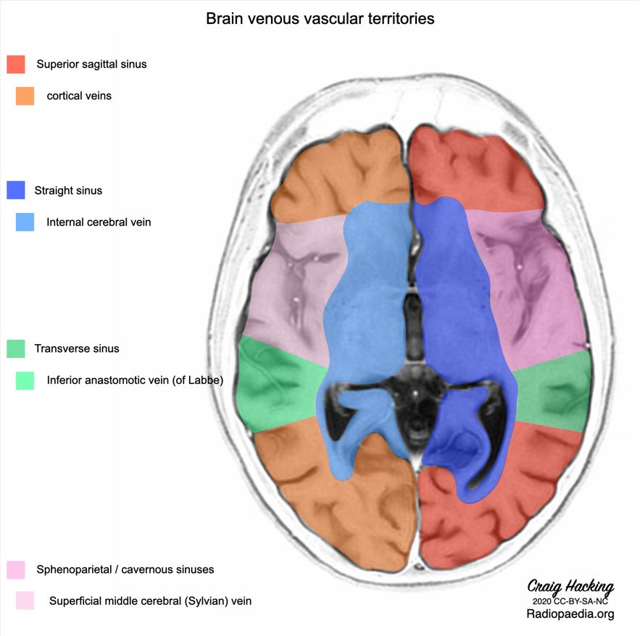
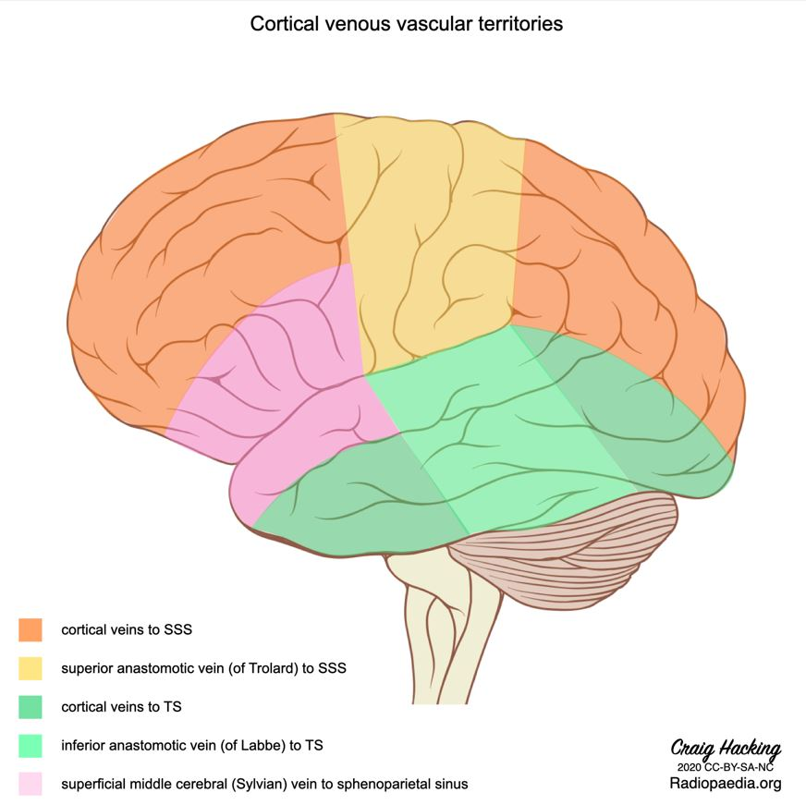
VEIN OF LABBE’

Slide 5
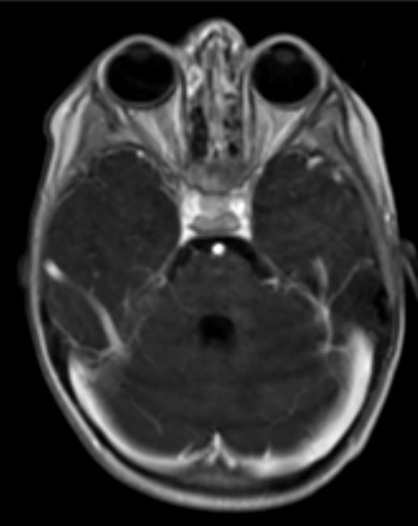
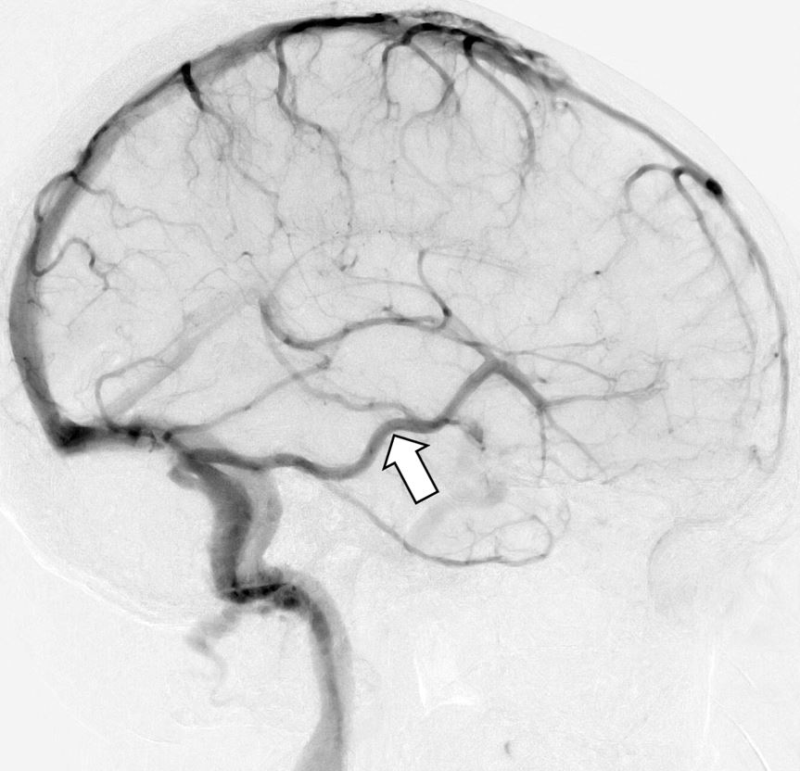
VEIN OF LABBE’
MRI: T1 with contrast

Slide 6
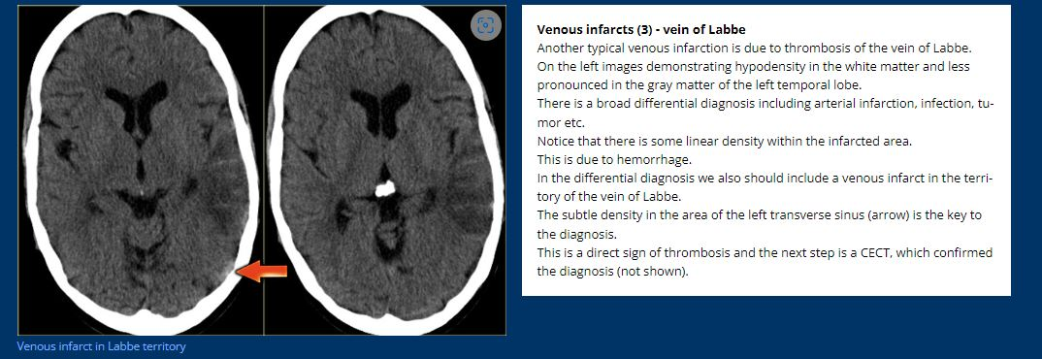
VEIN OF LABBE’

Slide 7
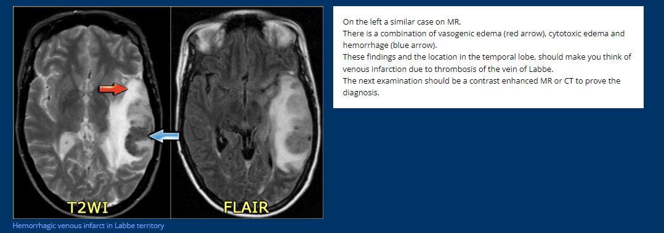
VEIN OF LABBE’

Slide 8

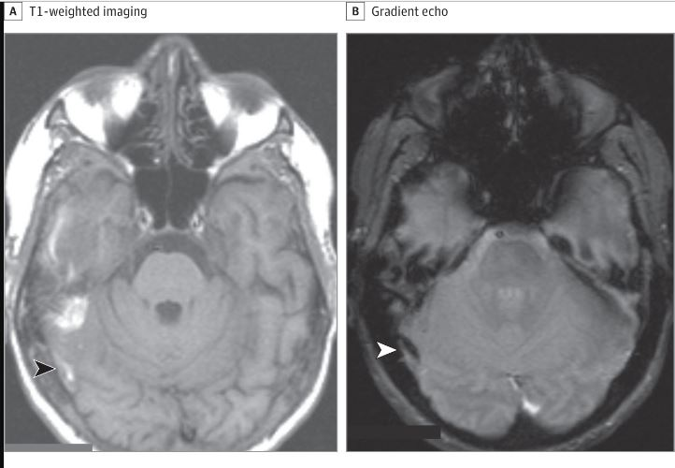
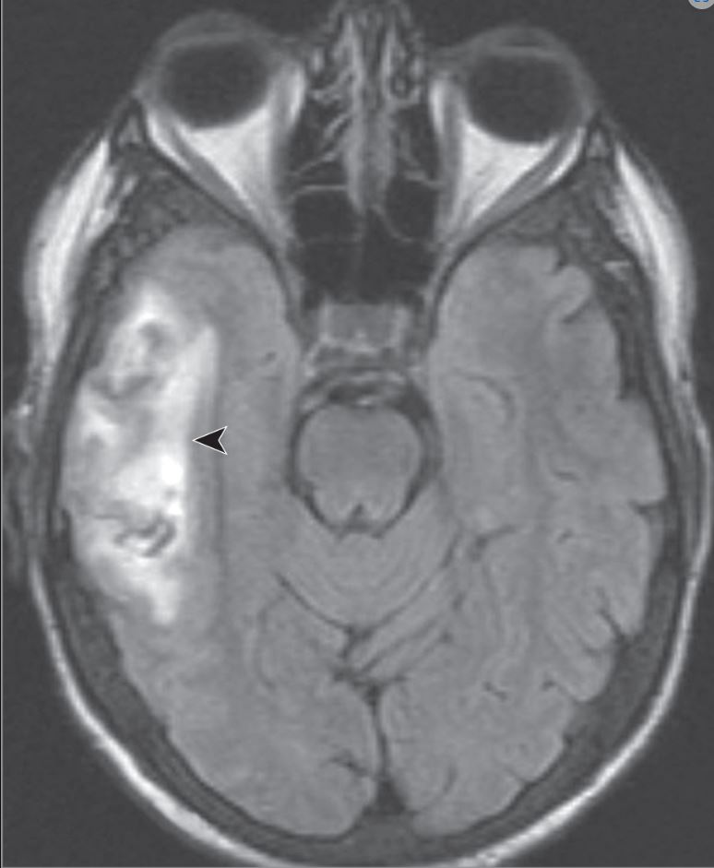
FLAIR: large hemorrhagic venous infarct
The thrombus in the right vein of Labbe (arrowheads) is hyperintense on T1

Slide 9
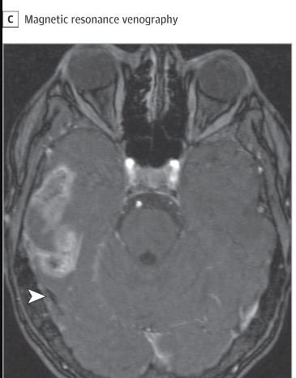
The thrombus in the right vein of Labbe (arrowheads) is hypointense on GRE, and absent bright signal on MRV

