Slide 1
TTP and Stroke
Sahily Reyes-Esteves, MD, PhD

Slide 2
Thrombocytopenic Thrombotic Purpura (TTP)
Clinical manifestations (<10% have pentad):
  Microangiopathic hemolytic anemia (MAHA)
  Thrombocytopenia
  Fever
  Renal insufficiency
  Neurological symptoms
Caused by ADAMTS13 deficiency
  vWF multimer protease
Notes:
Differential: HUS (typically after infection)
aHUS (other complement abnormalities)

Slide 3
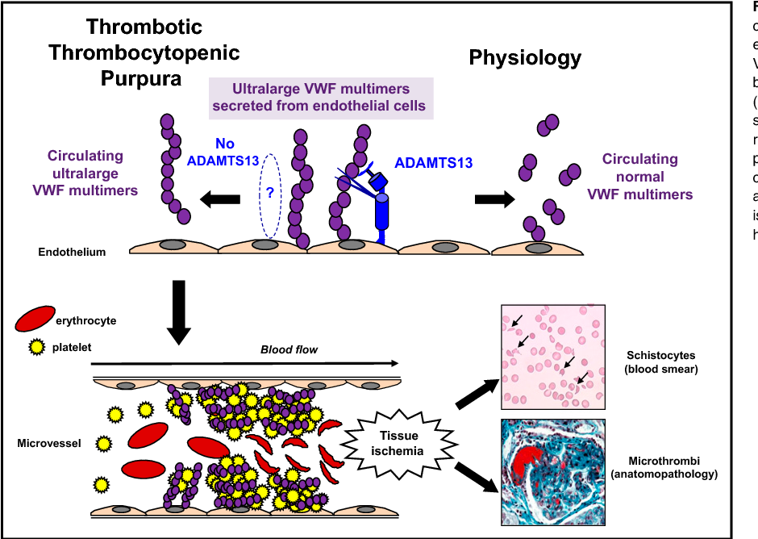
Berangere et al. Blood 2017
Notes:
ultralarge VWF (von Willebrand Factor) multimers to be secreted from their endothelial storage site in Weibel-Palade bodies and to either remain attached to the endothelial surface or released into the circulation

Slide 4
Neurologic manifestations
Wide range! But 60% have neurologic symptoms at onset.
Mild:
  Headache
  Confusion/fatigue/delirium (more in older adults)
Severe:
  Stroke
    Microangiopathic?
  Seizures
Heart and GI are other common sites of ischemia

Slide 5
TTP
ADAMTS13 deficiency:
  Immune (mostly acquired auto-IgGs in adulthood)
    Higher risk in Black patients, and in women
    Most idiopathic, but also ~HIV, cancer, pregnancy
  Genetic (AR; in childhood)
This is a chronic disease:
  Acute relapses triggered by illness or stress… or nothing
  Chronic/smoldering

Slide 6
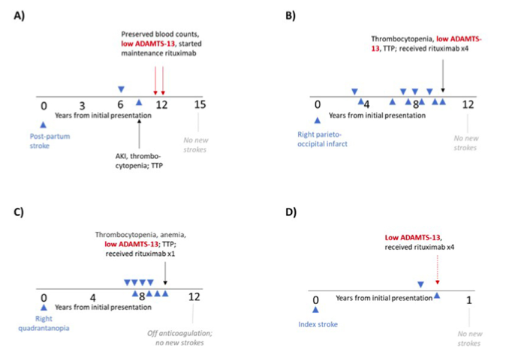
Matthews et al. J Stroke Cerebrovasc Dis 2022

Slide 7
How to Manage?
Dx/Monitoring: Measurement of ADAMTS13, both the enzyme activity level (<10%) and the presence of inhibitor activity
  Correlates with stroke recurrence
Treatment: immunosuppression
  PLEX and steroids daily until plt>150k
  Chemo (Ritux, Cytoxan,, vincristine, etc.)
  Salvage splenectomy
  + Caplacizumab
TNK and EVT? → no evidence
Notes:
The proportion of patients with a recurrence of aTTP in the overall study period (the drug treatment period plus a 28-day follow-up period after discontinuation of drug treatment) was lower in the Cablivi group (13 percent) compared to the placebo group (38 percent), a finding that was statistically significant.

Slide 8
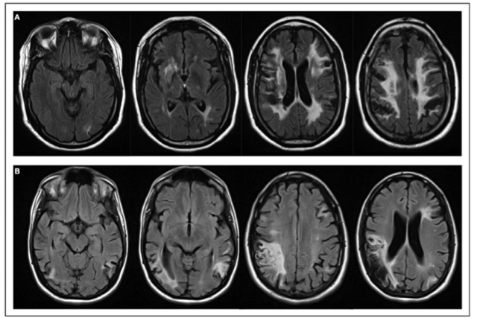
Matthews et al. J Stroke Cerebrovasc Dis 2022

Slide 9
References
Albo, et al. Thrombotic Thrombocytopenic Purpura (ADAMTS13 [a Disintegrin and Metalloproteinase With a Thrombospondin Type 1 Motif, Member 13] Deficiency) as Cause of Recurrent Multiterritory Ischemic Strokes, Stroke. 2022;53:e237–e240, https://doi.org/10.1161/STROKEAHA.121.034434
Joly BS, Coppo P, Veyradier A. Thrombotic thrombocytopenic purpura. Blood. 2017 May 25;129(21):2836-2846. doi: 10.1182/blood-2016-10-709857. Epub 2017 Apr 17. PMID: 28416507.
Matthews A, Yui J, Chiang EY, Pishko AM, Cuker A, Cucchiara BL, George D, Sayani F, Mullen MT. Cerebral Infarction due to Severe ADAMTS-13 Deficiency with Normal Hematological Parameters: A Cause of Cryptogenic Stroke. J Stroke Cerebrovasc Dis. 2022 Jun;31(6):106431. doi: 10.1016/j.jstrokecerebrovasdis.2022.106431. Epub 2022 Mar 16. PMID: 35305536.
Prevel R, Roubaud-Baudron C, Gourlain S, Jamme M, Peres K, Benhamou Y, Galicier L, Azoulay E, Poullin P, Provôt F, Maury E, Presne C, Hamidou M, Saheb S, Wynckel A, Servais A, Girault S, Delmas Y, Chatelet V, Augusto JF, Mousson C, Perez P, Halimi JM, Kanouni T, Lautrette A, Charvet-Rumpler A, Deligny C, Chauveau D, Veyradier A, Coppo P. Immune thrombotic thrombocytopenic purpura in older patients: prognosis and long-term survival. Blood. 2019 Dec 12;134(24):2209-2217. doi: 10.1182/blood.2019000748. PMID: 31530564.
Upreti H, Kasmani J, Dane K, Braunstein EM, Streiff MB, Shanbhag S, Moliterno AR, Sperati CJ, Gottesman RF, Brodsky RA, Kickler TS, Chaturvedi S. Reduced ADAMTS13 activity during TTP remission is associated with stroke in TTP survivors. Blood. 2019 Sep 26;134(13):1037-1045. doi: 10.1182/blood.2019001056. Epub 2019 Aug 20. PMID: 31431443; PMCID: PMC7022317.
https://www.fda.gov/news-events/press-announcements/fda-approves-first-therapy-treatment-adult-patients-rare-blood-clotting-disorder

