Slide 1
CANCER AND STROKE
________________________
Michela Rosso

Slide 2
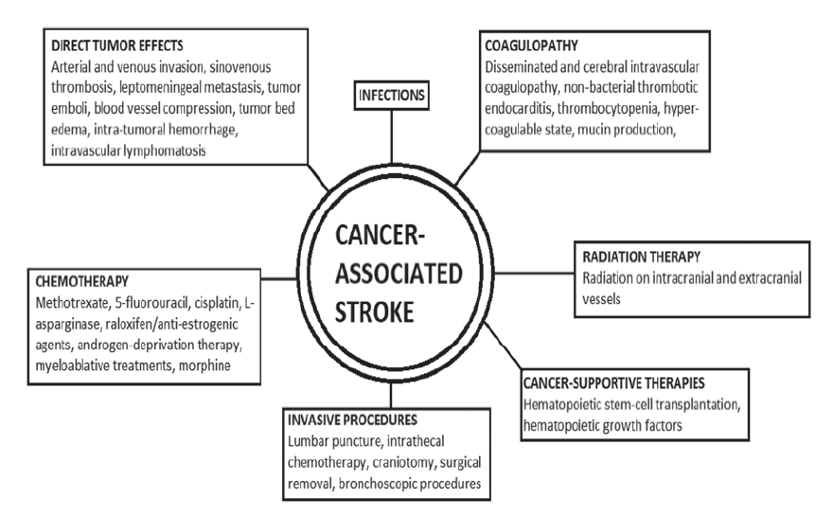
CANCER AND STROKE
Notes:
This picture is just to remind that hypercoagulability is only one of the multiple etiology of stroke in patients with cancer. We should not forget that cancer patients might have athero, lacunar strokes, Afib, other then causes related to the cancer itself as direct tumor effects on vessels, infections, side effects of chemotherapy

Slide 3
CANCER and VTE
LMWH for at least 3 to 6 months has been the standard of care in treating cancer-associated VTE [4].
Historically, LMWH have been preferred for cancer-associated VTE given RCTs demonstrating reduced risks of recurrent VTE vs warfarin [5,6].
However, consensus recommends[7,8];
Use of DOACs (with preference for edoxaban and rivaroxaban) in acute VTE and low bleeding risk, if no significant drug–drug interaction
Use of LMWH in acute VTE and high bleeding risk (including intraluminal gastrointestinal and genitourinary cancers or abnormalities)
Notes:
Lets start from what we do know about the use of AC in cancer patients

Slide 4
CANCER, Afib and PRIMARY PREVENTION of STROKE
Historically, vitamin K antagonists (VKA) have been preferred to LMWH for stroke prevention in AF and cancer [9]
However, given recent studies, DOACs can be an option based on case by case decision making and drug-to-drug interaction [10, 11]

Slide 5
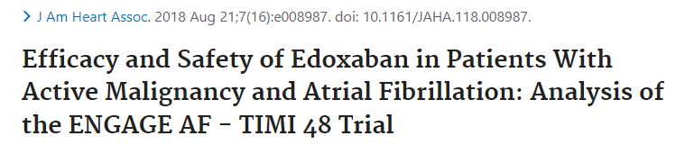
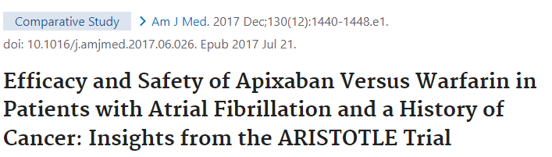
CANCER, Afib and PRIMARY STROKE PREVENTION
An analysis of the ENGAGE AF-TIMI 48 (Effective Anticoagulation with factor Xa next Generation in Atrial Fibrillation-Thrombolysis In Myocardial Infarction study 48) trial, which included 1,153 patients who developed cancer post-randomization, demonstrated preserved efficacy and safety of edoxaban compared with warfarin, regardless of cancer status [10]
Apixaban had superior safety and efficacy relative to warfarin among 157 patients with active cancer and 1,079 patients with a history of cancer enrolled in the ARISTOTLE (Apixaban for Reduction in Stroke and Other Thromboembolic Events in Atrial Fibrillation) trial [11]

Slide 6
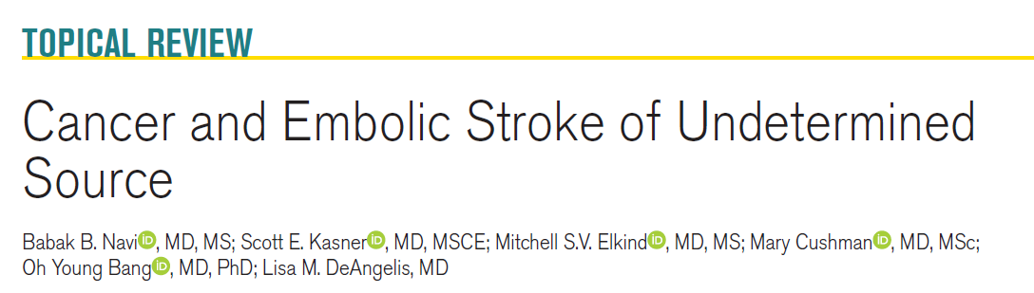
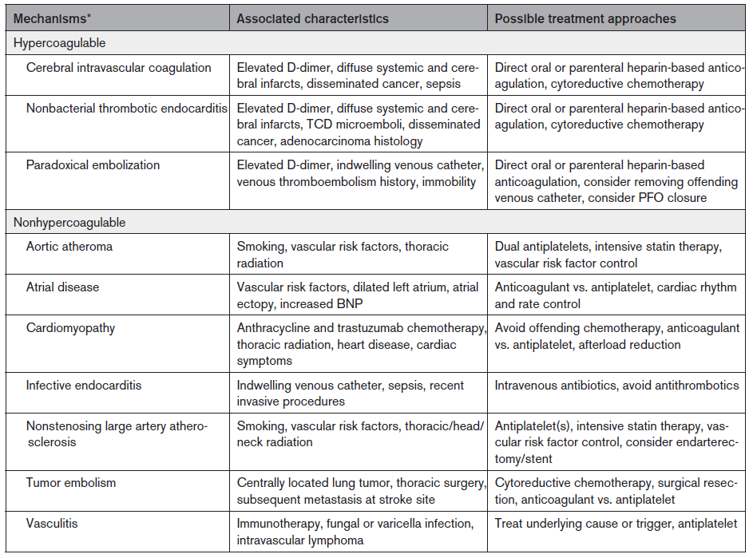
CANCER,ESUS, and SECONDARY STROKE PREVENTION
Approximately half of the ischemic strokes in patients with cancer are classified as ESUS, a higher proportion than in those without cancer [12]
Notes:
Several studies suggest that the rate of stroke recurrence btw AC and ASA is the same in ESUS patients with cancer

Slide 7
DOACs for secondary STROKE PREVENTION IN CANCER
DOACs are nowadays considered an attractive option for secondary stroke prevention in cancer patients:
DOACs are already recommended for acute VTE in cancer
Oral administration facilitates patient compliance and they offer a wide therapeutic window, requiring no laboratory monitoring [13].
DOACs share the short half‑life [14] advantage of LMWH
WHEN DO NOT USE DOACs: with cancer therapies that affect CYP3A4 metabolism and/or P-gp transport [9]

Slide 8
DOACs for secondary STROKE PREVENTION IN CANCER
DOACs are nowadays considered an attractive option for secondary stroke prevention in cancer patients:
DOACs are already recommended for acute VTE in cancer
Oral administration facilitates patient compliance and they offer a wide therapeutic window, requiring no laboratory monitoring [13].
DOACs share the short half‑life [14] advantage of LMWH
WHEN DO NOT USE DOACs: with cancer therapies that affect CYP3A4 metabolism and/or P-gp transport [9]
IN CONCLUSION: because cancer-related stroke has many possible underlying mechanisms, it is important that neurologists and oncologists work closely together to obtain a consensus for the best management of cancer-stroke patients [1]

Slide 9
BIBLIOGRAPHY
Navi BB, Kasner SE, Cancer and embolic stroke of undetermined source. Stroke. 2021;52:1121-1130
Sanossian N, Trends in cancer diagnoses among inpatients hospitalized with stroke. JSCVD 2013; 22: 1146–1150
Kim SJ, Clues to occult cancer in patients with ischemic stroke. PLoS ONE 2012; 7: e44959.
Dardiotis E, Aloizou AM, Markoula S, Siokas V, Tsarouhas K, Tzanakakis G, Libra M, Kyritsis AP, Brotis AG, Aschner M, Gozes I, Bogdanos DP, Spandidos DA, Mitsias PD, Tsatsakis A. Cancer-associated stroke: Pathophysiology, detection and management (Review). Int J Oncol. 2019 Mar;54(3):779-796. doi: 10.3892/ijo.2019.4669. Epub 2019 Jan 2. PMID: 30628661; PMCID: PMC6365034.
Lee AY, Low-molecular-weight heparin versus a coumarin for the prevention of recurrent venous thromboembolism in patients with cancer. N Engl J Med.
Lee AYY, Kamphuisen PW, Meyer G, et al. Tinzaparin vs warfarin for treatment of acute venous thromboembolism in patients with active cancer: a randomized clinical trial. JAMA
Khorana AA, Noble S, Lee AYY, et al. Role of direct oral anticoagulants in the treatment of cancer-associated venous thromboembolism: guidance from the SSC of the ISTH. J Thromb Haemost 2018;16:1891–4. [PubMed: 30027649]
National Comprehensive Cancer Network. NCCN Guidelines for Cancer-Associated Venous Thromboembolic Disease. Available at: https://www.nccn.org/Common/FileManager.ashx?fileManagerId=b0461271-ae6f-455a-bbb9-a637326abe49. Accessed January 2, 2019.
Mosarla RC, Vaduganathan M, Qamar A, Moslehi J, Piazza G, Giugliano RP. Anticoagulation Strategies in Patients With Cancer: JACC Review Topic of the Week. J Am Coll Cardiol. 2019 Mar 26;73(11):1336-1349. doi: 10.1016/j.jacc.2019.01.017. PMID: 30898209; PMCID: PMC7957366.
Fanola CL, Ruff CT, Murphy SA, Jin J, Duggal A, Babilonia NA, Sritara P, Mercuri MF, Kamphuisen PW, Antman EM, Braunwald E, Giugliano RP. Efficacy and Safety of Edoxaban in Patients With Active Malignancy and Atrial Fibrillation: Analysis of the ENGAGE AF - TIMI 48 Trial. J Am Heart Assoc. 2018 Aug 21;7(16):e008987. doi: 10.1161/JAHA.118.008987. PMID: 30369307; PMCID: PMC6201390.
Melloni C, Dunning A, Granger CB, Thomas L, Khouri MG, Garcia DA, Hylek EM, Hanna M, Wallentin L, Gersh BJ, Douglas PS, Alexander JH, Lopes RD. Efficacy and Safety of Apixaban Versus Warfarin in Patients with Atrial Fibrillation and a History of Cancer: Insights from the ARISTOTLE Trial. Am J Med. 2017 Dec;130(12):1440-1448.e1. doi: 10.1016/j.amjmed.2017.06.026. Epub 2017 Jul 21. PMID: 28739198.
Hart RG, Catanese L, Perera KS, Ntaios G, Connolly SJ. Embolic stroke of undetermined source: a systematic review and clinical update. Stroke. 2017;48:867–872. doi: 10.1161/STROKEAHA.116.016414
van Es N and Büller HR: Using direct oral anticoagulants (DOACs) in cancer and other high-risk populations. Hematology Am Soc Hematol Educ Program 2015: 125-131, 2015. Magne JL, Pirvu A, Sessa C, Cochet E, Blaise H and Ducos C: Carotid artery revascularisation following neck irradiation: Immediate and long-term results. Eur J Vasc Endovasc Surg 43: 4-7, 2012.
van der Hulle T, den Exter PL, Kooiman J, van der Hoeven JJ, Huisman MV and Klok FA: Meta-analysis of the efficacy and safety of new oral anticoagulants in patients with cancer-associated acute venous thromboembolism. J Thromb Haemost 12: 1116-1120, 2014
Nam KW, Kim CK, Kim TJ, An SJ, Oh K, Ko SB, Yoon BW. Treatmen of cryptogenic stroke with active cancer with a new oral anticoagulant. J Stroke Cerebrovasc Dis. 2017;26:2976–2980. doi: 10.1016/j. jstrokecerebrovasdis.2017.07.029
Navi BB, Singer S, Merkler AE, Cheng NT, Stone JB, Kamel H, Iadecola C, Elkind MS, DeAngelis LM. Recurrent thromboembolic events after ischemic stroke in patients with cancer. Neurology. 2014;83:26–33. doi:10.1212/WNL.0000000000000539
Martinez-Majander N, Ntaios G, Liu YY, Ylikotila P, Joensuu H, Saarinen J, Perera KS, Marti-Fabregas J, Chamorro A, Rudilosso S, et al; NAVIGATE ESUS investigators. Rivaroxaban versus aspirin for secondary prevention of ischaemic stroke in patients with cancer: a subgroup analysis of th NAVIGATE ESUS randomized trial. Eur J Neurol. 2020;27:841–848. doi: 10.1111/ene.14172
Park H, Kim J, Ha J, Hwang IG, Song TJ, Yoo J, Ahn SH, Kim K, Kim BM, Kim DJ, et al. Histological features of intracranial thrombi in stroke patients with cancer. Ann Neurol. 2019;86:143–149. doi: 10.1002/ana.25495

Slide 10
AC vs ASA for SECONDARY STROKE PREVENTION in patients with cancer and stroke
TEACH (Trial of Enoxaparin versus Aspirin in Patients With Cancer and Stroke) pilot trial randomized 20 cancer patients with a recent ischemic stroke to enoxaparin vs aspirin: no differences in the cumulative rates of recurrent thromboembolic events, major bleedings, or survival between the groups. Enrollment failure: patient aversion to receiving injections → 40% of patients randomized to enoxaparin crossed-over to ASA because of discomfort with injections [15]
A retrospective cohort study performed at MSK, including 172 patients with active cancer and AIS, compared the odds of recurrent stroke, thromboembolism, or death between 102 patients (92 ASA) that received an antiplatelet and 90 that received an AC (79 LMWH) at discharge (some received both).[16] Although there may have been confounding by indication, there were no differences in treatment groups.
An exploratory analysis of the NAVIGATE ESUS ( New Approach riVaroxaban Inhibition of Factor Xa in a Global trial versus ASA to prevenT Embolism in Embolic Stroke of Undetermined Source) trial studied 543 (7.5%) patients with recent ESUS and history of cancer (whether these cancers were active was not reported), that were randomized to 15 mg rivaroxaban vs 100 mg ASA. Although patients with cancer had higher rates of recurrent stroke than patients without cancer, the risk of recurrent stroke between treatment groups was not significantly different. Furthermore, the risk of major bleeding was more than doubled in the rivaroxaban-randomized patients. The trial itself was not, however, designed for this purpose [17].
Lastly, endovascularly retrieved intracranial thrombi from patients with cancer related ESUS are platelet-rich, indicating that antiplatelet therapy may benefit this population. [18]

Slide 11
THE FUTURE
multicenter, double-blind, randomized trial, entitled TEACH2 (Trial of Apixaban Versus Aspirin in Cancer Patients With Cryptogenic Ischemic Stroke), to determine if anticoagulant therapy with apixaban is safe and effective compared with antiplatelet therapy with aspirin in patients with active cancer and ESUS. In this trial, we will employ a patient-centric design, whereby the composite primary outcome includes all major thromboembolic events that impact quality of life measures and cancer treatment decisions in patients with cancer. Venous thromboembolic disease, in particular, will be included as part of the composite outcome because it is the second most common cause of death in patients with cancer and often hinders their functional status.75
the only active randomized trial evaluating different antithrombotic approaches in patients with cancer and ESUS is the ENCHASE trial (Edoxaban for the Treatment of Coagulopathy in Patients With Active Cancer and Acute Ischemic Stroke: A Pilot Study; https://www.clinicaltrials.gov; Unique identifier: NCT03570281). This pilot trial in Korea is comparing the direct oral anticoagulant, edoxaban, to the injectable low-molecular weight heparin, enoxaparin, in 40 patients with cancer-associated ESUS. Additionally, the ongoing MOST-Cancer and OASIS-Cancer prospective cohort studies are evaluating biomarkers of hypercoagulability and antithrombotic treatment effects in patients cancerrelated ESUS, albeit in nonrandomized designs.

