Slide 1
SENSITIVITY OF MRI FOR LATERAL MEDULLARY STROKES
________________________
Michela Rosso

Slide 2
FALSE NEGATIVE RATES
Rate of false-negative axial DWI findings in brainstem infarction within the first 24 h of symptom onset ranges from 17-63%.
The FN rate of brainstem infarction using axial DWI was 27.6% while that of hemispheric infarctions was 1.2% (3T MRI) (P < 0.01) [1]
26% of acute LMI patients initially showed negative findings in standard axial DWI-MRI (1.5T) [2].
[1] Takeshige, 2018
[2] Ohira, 2020
Notes:
This prevalence however is mostly from studies published around 2000

Slide 3
The small diameter of brain stem lesions and susceptibility artifacts due to the proximity to the bone poses difficulties for the detection of AIS.
The detectability tends to be low in the acute phase of brainstem infarctions and increases in the subacute phase. Thus, even if the initial DWI-MRI after the onset of symptoms yields negative findings, lesions in the brainstem may appear on follow-up MRI assessments.

Slide 4
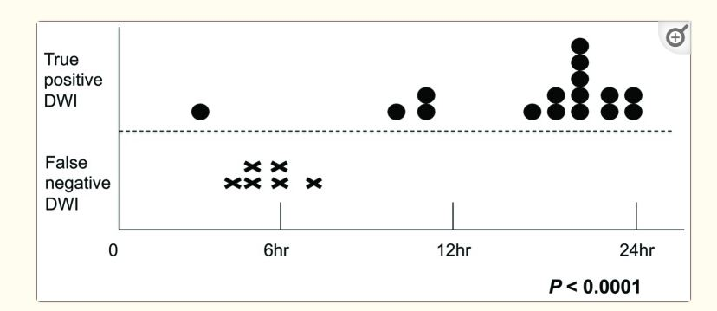
FN-BIs were more frequently diagnosed using standard axial DWI performed within 6 h of the onset of symptoms and that the volumes of the FN lesions were significantly smaller than those of the TP lesions.

Slide 5
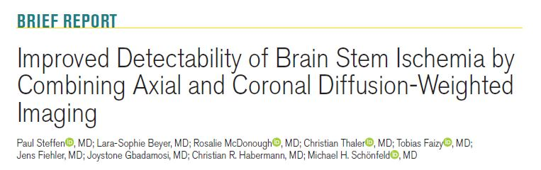
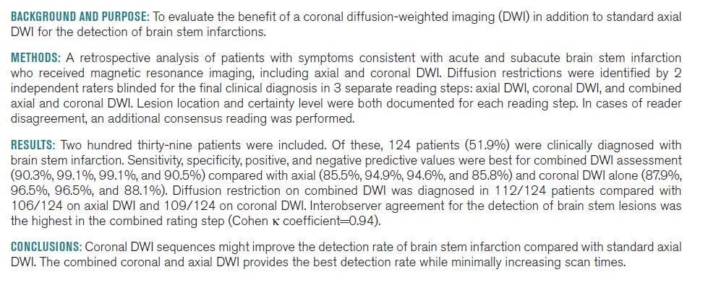

Slide 6
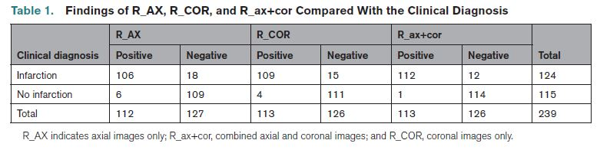
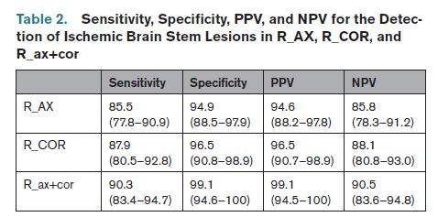
The inter-observer reliability was excellent, with κ values of 0.87 (95% CI, 0.81–0.94; P<0.001) for R_AX, 0.88 (95% CI, 0.82–0.94; P<0.001) for R_COR, and 0.94 (95% CI, 0.90–0.98; P<0.001).

Slide 7
