Slide 1

Quick take:
Review of Spinal Cord Vascular Supply
Sahily Reyes-Esteves, MD, PhD

Slide 2



Spinal Cord Arterial Supply
Cervical Cord
Thoracic Cord
Cauda
Posterior Spinal Arteries
Anterior Spinal Artery

Slide 3

Spinal Cord Arterial Supply
Posterior Spinal Arteries
Anterior Spinal Artery
Cervical Cord
Thoracic Cord
Cauda

Slide 4
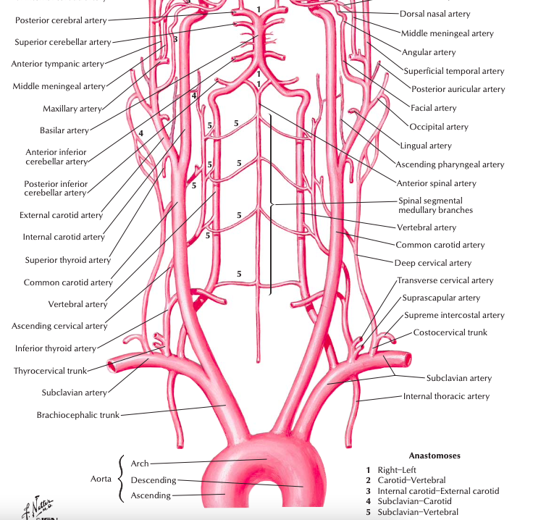

Slide 5
Cervical Cord

Slide 6
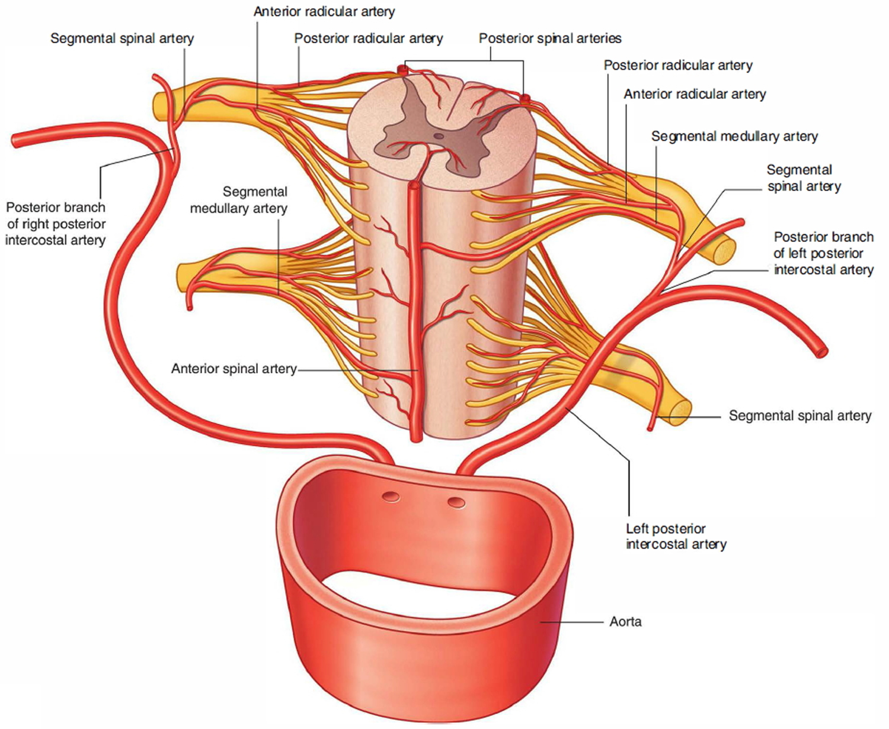
(Upper) Thoracic Cord

Slide 7
(Upper) Thoracic Cord
Some references say that this is
mostly in C- and low T/L cord

Slide 8
(Upper) Thoracic Cord
Some references say that this is
mostly in C- and low T/L cord
Some references say radicular arteries actually only supply nerve roots

Slide 9
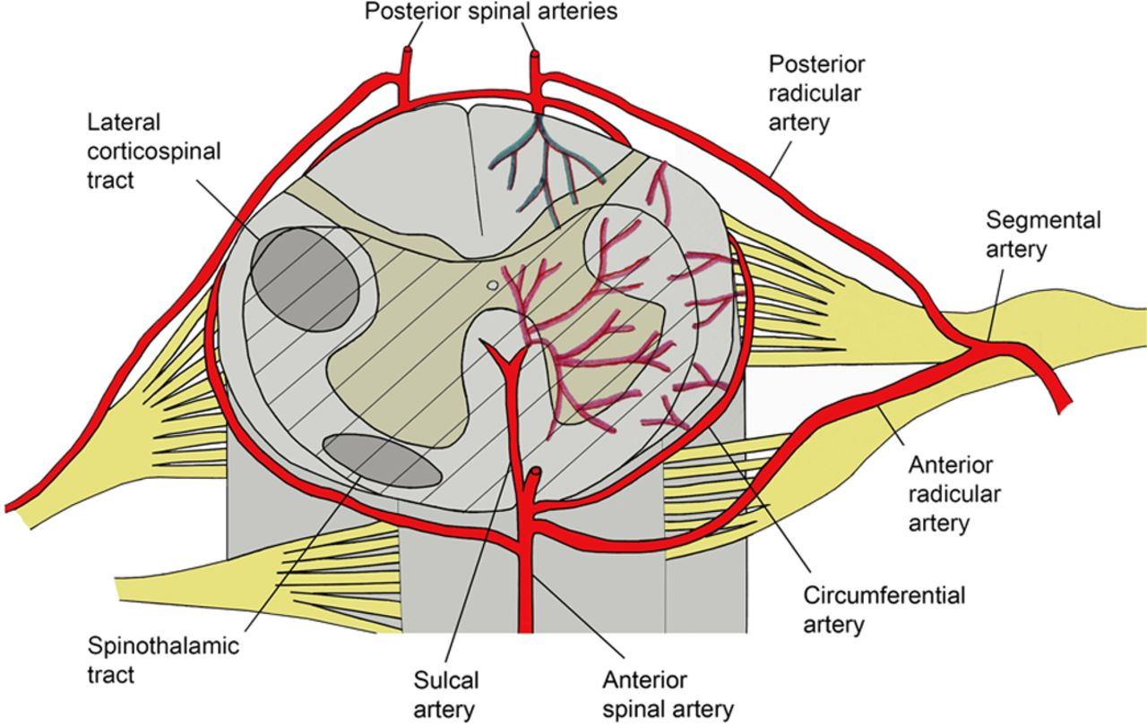
(Upper) Thoracic Cord
A different take

Slide 10
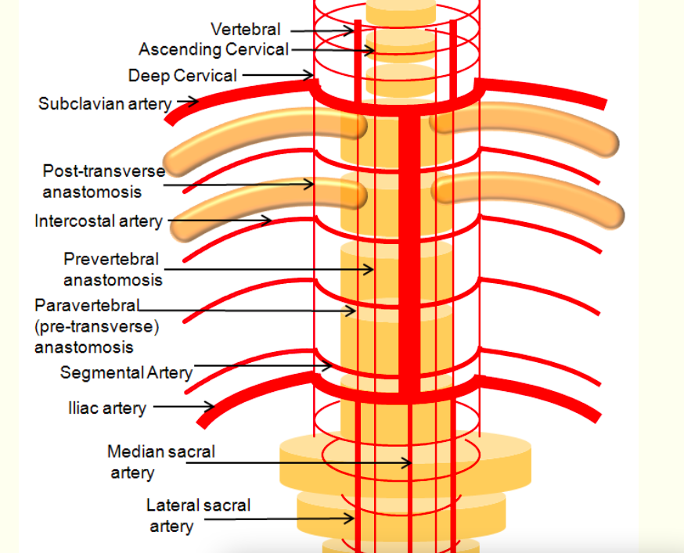
Theme of anastomoses throughout
“Boosters/Feeders”

Slide 11
The ASA loses caliber as it travels
“The diameter of the ASA through the thoracic spinal cord is notably narrower when compared to its size in the cervical and lumbar regions. Thus, much of the blood flow to the thoracic spine derives from segmental arteries branching from the dorsal aorta.”

Slide 12
Thoughts on the PSAs
“Often found to be discontinuous, and occasionally one artery will move across to supply the opposite side.”
It is useful to think of the posterior spinal artery as a plexus as it often anastomoses with the contralateral posterior spinal artery and may receive anastomoses with the anterior spinal artery via a plexus that encases the cord.

Slide 13
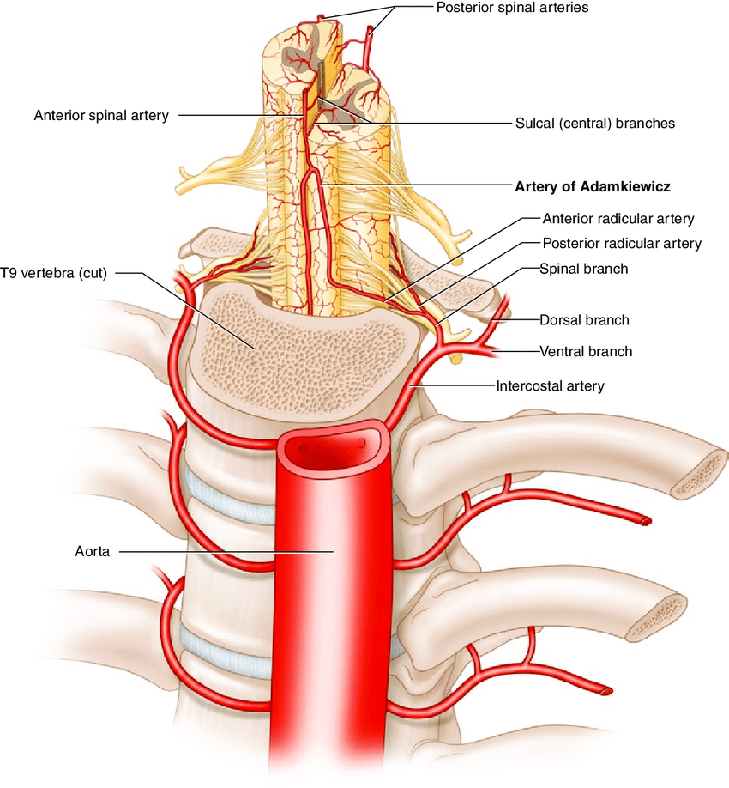
(Lower) Thoracic Cord
And the famous
Adamkiewicz

Slide 14
“In up to 70% on cases there is a large anterior radicular branch of intercostal artery arising from the T10 to T 12 segments on the left. It makes a hairpin bends as it enters the anterior spinal artery and thus provides a major source of blood supply to especially the anterior part of the cord below this level. This is the great radiculomedullary artery of Adamkiewicz or arteria radicularis magna (ARM).”

Slide 15
“In up to 70% on cases there is a large anterior radicular branch of intercostal artery arising from the T10 to T 12 segments on the left. It makes a hairpin bends as it enters the anterior spinal artery and thus provides a major source of blood supply to especially the anterior part of the cord below this level. or arteria radicularis magna (ARM) This is the great radiculomedullary artery of Adamkiewicz.”

Slide 16
segmental medullary artery

Slide 17
Adamkiewicz variations
“It is the largest anterior radiculomedullary artery of that individual, contributing to its significant variation of location.”
“Due to its atypical nature, the artery of Adamkiewicz typically arises from the left side of the aorta between T8 and L2 in 75% of people, although it is important to realize that the artery of Adamkiewicz can also be present above T8 in about 20% of people - other less common variations exist, and collateral circulation with lumbar arteries exist.”

Slide 18
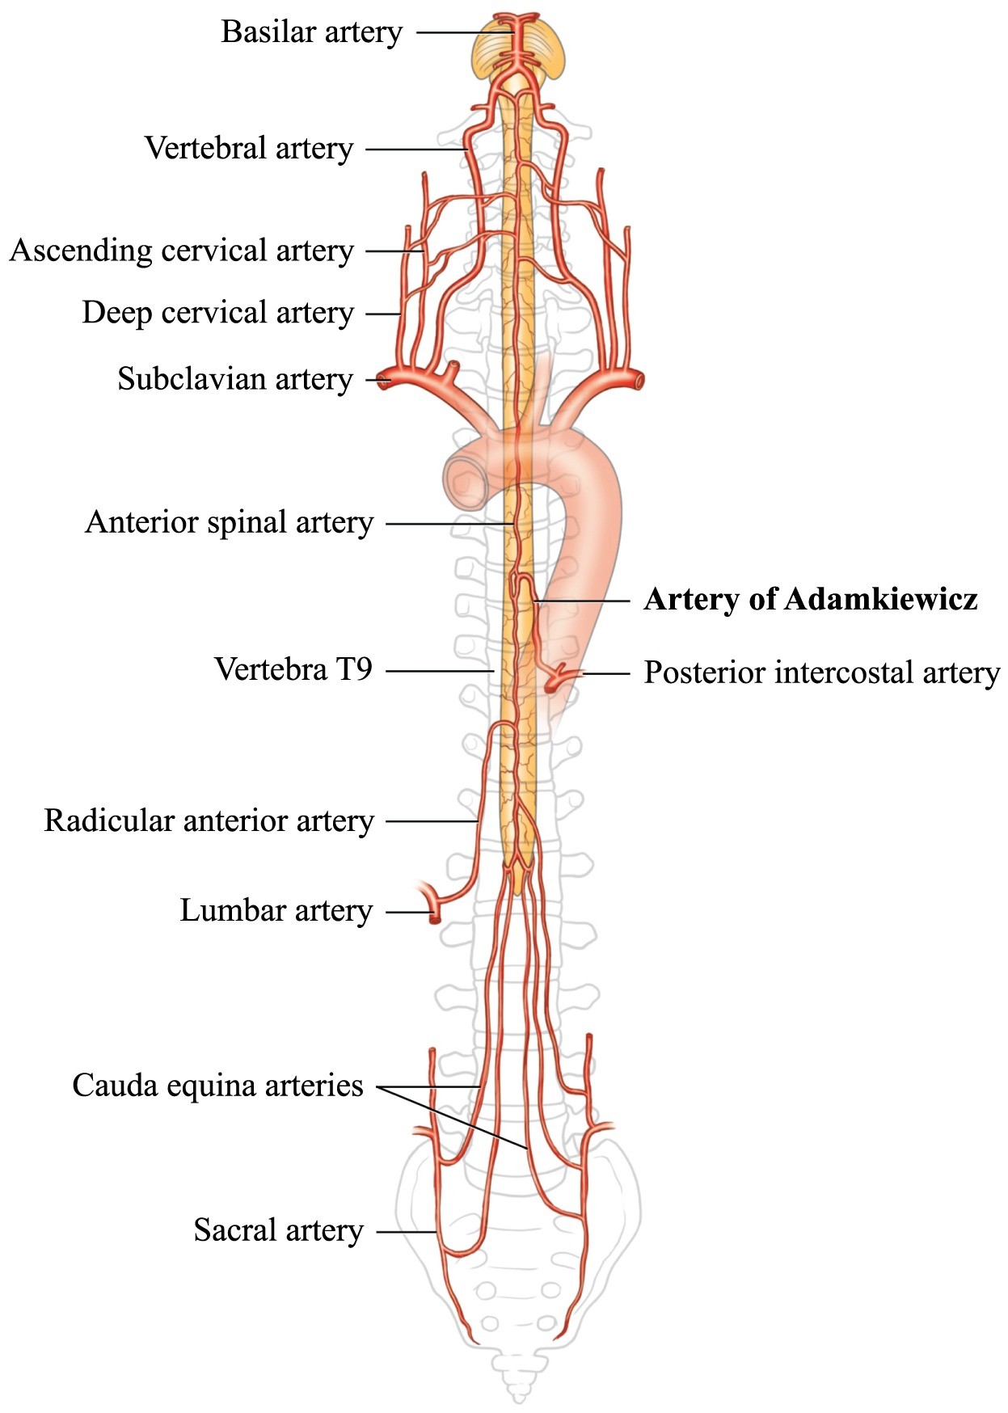

Slide 19
Some References
David G Greathouse, PT, PhD, John S Halle, PT, PhD, Arthur F Dalley, II, PhD, Blood Supply to the Spinal Cord, Physical Therapy, Volume 81, Issue 6, 1 June 2001, Pages 1264–1265, https://doi.org/10.1093/ptj/81.6.1264
Kenneth Ozoilo, Michael Stein, Paraplegia complicating embolization for bleeding intercostal artery in penetrating trauma, Injury Extra, Volume 44, Issue 8, 2013, 70-73, https://doi.org/10.1016/j.injury.2013.05.015
Hasan S, Arain A. Neuroanatomy, Spinal Cord Arteries. [Updated 2022 Aug 15]. In: StatPearls [Internet]. Treasure Island (FL): StatPearls Publishing; 2022 Jan-. Available from: https://www.ncbi.nlm.nih.gov/books/NBK539889/
Netter Neuroanatomy
Wikipedia, Google Images

