Slide 1
PSEUDOXANTHOMA ELASTICUM AND STROKES
________________________
Michela Rosso

Slide 2
PSEUDOXANTHOMA ELASTICUM
A rare, late-onset, heritable disorder characterized by abnormal mineralization, fragmentation, and calcification of elastic fibers in the skin, eye, vascular, and gastrointestinal system.
PREVALENCE: 1:25,000 to 1:100,000; with twice as many females as males.
Average diagnosis is at 30-40 years
Notes:
This prevalence however is mostly from studies published around 2000

Slide 3
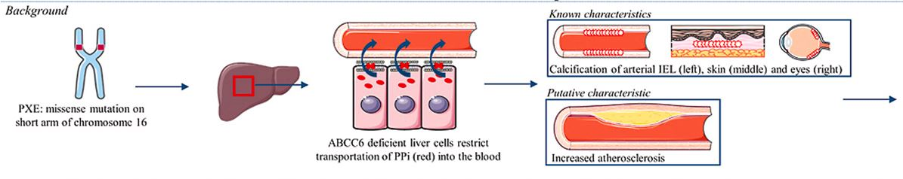
PSEUDOXANTHOMA ELASTICUM
GENETICS: AR mutation of ABCC6 gene on chromosome 16, encoding an ATP-dependent efflux transporter that creates inorganic pyrophosphate (PPi), a strong inhibitor of mineralization.
Reduced PPi levels in PXE allow ectopic mineralization in elastin-rich tissues, including skin, eyes, and the arterial blood vessels
Internal elastic lamina
Notes:
This prevalence however is mostly from studies published around 2000

Slide 4
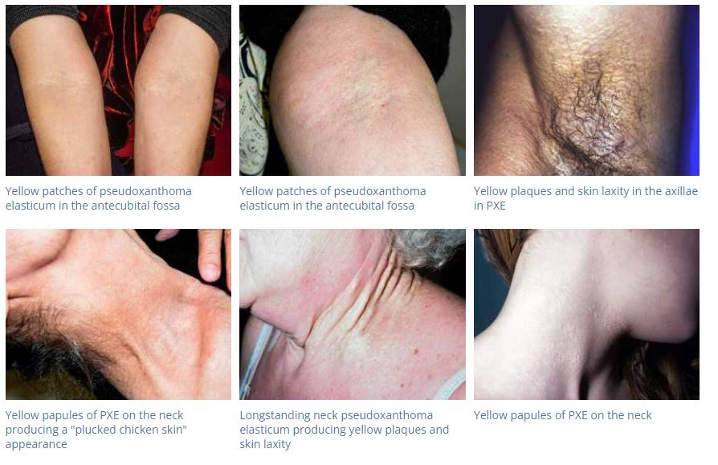
CLINICAL FEATURES
Cutaneous features:
  1–5 mm yellowish papules, over lateral neck and flexural areas
  Reticular or linear arrangement of lesions
  Lesions progressively coalesce into larger plaques with a “cobblestone” appearance
  Affected skin becomes soft, lax, and wrinkled over time
  Prominent mental (chin) fold
  Lesions are asymptomatic.
Notes:
This prevalence however is mostly from studies published around 2000

Slide 5
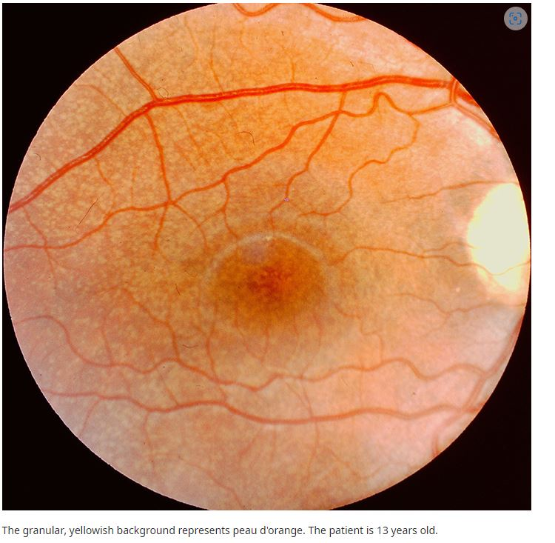
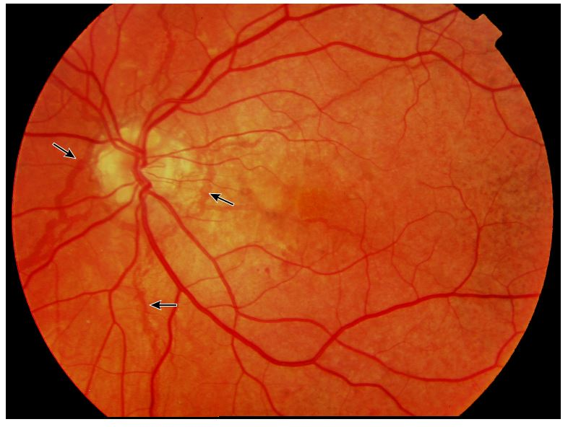
CLINICAL FEATURES
b) Ocular features:
  Peau d’orange: mottled appearance of the temporal retina.
  Angioid streaks: narrow, irregular streaks that resemble blood vessels.
  “Comet tails'': areas of chorioretinal atrophy in the peripheral retina (pathognomonic feature of PXE).
  Choroidal neovascularization (CNV): a major complication at later stages of disease that causes vision loss.
Notes:
This prevalence however is mostly from studies published around 2000

Slide 6
CLINICAL FEATURES
c) Cardiovascular features:
  Peripheral artery disease
  Aneurysms
  Ischemic/hemorrhagic stroke and transient ischemic attacks
  Carotid stenosis
  Premature coronary artery disease
  Hypertension secondary to renovascular stenosis
Notes:
This prevalence however is mostly from studies published around 2000

Slide 7
CLINICAL FEATURES
d) Other systemic features:
  Gastrointestinal or urinary tract bleeding (15%)
  Benign calcification of breasts, pancreas, testicles, spleen, and liver
  Symptomatic calcification of renal arteries
  Reduced pulmonary function
  Miscarriage is more common in early pregnancy
Notes:
This prevalence however is mostly from studies published around 2000

Slide 8
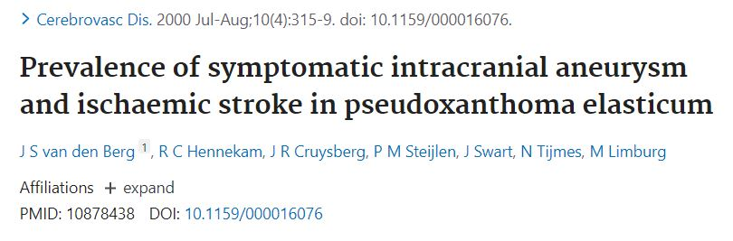
PXE AND ISCHEMIC STROKE
In a Dutch cohort of 100 patients with PXE (mean follow-up 17.1 years, range 1-49 years), the estimated risk for ischemic stroke under the age of 65 years was nearly four times higher than in the general population (relative risk 3.6; 95% CI 3.3-4.0)
Notes:
This prevalence however is mostly from studies published around 2000

Slide 9
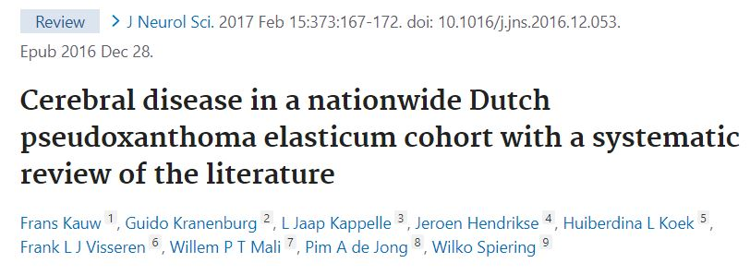
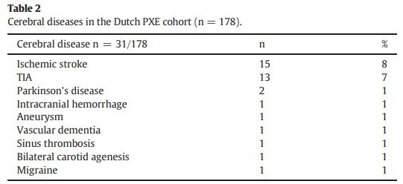
PXE AND CEREBRAL DISEASE
Notes:
This prevalence however is mostly from studies published around 2000

Slide 10
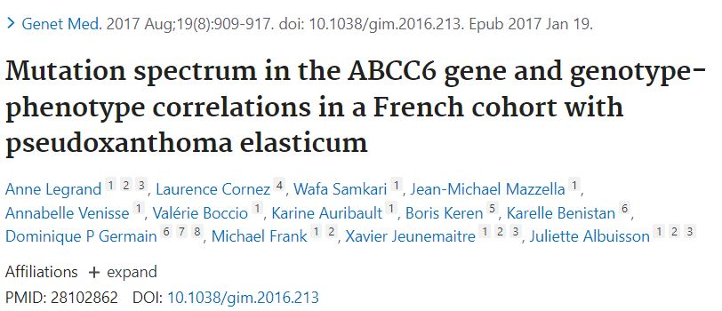
In a French cohort of 239 PXE cases (63% F, 79% Caucasian, median age 43.5), the prevalence of neurovascular manifestations (transient ischemic attack or ischemic stroke) was 10 % (median age 51.5, range 31–73)
Notes:
This prevalence however is mostly from studies published around 2000

Slide 11
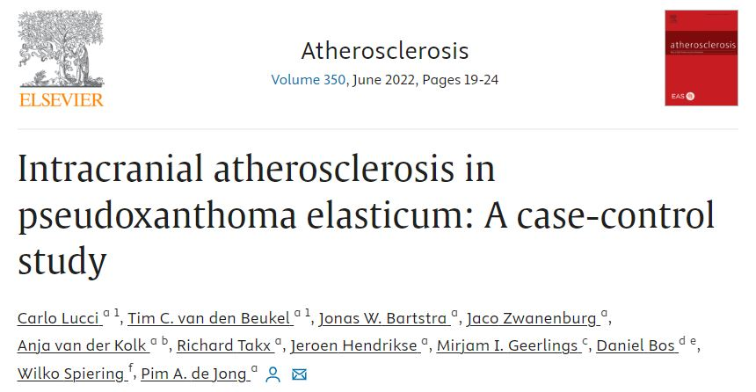
Recent investigations highlighted PXE patients are at increased risk of stroke. Is this caused by increased intracranial atherosclerosis?
Internal elastic lamina

Slide 12
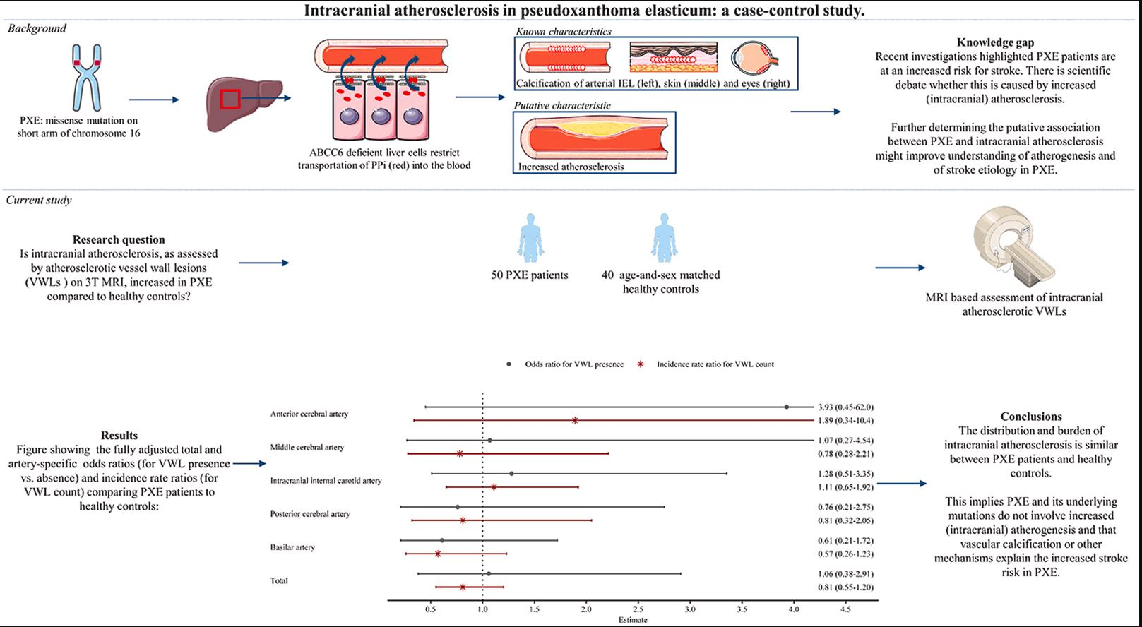
PXE patients from the Dutch National Expertise Center for PXE (DNECP), an ongoing prospective PXE cohort situated at the University Medical Center Utrecht (UMCU) in the Netherlands.

Slide 13
The total burden of intracranial atherosclerotic VWLs was similar between PXE patients (68 VWLs, age 58.7) and healthy controls (73 VWLs, age 59.5).

Slide 14
PXE has been shown to cause internal elastic lamina calcification
Arterial stiffness → increase pulsatile energy that travels into the cerebral microcirculation
Aortic stiffness might contribute to increased occurrence of cardiogenic stroke through an increased load on the left heart causing impaired LVF

Slide 15
PXE AND ISCHEMIC STROKE: CONCLUSION
PXE increases susceptibility to ischemic strokes
PXE might cause a PXE-mediated vasculopathy rather than typical atherosclerosis
Good control of typical atherosclerotic risk factor in PXE patients is the best that could be offered at this point
Notes:
This prevalence however is mostly from studies published around 2000

