Slide 1
Is there evidence that L-arginine work as a treatment for MELAS?

Slide 2
No.

Slide 3
Well, maybe.

Slide 4
Proposed mechanism
Stroke-like episodes in MELAS:
- Microangiopathy
- Neuronal excitability and cytopathy
- low NO → oxidative stress
L-arginine: strong NO donor

Slide 5
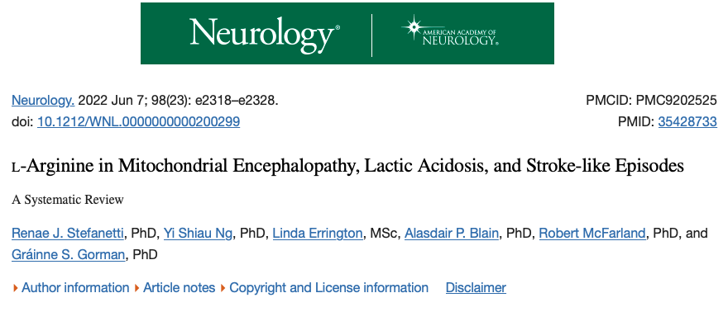

Slide 6
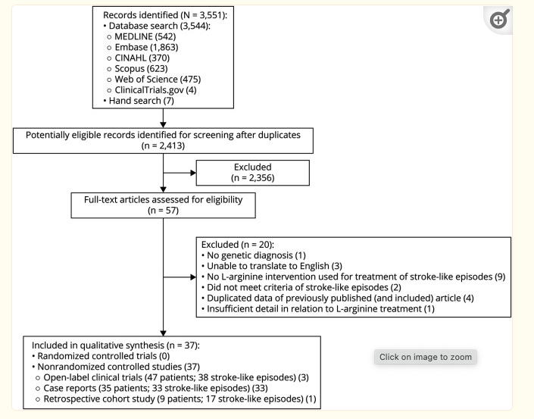

Slide 8
Problems with definitions in open-label trials
Most (but not all) had genetic diagnosis
Definition of stroke-like episode
  No requirement for MRI
  Sometimes just headache/nausea/seizure
Confounders
  Concomitant AED use
Outcome measures
  ?Improvement in headache at 24 hours

Slide 9
Variations with intervention
Open label trials: Single dose of 0.5 g/kg, except one study that had repeated dosing
Cohort/case reports: lots of different doses and lengths of therapy

Slide 10
Three Open Label Trials:
Koga 2010: 22 patients
  IV: Improved the rates of four major symptoms—headache, nausea/vomiting, impaired consciousness, and visual disturbance.
  Oral: no statistically significant difference in the MELAS stroke scale, mitochondrial disease severity scores, or migraine severity scores; extended interictal phase
  AE: Fever, anemia

Slide 11
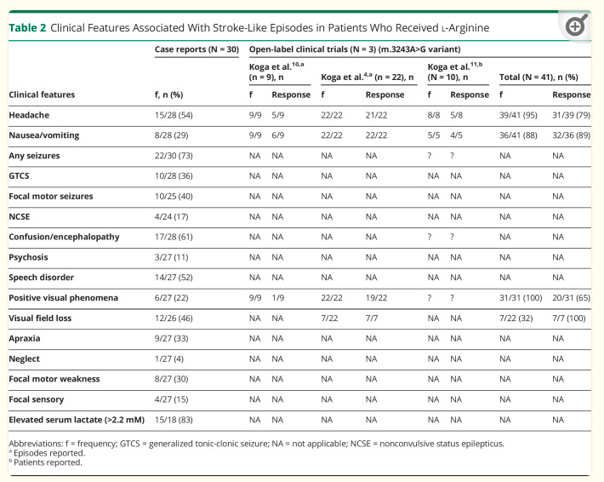

Slide 12
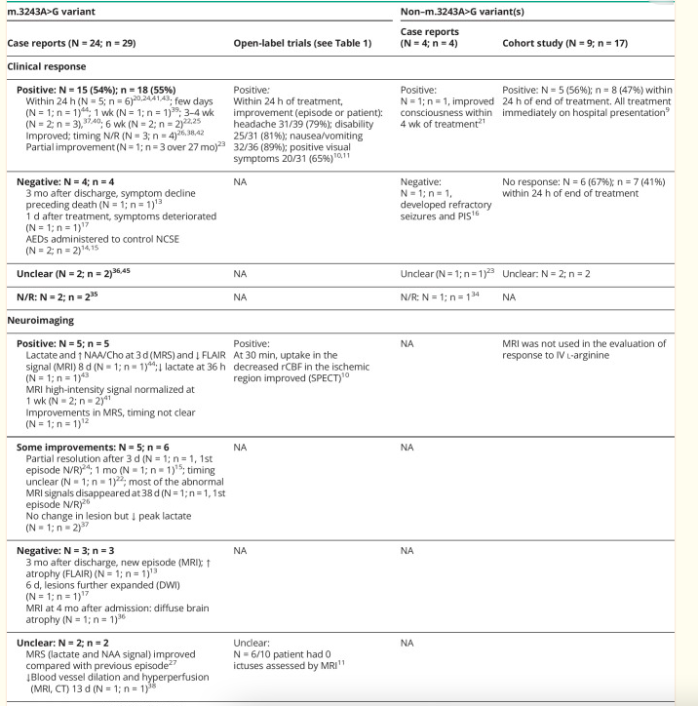

Slide 13
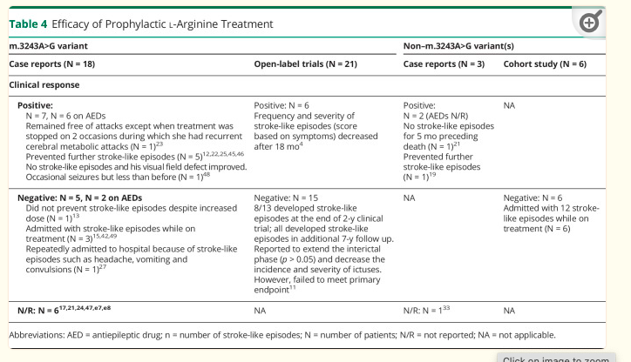

Slide 14
Side effects
In studies,
- Fever
- Anemia
- Lactic acidosis

Slide 15
Side effects
>10%:
Hematologic & oncologic: Hematologic abnormality (11%; including anemia [4%], disorder of hemostatic components of blood [<3%], disorder of the lymphatic system, disseminated intravascular coagulation [3%], hemorrhage [<3%], pancytopenia [<3%], and thrombocytopenia [<3%])
Infection: Infection (12%; including sepsis [<3%], septic shock [<3%], and urinary tract infection [3%])
Nervous system: Central nervous system dysfunction (22%; including absent reflexes [<3%], ataxia [<3%], brain edema [5%], cerebral atrophy [<3%], cerebral hemorrhage [<3%], cerebral infarction [<3%], clonus [<3%], coma [3%], decreased mental acuity [6%], encephalopathy [<3%], impaired consciousness [<3%], increased intracranial pressure [<3%], paralysis [nerve: <3%], seizure [6%], and tremor [<3%])
Respiratory: Respiratory system disorder (15%; including acute respiratory distress syndrome [<3%], dyspnea [<3%], hypercapnia [<3%], hyperventilation [<3%], Kussmaul respiration [<3%], pulmonary edema [<3%], pulmonary hemorrhage [<3%], respiratory acidosis [<3%], respiratory alkalosis [<3%], respiratory distress [3%], respiratory failure [<3%], tachypnea [<3%], and variations in blood CO2 concentrations [<3%])
1% to 10%:
Cardiovascular: Cardiac disorder (9%; including acute cardiorespiratory failure [<3%], bradycardia [<3%], cardiogenic shock [<3%], cardiomyopathy [<3%], heart failure [<3%], myocardial rupture [atrial: <3%], and pericardial effusion [<3%]), chest pain (<3%), edema (<3%), hypertension (<3%), hypotension (4%), low cardiac output (<3%), vascular disease (6%; including flushing [<3%], thrombosis [<3%], and venous thrombosis [<3%])
Dermatologic: Dermatological disorder (6%; including alopecia [<3%], pruritus [<3%], skin blister [<3%], skin rash [<3%], and urticaria [<3%])
Endocrine & metabolic: Acidosis (3%), alkalosis (<3%), dehydration (<3%), fluid retention (<3%), hyperglycemia (7%), hypernatremia (<3%), hypocalcemia (3%), hypoglycemia (<3%), hypokalemia (7%), increased serum pH (<3%), metabolic acidosis (4%)
Gastrointestinal: Abdominal distention (<3%), cholestasis (<3%), diarrhea (3%), gastrointestinal hemorrhage (<3%), nausea (3%, vomiting (9%)
Hepatic: Hepatic artery stenosis (<3%), hepatic failure (<3%), hepatotoxicity (<3%), jaundice (<3%)
Local: Injection-site reaction (3%)
Nervous system: Asthenia (<3%), cerebral herniation (<3%), psychiatric disturbance (5%; including acute psychosis [<3%], aggressive behavior [<3%], agitation [3%], confusion [<3%], and hallucination [<3%]), subdural hematoma (<3%)
Neuromuscular & skeletal: Tetany (<3%)
Ophthalmic: Blindness (<3%)
Renal: Renal disease (4%; including anuria [<3%], renal failure syndrome [<3%], and urinary retention [<3%])
Miscellaneous: Fever (5%), multi-organ failure (<3%)

