Slide 1
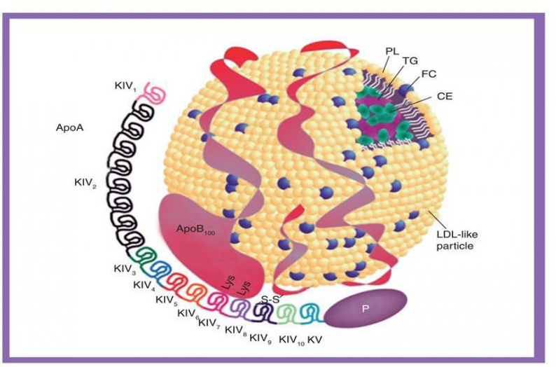
LIPOPROTEIN(a)
It is a pro-atherogenic protein particle (similar to LDL in term of structure)
Apolipoprotein(a) is what cause atherogenicity
The size of apoA makes lipoprotein(a) more atherogenic
LPA gene (90%) regulates the size of Apo(a)
mg/dl (mass) → 30 mg/dl
nmol/L (particle number) → 75 nmol/L

Slide 2
LIPOPROTEIN(a)
PATHOGENIC MECHANISMS OF Lp(a)
Pro-inflammatory
Pro-atherogenic
Pro-thrombotic
Higher the level higher the risk.
“high level” when it is 2x normal value

Slide 3
LIPOPROTEIN(a)
It is common! 20% of healthy population has > 50 mg/dL
However it is an independent risk factor for ASCVD*, adjusted for age and smoking
2018 AHA/ACC Multisociety Cholesterol Guidelines consider Lp(a) a risk enhancing factor for ASCVD for Lp(a)> 50 mg/dl
*ASCVD: AtheroSclerotic CardioVascular Disease

Slide 4
LIPOPROTEIN(a)
What influence Lp(a) levels:
LPA gene (most important, 80-90% levels is determined by this gene)
Race (AA and South Asian higher baseline levels)
Sex (women slight higher levels in post-menopausal 2/2 hormones)
CKD (especially nephrotic syndrome)

Slide 5
LIPOPROTEIN(a)
When should we check Lp(a)?
Familiar hypercholesterolemia
Severe hypercholesterolemia LDL-c> 180 mg/dl
Progressive disease despite optimal lipid-lowering therapy (“at goal” LDL-c)
Premature ASCVD
Family history of premature ASCVD

Slide 6
LIPOPROTEIN(a)
TREATMENTS
- Statin increases Lp(a) values of 1-7%
- Ezetimibe no changes on Lp(a) levels
PCSK9 inhibitors reduces LDL 50-55% and 25-25% Lp(a)
Lipoprotein apheresis: higher efficacy → reduces 74% Lp(a)
  One indication of lipoprotein apheresis is LDL-c>= 100 mg/dl and Lp(a)>= 60 mg/dl and either documented CAD or PAD
Notes:
PCSK9 inhibits a protein convertase, that binds to LDL receptors and stop LDL from being removed from the blood → blocking PCSK0 there are more receptors available and more LDL is removed from the blood

