Slide 1
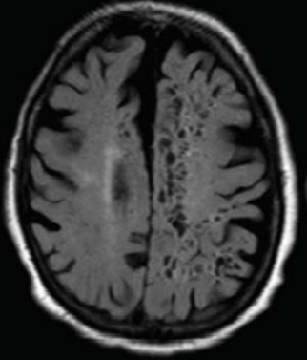
IMPLICATIONS OF ENLARGED PERIVASCULAR SPACES
_____________
Michela Rosso

Slide 2
What are Perivascular spaces (PVS)?
Perivascular spaces (PVS) are fluid-filled compartments that that are part of the cerebral blood vessel wall and represent the conduit for fluid transport in and out of the brain.
Role in transporting molecular debris from the brain into CSF → in the absence of “traditional” lymphatic vessels, PVS serve as the highways for clearance of metabolic waste products from the brain.

Slide 3
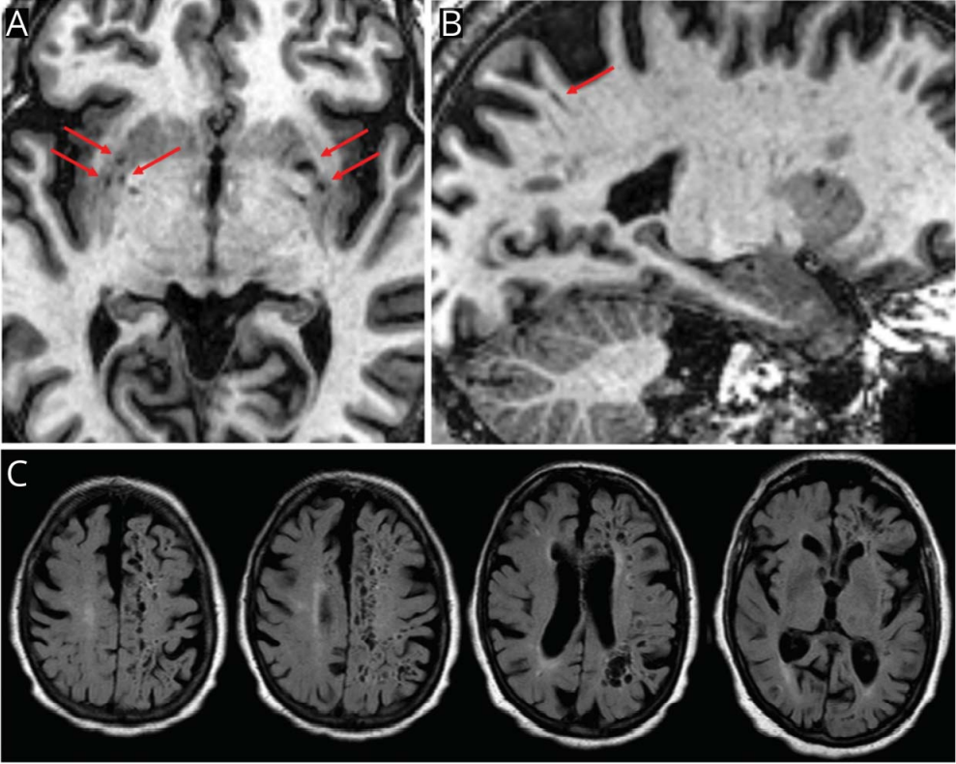
When are PVS pathologic?
PVS are considered pathologic, when sufficiently enlarged to be visible on MRI → isointense with CSF and appear round when imaged perpendicular to penetrating vessels and linear when parallel to a vessel.
ePVS are most common in the centrum semiovale and basal ganglia and, to a lesser extent, in the midbrain and hippocampus
Notes:
Cortical arterioles acquire one layer of pia mater, while perforating arterioles of deep subcortical structures and white matter possess 2 such layers. Such anatomical differences could account for the predominant location of ePVS in areas other than cortex.

Slide 4
What are ePVS RF?
RISK FACTORS:
  advancing age (age correlates with ePVS burden in BG> centrum semiovale)
  HTN
2 major mechanisms likely contribute to ePVS:
  arterial stiffening → SVD
  protein aggregation such as beta-amyloid → CAA, AD

Slide 5
What are ePVS implications?
ePVS are considered marker of SVD→ ePVS in the basal ganglia appear to be associated with WMHs and lacunes in patients with stroke and community-based older adults
ePVS are closely related to CAA (where failed clearance pathways likely contribute to the vascular accumulation of β-amyloid in the walls of cerebral arterioles) → strong evidence that CAA severity is associated with the number and extent of ePVS
ePVS burden (>20 ePVS visible on a given axial MRI slice in the WM>BG) is associated with increased risk of developing dementia; ePVS in the centrum semiovale could be highly associated with AD pathology
ePVS in the basal ganglia seem to be associated with the cognitive domains of executive function and information processing speed in elderly
Notes:
ePVS are considered marker of SVD, as are WMHs (white matter hyperintensities), lacunes, and cerebral microbleeds

Slide 6
Unsolved questions
Do MRI-visible PVS themselves lead to disruption of brain tissue and thus increase the risk of cognitive impairment, or are they merely a marker of an underlying condition such as HTN or CAA, which is driving the association?
Is fluid flow reduced in MRI-visible PVS, or could the enlargement indicate some sort of compensatory mechanism?
How do we measure or quantify ePVS (single slice vs whole-brain approach, manual vs semiautomated vs automated quantifications)
Notes:
Are ePVS the cause of brain damage or are they the result of brain and damage?

