Slide 1
~4 minutes on the physiology of fibrocartilagenous strokes
Sahily Reyes-Esteves

Slide 2
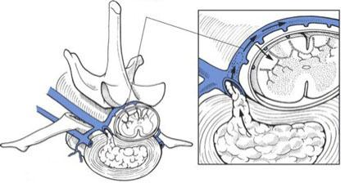
Quick background
First described in 15-year-old boy after a fall ^{1,2}
Abundant case reports in veterinarian literature (specifically dogs)
Odd physiology…supported by pathology³

Slide 3
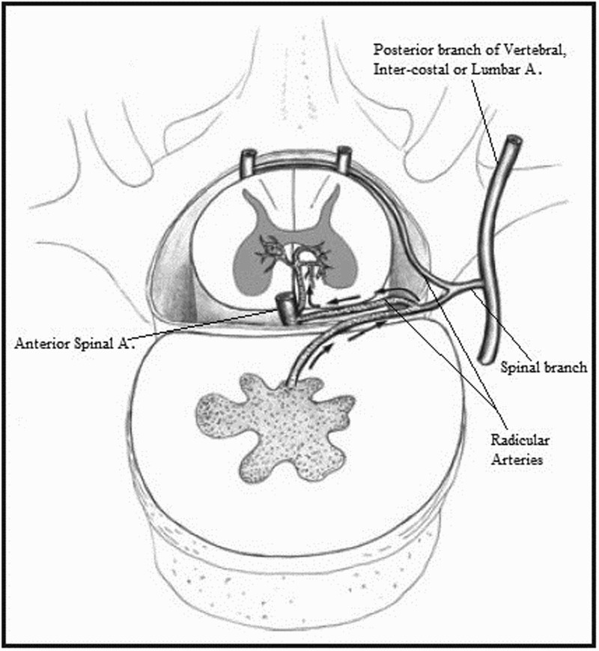
1

Slide 4
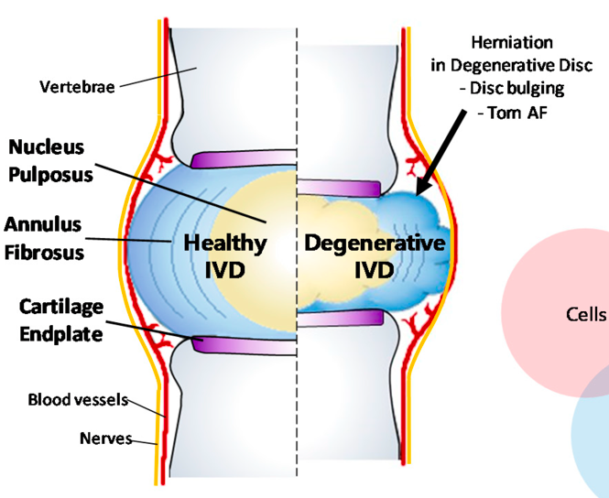
4

Slide 5
It’s not that simple
4

Slide 6
Mechanism
Sites of vascular access:
Persistent neonatal vasculature^{1, 5}
Re-vascularization with age⁶
Schmorl’s nodes¹
Pressure gradient:
Intrathoracic/abdominal pressure→ Disk pressure → arterial pressure
Notes:
soft tissue of the intervertebral disc bulges out into the adjacent vertebrae through an endplate defect.

Slide 7
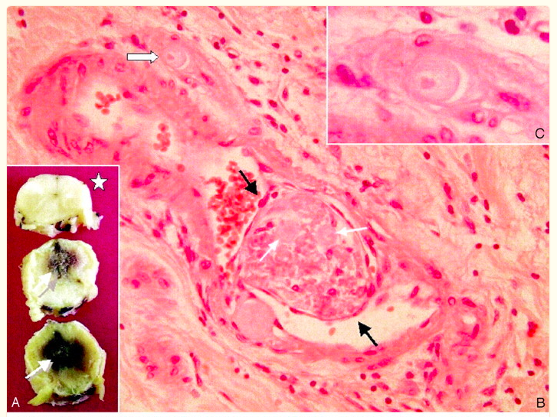
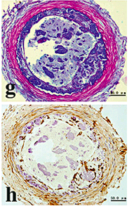
Evidence
Cartilage and vimentin staining
in autopsy specimen ⁷
Cartilage and chondrocytes in vessel lumen of autopsy specimen ⁷

Slide 8
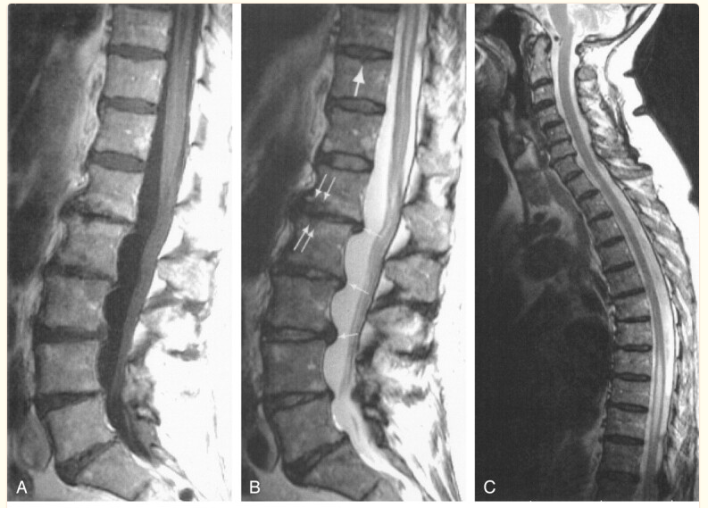
Radiographically
8

Slide 9
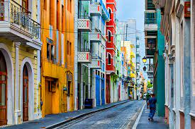
Remaining Questions
How far is too far (of a disc herniation)?
Still relatively uncommon despite how common DJD is.
Thank You!

Slide 10
References
AbdelRazek MA, Mowla A, Farooq S, Silvestri N, Sawyer R, Wolfe G. Fibrocartilaginous embolism: a comprehensive review of an under-studied cause of spinal cord infarction and proposed diagnostic criteria. J Spinal Cord Med. 2016;39(2):146-54. doi: 10.1080/10790268.2015.1116726. Epub 2015 Dec 17. PMID: 26833287; PMCID: PMC5072491.
Naiman JL, Donohue WL, Prichard JS. Fatal nucleus pulposus embolism of spinal cord after trauma. Neurology1961;11:83–7. doi: 10.1212/WNL.11.1.83 1. Naiman JL, Donohue WL, Prichard JS. Fatal nucleus pulposus embolism of spinal cord after trauma. Neurology1961;11:83–7. doi: 10.1212/WNL.11.1.83
Fossum, TW, Small Animal Surgery: 3rd ed, 2007; obtained from https://dvsc.com/medical_library/fibrocartilaginous-embolism-fce/
Choi Y, Park MH, Lee K. Tissue Engineering Strategies for Intervertebral Disc Treatment Using Functional Polymers. Polymers. 2019; 11(5):872. https://doi.org/10.3390/polym11050872
Roberts, Sally PhD; Evans, Helena BSc; Trivedi, Jayesh MCh(Orth), FRCS, FRCS(Tr&Orth); Menage, Janis HND. Histology and Pathology of the Human Intervertebral Disc. The Journal of Bone & Joint Surgery: April 2006 - Volume 88 - Issue suppl_2 - p 10-14 doi: 10.2106/JBJS.F.00019
Heckmann JG, Dutsch M, Struffert T, Dorfler A, Schwab S. Spinal cord infarction: a case of fibrocartilaginous embolism? Eur J Neurol2007;14(8):e23–4. doi: 10.1111/j.1468-1331.2007.01876.x
Piao YS, Lu DH, Su YY, Yang XP. Anterior spinal cord infarction caused by fibrocartilaginous embolism. Neuropathology. 2009 Apr;29(2):172-5. doi: 10.1111/j.1440-1789.2008.00938.x. PMID: 18627484.
Duprez TP, Danvoye L, Hernalsteen D, Cosnard G, Sindic CJ, Godfraind C. Fibrocartilaginous embolization to the spinal cord: serial MR imaging monitoring and pathologic study. AJNR Am J Neuroradiol. 2005 Mar;26(3):496-501. PMID: 15760855; PMCID: PMC7976489.

Slide 11
