Slide 1
Is there evidence for distal embolization from a chronically occluded carotid?
5 minute presentation

Slide 2
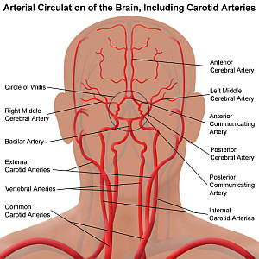
How can you embolize from an occluded carotid?
Emboli from distal portion
Emboli from proximal portion of occluded vessel → ECA collaterals → brain (“stump emboli hypothesis”)
Contralateral disease leading to a paradoxical embolus

Slide 3
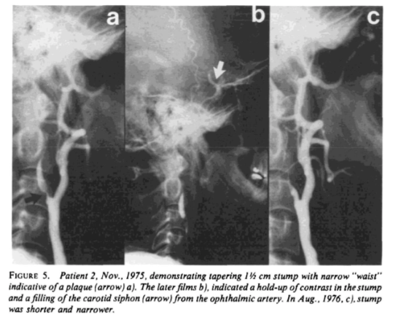
Barnett et al. Stroke 1978: 9 patients with recurrent spells ipsilateral to known ICA occlusions over different intervals

Slide 4
Case series
Georgiadis, et al. Stroke 1993: 7 patients with one occluded ICA and one stenosed ICA. Microemboli noted by TCD over 2.5 hours of monitoring of b/l MCAs and ACAs. This resolved after endarterectomy of stenosed ICA.
  Chronicity of occluded ICA unknown

Slide 5
Other studies
Penn study: Liberman et al. Stroke 2017: Study of ~50 patients with symptomatic carotid stenosis vs occlusion. No difference in ipsilateral microemboli detection between the two.
  TCDs for 1 hour; done within hours of symptom onset
  About 20% had contralateral carotid stenosis
  Not controlled for baseline antiplatelet; folks on AC excluded

Slide 6
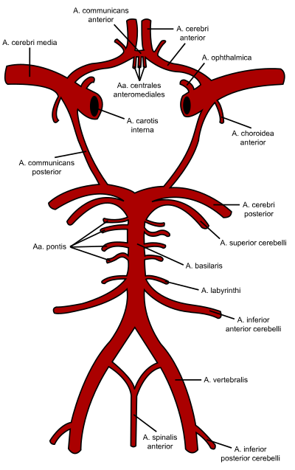
Other studies
Delcker et al. J Neurol 1997: 38 patients with ICA occlusion and no contralateral stenosis. Rate of ipsilateral MCA micro-emboli was higher than contralateral ACA emboli.
  Mix of symptomatic and asymptomatic. For symptomatic, wide range in time lapsed since stroke
  Not designed to see whether rate of emboli changed over time

Slide 7
References
Barnett HJ, Peerless SJ, Kaufmann JC. "Stump" on internal carotid artery--a source for further cerebral embolic ischemia. Stroke. 1978 Sep-Oct;9(5):448-56. doi: 10.1161/01.str.9.5.448. PMID: 705825.
Delcker A, Diener HC, Wilhelm H. Source of cerebral microembolic signals in occlusion of the internal carotid artery. J Neurol. 1997 May;244(5):312-7. doi: 10.1007/s004150050093. PMID: 9178157.
Georgiadis, Dimitrios, Donald G. Grosset, and Kennedy R. Lees. "Transhemispheric passage of microemboli in patients with unilateral internal carotid artery occlusion." Stroke 24.11 (1993): 1664-1666.
Liberman, Ava L., et al. "Symptomatic carotid occlusion is frequently associated with microembolization." Stroke 48.2 (2017): 394-399.

