Slide 1
Confusion Perfusion:
Behavioral Changes in PCA Stroke
Jonah Zuflacht
5/5/2022

Slide 2
Last Week’s Case…
84 year old woman with sudden onset confusion.
Patient tearful, agitated throughout encounter, repeating the phrase, "I don't know what you people want me to do."
Yelling repeatedly, "help me, help me." Asking, "what's wrong with me?" When asked the month, states "I'm scared to death."

Slide 3
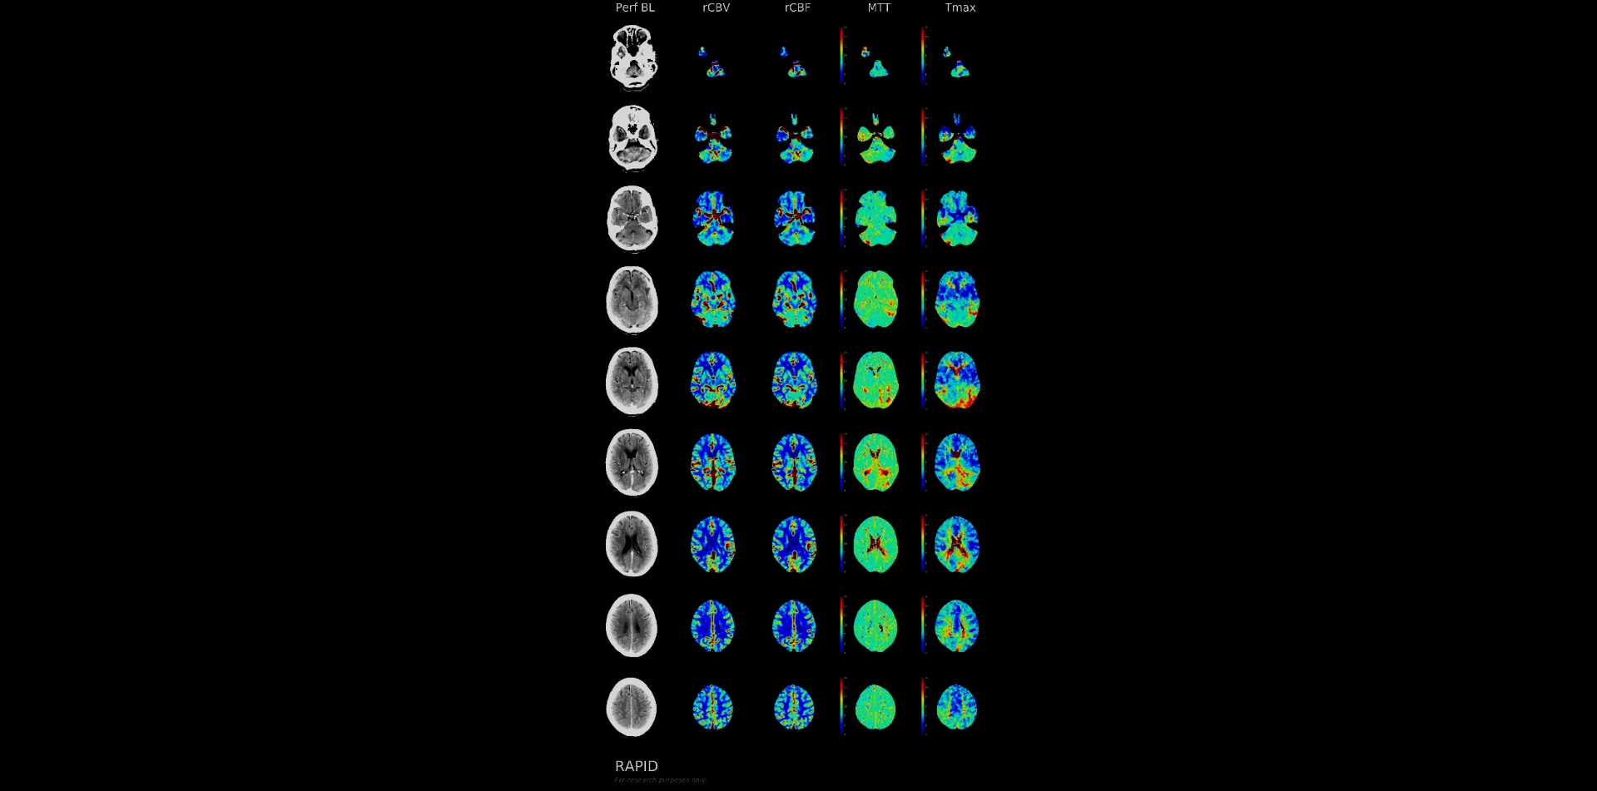

Slide 4
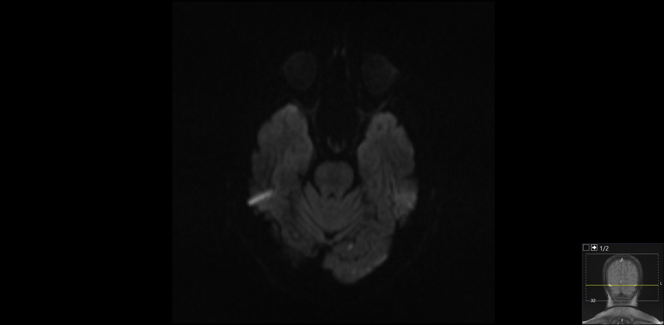

Slide 5
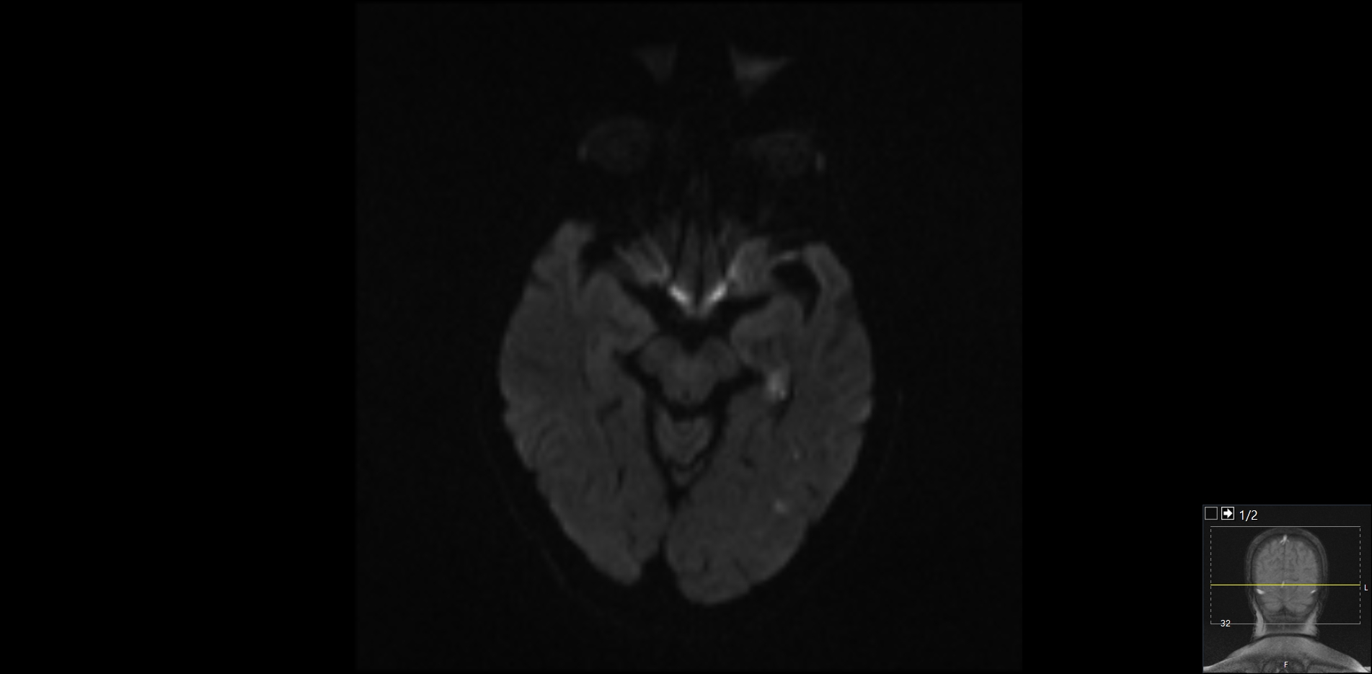

Slide 6
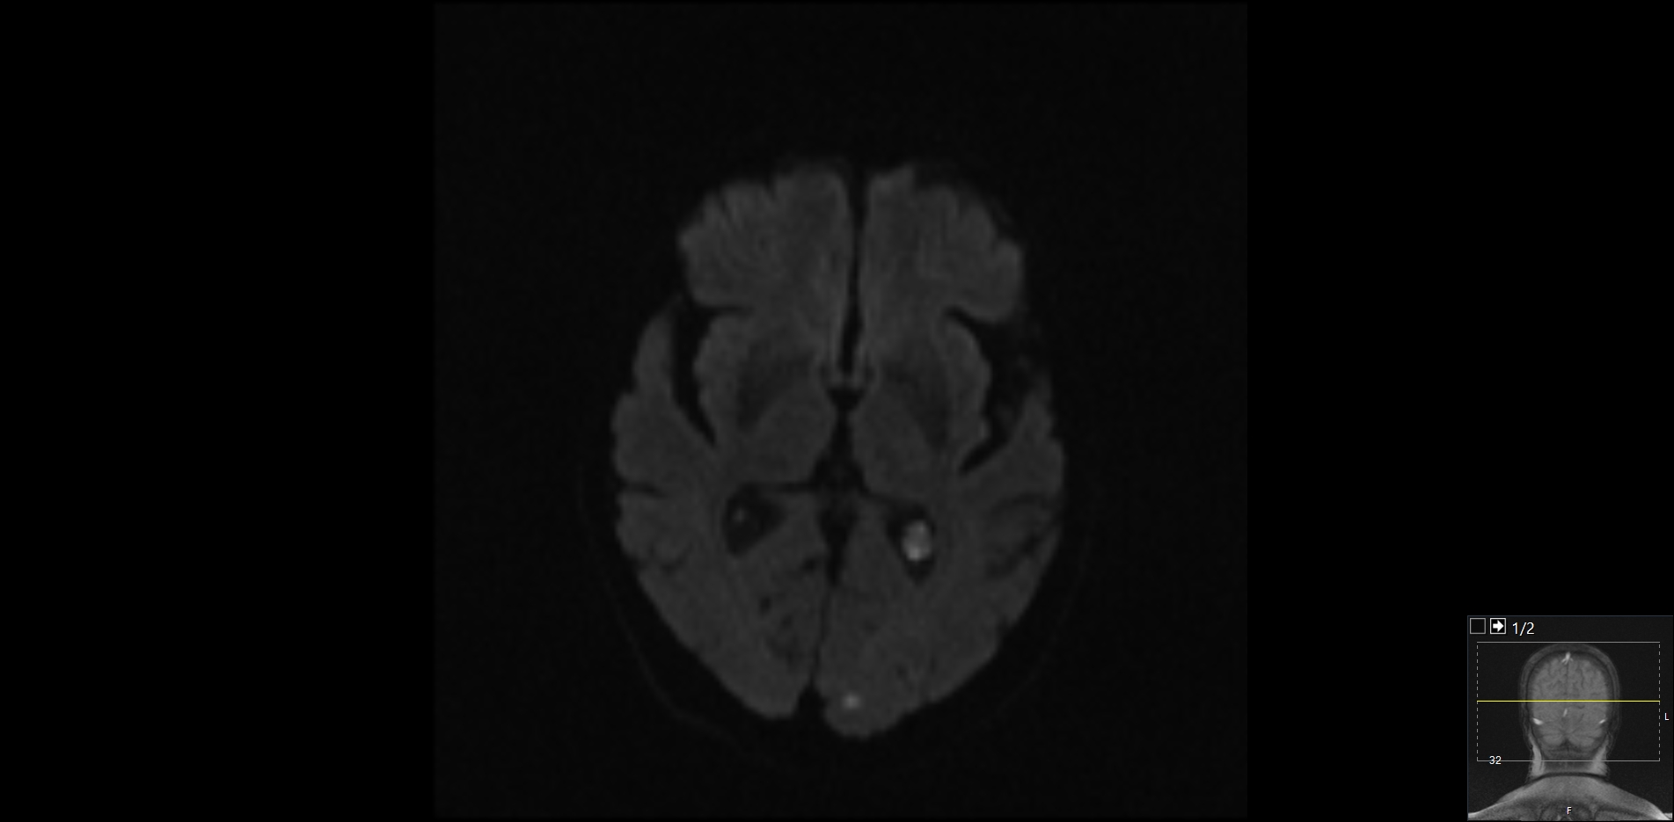

Slide 7
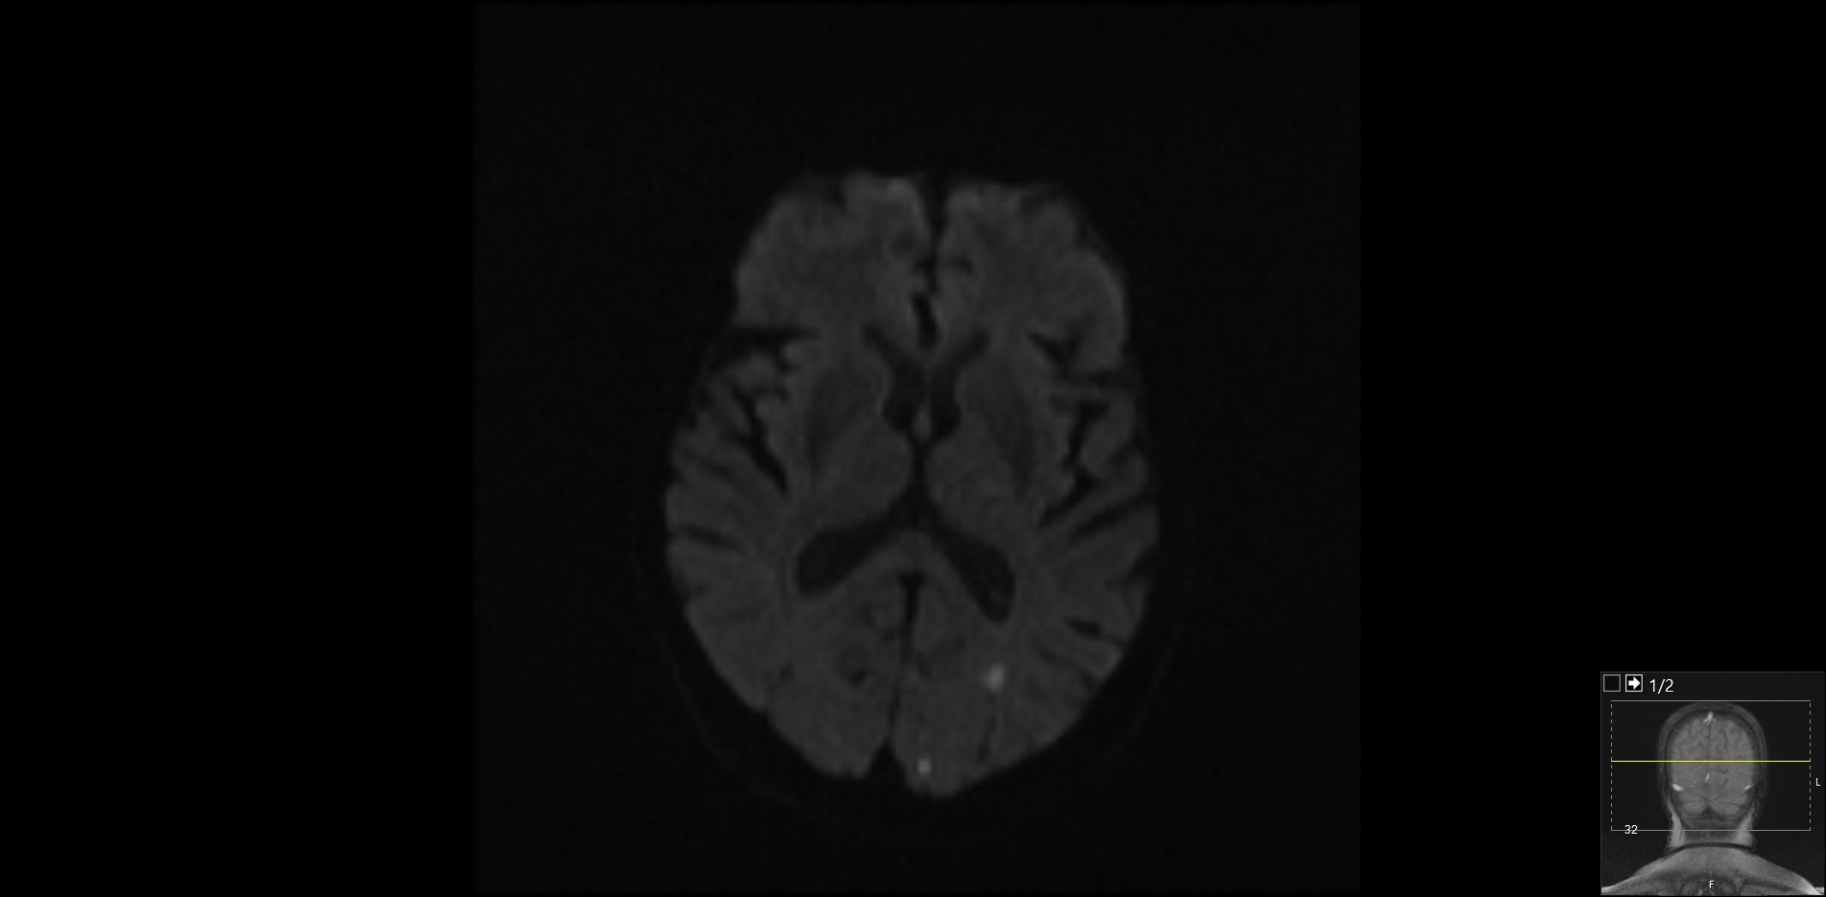

Slide 8
Miller Fisher (1983)
Abulic patients had lesions in the upper mesencephalic tegmentum, substania nigra, medial thalami, striatum, and frontal lobes
Hyperactive agitated patients had lesions in posterior portions of the cerebral hemispheres in the temporal, occipital, and inferior parietal lobes…many had infarcts that involved the limbic cortex

Slide 9
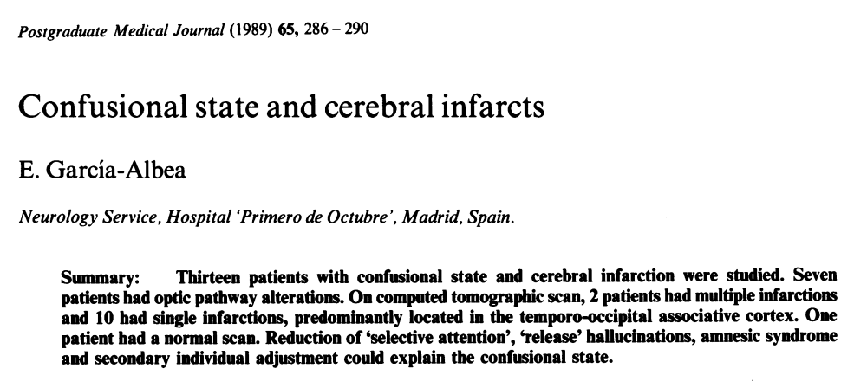

Slide 10
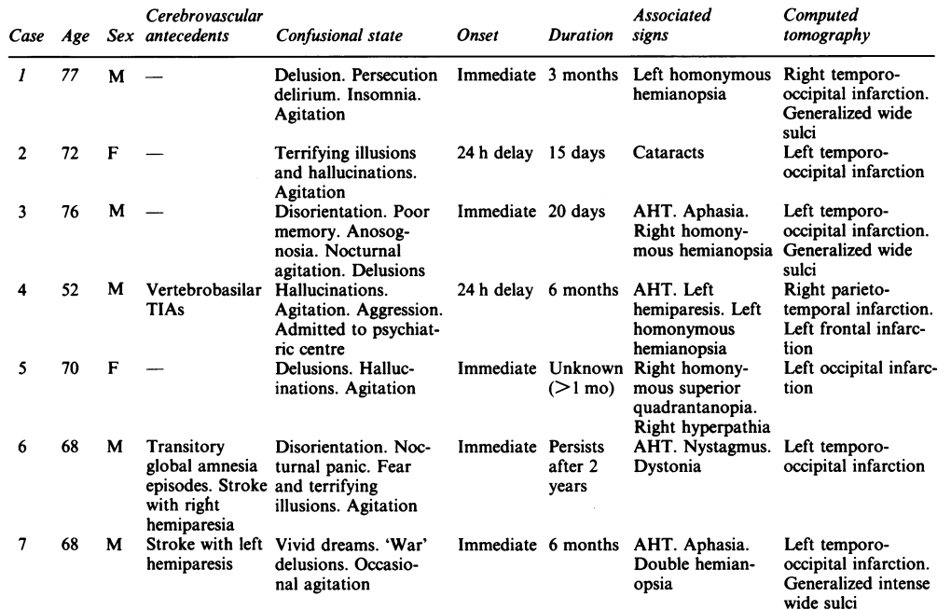

Slide 11
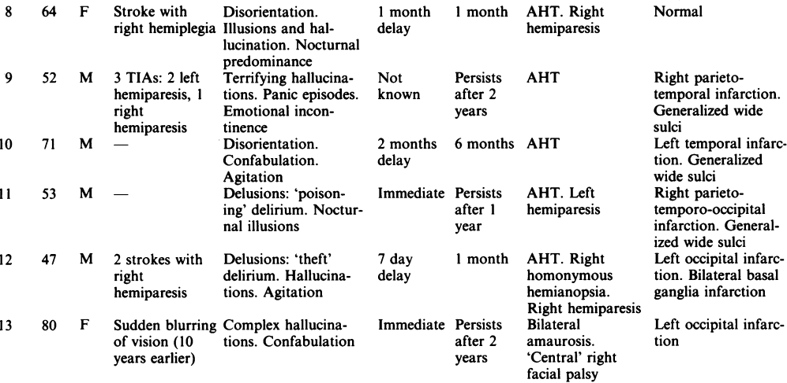

Slide 12
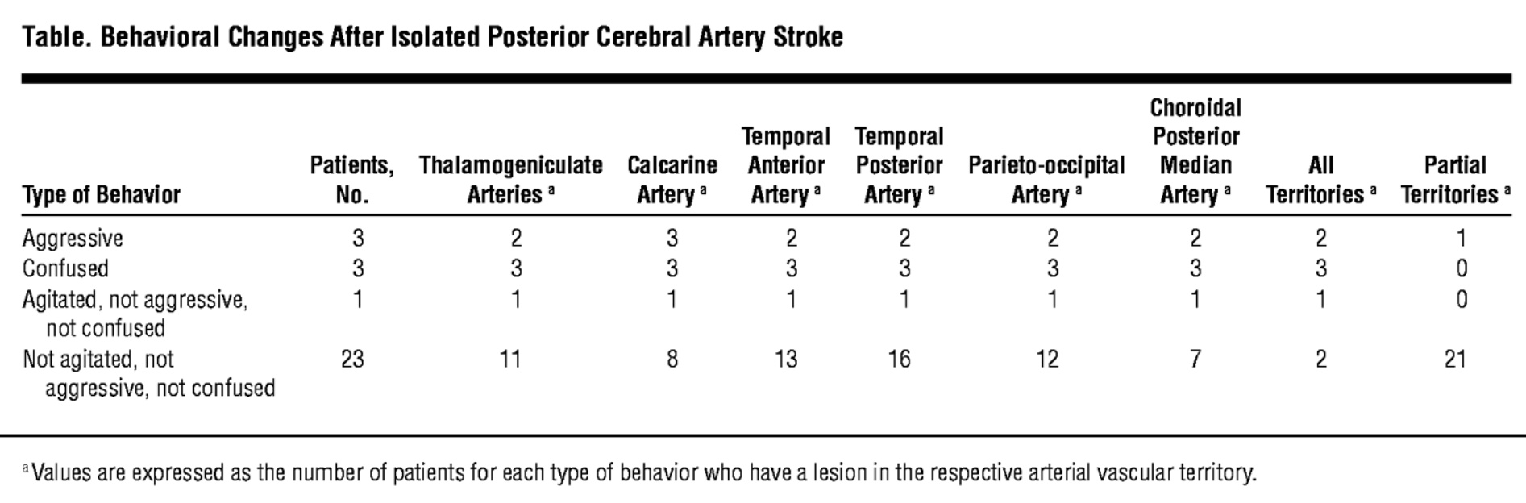
Arch Neurol. 2007;64(7):1029-1033. doi:10.1001/archneur.64.7.1029
Notes:
Traditional knowledge points to the limbic system as being the culprit, not only the orbitofrontal cortex but also the amygdala, which allows the evaluation and interpretation of emotions and represents the final pathway in the generation of aggressive outbursts.¹⁶ Involvement of the amygdala or an interruption of the occipitolimbic connections could be suggested in our 3 patients. The latter connections were illustrated in recent experiments in monkeys showing a link between the retrosplenial cortex and the associative visual area (V2)¹⁷ and between the parahippocampal gyri and the prestriated visual area (V4).¹⁸ The involvement of a more diffuse structure such as the serotoninergic system¹⁹ in the generation of aggressive outbursts could also explain why such diverse anatomical locations result in a similar behavioral disorder.

Slide 13
But Why?
Limbic system? Amygdala?
Interruption of occipitolimbic connections?
More diffuse structure such as the serotoninergic system?

