Slide 1
Caseous Mitral Valve Calcification (C-MAC) and Stroke

Slide 2
Brief review of patient
Small mobile mass in mitral valve noted on prior imaging, prior ?subclinical stroke, on DOAC, now with new recurrent migraines with aura c/f recurrent cardioembolism
TEE: There is a small 6-7 mm long filamentous echogenic mobile mitral valve density present on the atrial aspect of the posterior mitral annulus. This may represent thrombus, denuded MAC, or caseation.

Slide 3
Caseous MAC (CMAC)
Spectrum → liquefaction necrosis of MAC
0.6% of patients with MAC
  But 2.7% of all MAC in autopsy studies
Close to AV node = arrhythmias
Also related to MR/HF
More common in women, older patients, ESRD
No reports of stroke in younger patients that I found

Slide 4
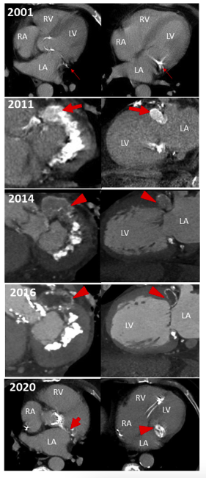
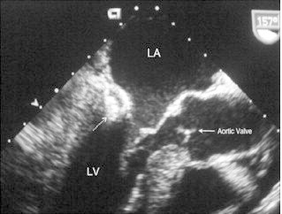
Features
CMAC <-> MAC
Calcium + fat + cholesterol = ‘toothpaste-like’
Can look like a tumor or abscess= Posterior, echodense with central lucence
TEE -> Cardiac MRI

Slide 5
Stroke
Emboli from calcium, thrombus, fistulization
  Stroke, ACS > ?systemic emboli
Biggest case series published in 2001 – 19 patients, 5 had strokes, 1 referred to surgery for emboli, 2 had surgery for MV dysfunction
  Replacement > Repair (highly technically difficult)

Slide 6
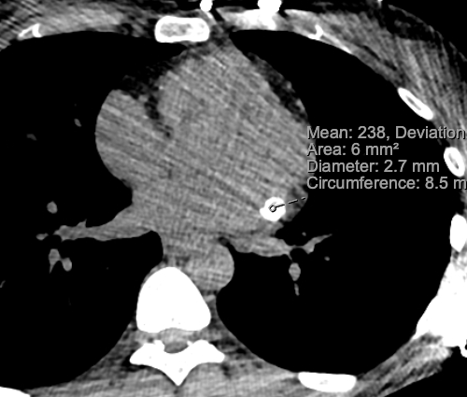
Our patient
Operative note documents caseous appearance of valve = Caseous MAC
CTC = CMAC

Slide 7
References
Akram M, Hasanin AM. Caseous mitral annular calcification: Is it a benign condition? J Saudi Heart Assoc. 2012 Jul;24(3):205-8. doi: 10.1016/j.jsha.2012.02.003. Epub 2012 Feb 14. PMID: 23960697; PMCID: PMC3727444.
Davidson MJ, Cohn LH. Surgical treatment of caseous mitral valve annulus calcification. J Thorac Cardiovasc Surg. 2006 Mar;131(3):738-9. doi: 10.1016/j.jtcvs.2005.11.025. PMID: 16515935.
Rosenblatt S. Caseous calcification of the mitral annulus. J Am Soc Echocardiogr. 2001; 14: 825-831
Chevalier B, Reant P, Laffite S, Barandon L. Spontaneous fistulization of a caseous calcification of the mitral annulus: an exceptional cause of stroke. Eur J Cardiothorac Surg. 2011 Jun;39(6):e184-5. doi: 10.1016/j.ejcts.2011.01.038. Epub 2011 Mar 3. PMID: 21376613.

