Slide 1
Which are the relevant angio—invasive organisms in stroke?
Sahily Reyes-Esteves, MD, PhD

Slide 2
Bacteria
Meningovascular syphilis:
  Spirochete invasion → infiltration of lymphocytes into adventitia and media → thickening → stroke
TB:
  rare cause of stroke; controversial pathogenesis (not clearly angio-invasive?), Heubner’s arteritis

Slide 3
Bacteria
Endocarditis
  Staph, Strep
  HACEK organisms
    Haemophilus, Aggregatibacter (previously Actinobacillus), Cardiobacterium, Eikenella, Kingella
Pneumococcus
  Stroke can be delayed, as discussed last week
    No clear evidence for strokes being directly due to vascular invasion
Lyme
  Very little evidence of direct correlation with stroke

Slide 4
Fungus
Aspergillus
  Hematogenous spread
  Typically a necrotizing arteritis, not a meningitis
    LP can be bland
    Direct invasion, mycotic aneurysms
    Can cause meningitis, abscesses
  Ischemic or hemorrhagic
Mucor
  Direct vessel invasion, external compression of vessels, septic emboli.
  Commonly through nasal passages
Candida
  Endocarditis and septic emboli
  Abscesses, vasculitis; rarely vascular invasion

Slide 5
Fungus
Cryptococcus
  Not angio-invasive
  Stroke assoc. to basilar meningitis
Coccidiomycosis
  Stroke assoc. to basilar meningitis

Slide 6
Parasites
Chagas
  T. cruzei, cardiac and GI dilatation
  Cardioembolic strokes
Cysticercosis
  Meningitis +/- angiitis

Slide 7
Viruses
VZV vasculopathy
  Not angioinvasive
  Inflammatory process; correlation with VZV Ab’s and GCA
HIV
  Vasculopathy
  Vasculitis
  Accelerated athero

Slide 8
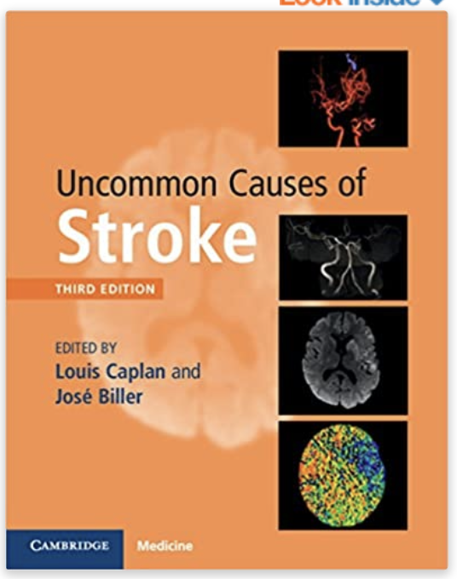
References

