Slide 1
5 minute talk:
Pathological evidence of stroke in patients with bacterial meningitis
Sahily Reyes-Esteves, MD, PhD

Slide 2
Cerebrovascular complications of bacterial meningitis
Many case reports/series prior to establishment of steroids as a adjunct treatment in pneumococcal meningitis
In post-steroid era, described phenomena of delayed cerebral thrombosis in patients with meningitis
  Initial good recovery followed by sudden deterioration several days after presentation has been described
  Mostly described in pneumococcal meningitis

Slide 3
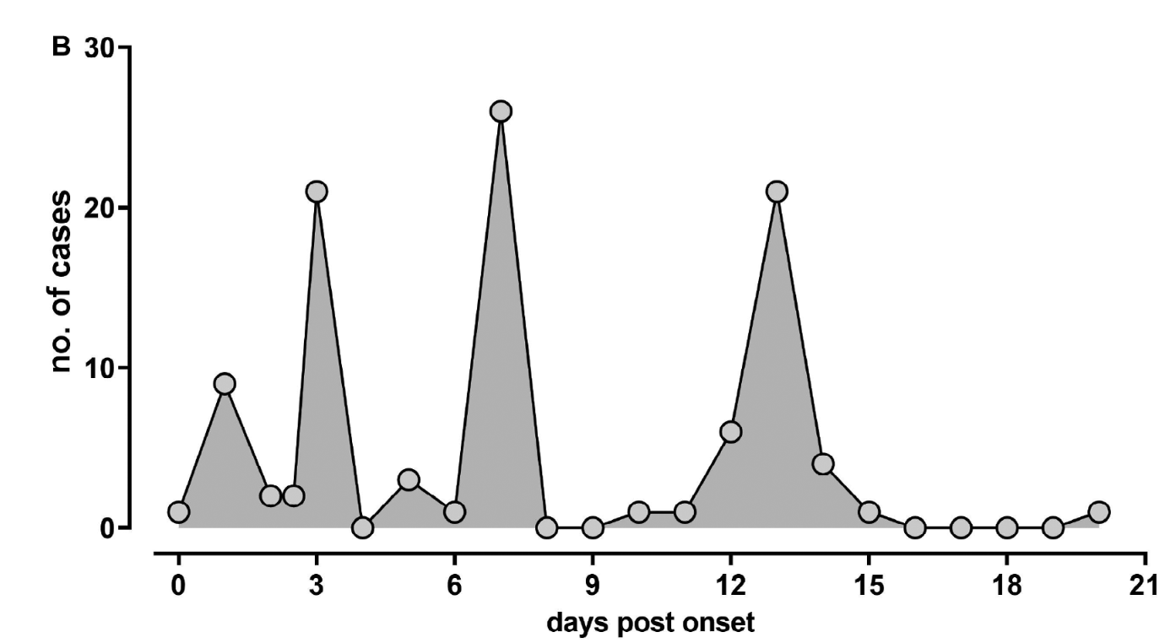
Large study of DCT, and meta-analysis
Annals Neurol 2023
100 patients from Munich Hospital; 19 had strokes
  Higher rate than most other studies
Meta-analysis: ~1,100 patients
Heterogeneous: less details about abx, length of steroids, etc.

Slide 4
Largest DCT Cohort (Spain, 2020)
Cohort of 162 cases from Barcelona hospital: 17 DCT identified –
  Deterioration least 72 hours from adequate therapy (median was 4 days)
    15 only had HCT/MRI with bleed or stroke
    2 also had vessel imaging supporting it
    None had pathology
  Significantly more common in people with: recurrent meningitis, splenectomy, delay in presenting, coma, fever recurrence, heme malignancy, immunosuppression, lower WBC count
  Less in: folks with otitis media

Slide 5
Mechanism?
“Immunosuppressive effect by dexamethasone during the first 4 days of meningitis treatment wears off after 7–14 days and bacterial fragments cause a resurgence of the inflammatory response…direct bacterial invasion, activation of coagulation or a post-infectious immunoglobulin deposition.”
- Engelen-Lee et al, 2020

Slide 6
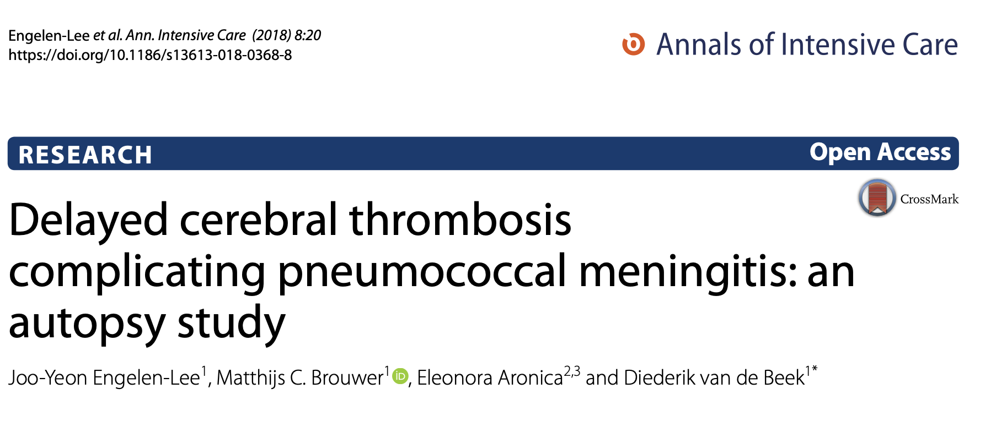
Where is the histopathology?

Slide 7
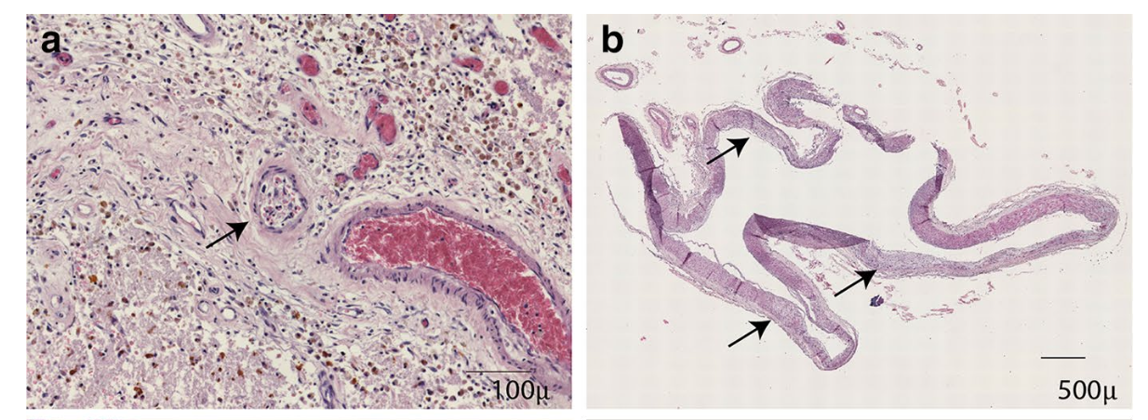
Case 1: 39 yr old M with deterioration after 14 days, withdrawal of care after 30 days
No overt vasculitis
a small arteries with organized thrombosis are occasionally observed
b the basilar artery showed no active inflammation and was dilated with irregular thickening of endothelial layer (arrow) and disruption of elastic layer.

Slide 8
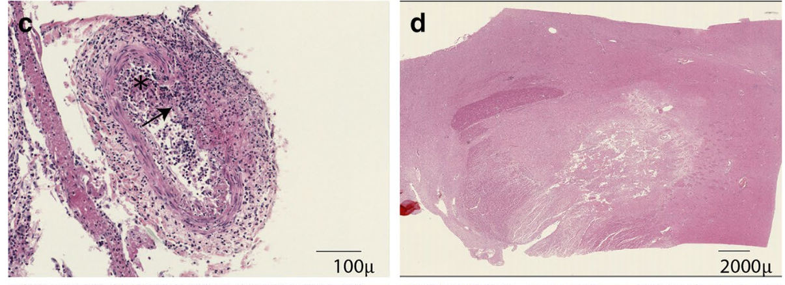
Case 2: 52 yr old M with deterioration after 10 days, withdrawal of care at 12 days
c the arteries showed still active inflammation with disruption of elastic layer (arrow) and thrombosis (star).
d Infarction in basal ganglia.

Slide 9
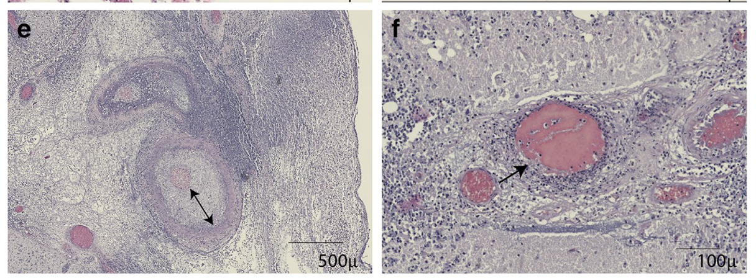
Case 3: 73 yr old M with deterioration after 7 days, withdrawal of care after 25 days
e larger meningeal arteries show often circumferential thickening of intima (arrow) and active inflammation in the media (arrow).
f Many smaller arteries in the vicinity of the inflamed or destructed arteries show thrombosis with neutrophil infiltrates.

Slide 10
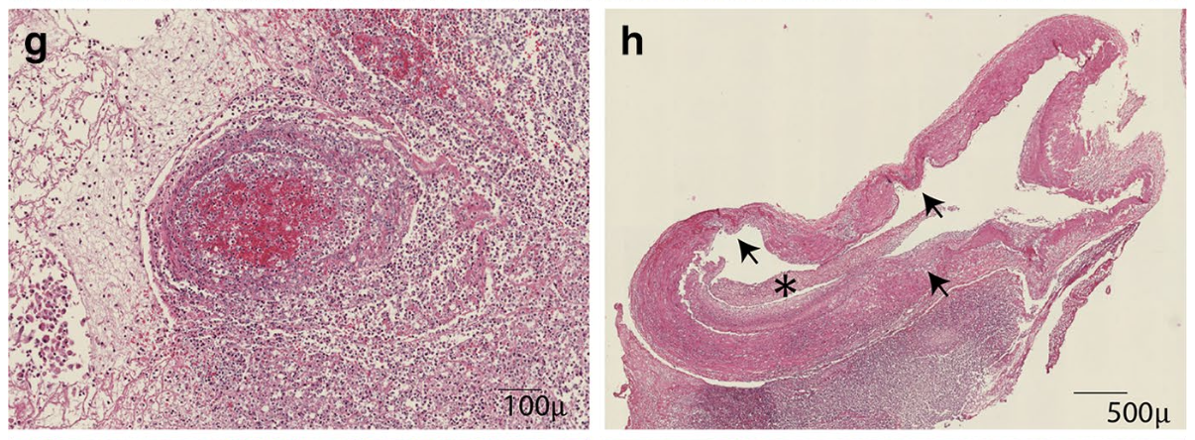
Case 4: 68 yr old F with deterioration at day 7, withdrawal of care at day 16
g a severely inflamed artery with vascular destruction and obstruction in the meningeal pus pocket at the frontal lobe showing organization.
h The basilar artery showed chronic active inflammation and dilatation with disruption of elastic layer (arrows), partially obstructed by thromboembolus (star) with leucocyte clearance.

Slide 11
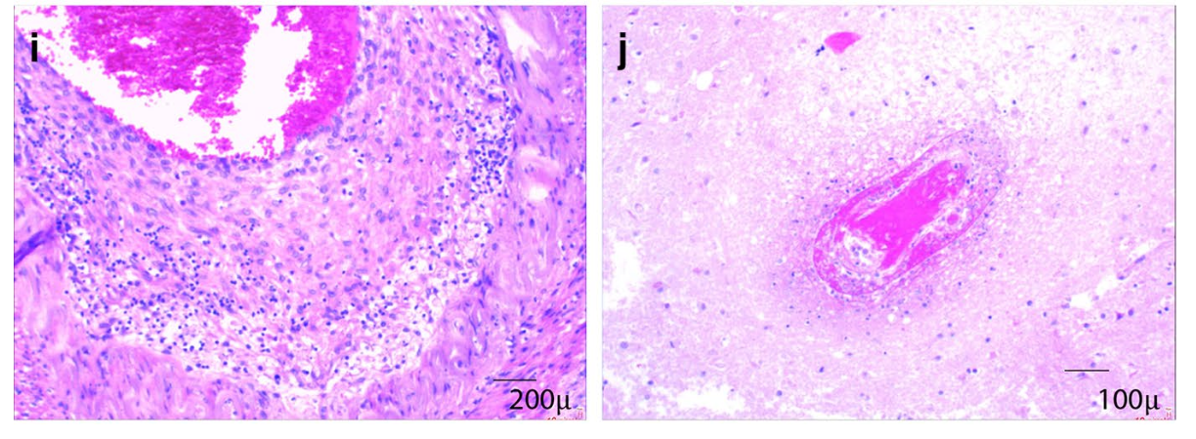
Non-DCV Meningitis Representative Cases (8)
i active vascular inflammation of a meningeal artery with thickening of intima and inflammation of tunica media.
j thrombosis of small parenchymal vessel

Slide 12
Non-DCV Meningitis Representative Cases (8)
i active vascular inflammation of a meningeal artery with thickening of intima and inflammation of tunica media.
j thrombosis of small parenchymal vessel
Why did they die? The cause of death among non-DCT meningitis patients was known in 7 patients and attributed to systemic complications in 6 patients (86%: 3 PNA, 1 MI, 1 ruptured AAA, 1 septic shock.
PROBLEMS: Unknown variables!!! --> abx? Steroids? Time to presentation?

Slide 13
Other testing
No difference in antibody deposition patterns between the non-DCT meningitis and DCT cases.
No obvious difference in Immunofluorescence staining of pneumococcal capsule between DCT and non-DCT cases.
One difference: 2/4 DCT patients had basilar artery dilation. None of the non-DCT patients had basilar artery dilation.
Other paper from same group: Complement factor 5a was higher in DCT patients and pts had genetic variation in this gene. Maybe this influences disease course?

Slide 14
References
Beuker, C., Werring, N., Bonberg, N., Strecker, J.-K., Schmidt-Pogoda, A., Schwindt, W., Stracke, P., Schulte-Mecklenbeck, A., Gross, C., Wiendl, H., Minnerup, H. and Minnerup, J. (2023), Stroke in Patients with Bacterial Meningitis: A Cohort Study and Meta-Analysis. Ann Neurol. https://doi.org/10.1002/ana.26618
Lucía Boix-Palop, Tamara Fernández, Iván Pelegrín, Meritxell Obradors, Kevin García-Roulston, Mariona Xercavins, Dolors García-Somoza, Carmen Ardanuy, Javier Garau, Esther Calbo, Carmen Cabellos. Delayed Cerebral Vasculopathy in Pneumococcal Meningitis: Epidemiology and Clinical Outcome. A Cohort Study. International Journal of Infectious Diseases, Volume 97, 2020, https://doi.org/10.1016/j.ijid.2020.06.005.
Engelen-Lee JY, Brouwer MC, Aronica E, van de Beek D. Delayed cerebral thrombosis complicating pneumococcal meningitis: an autopsy study. Ann Intensive Care. 2018 Feb 9;8(1):20. doi: 10.1186/s13613-018-0368-8. PMID: 29427117; PMCID: PMC5807251.
E. S. Schut, M. C. Brouwer, J. de Gans, S. Florquin, D. Troost, D.van de Beek. Delayed cerebral thrombosis after initial good recovery from pneumococcal meningitis. Neurology Dec 2009, 73 (23) 1988-1995; DOI:10.1212/WNL.0b013e3181c55d2e

