Slide 1
What is the association between cor triatriatum and stroke?
Jonah Zuflacht
9/16/2021

Slide 2
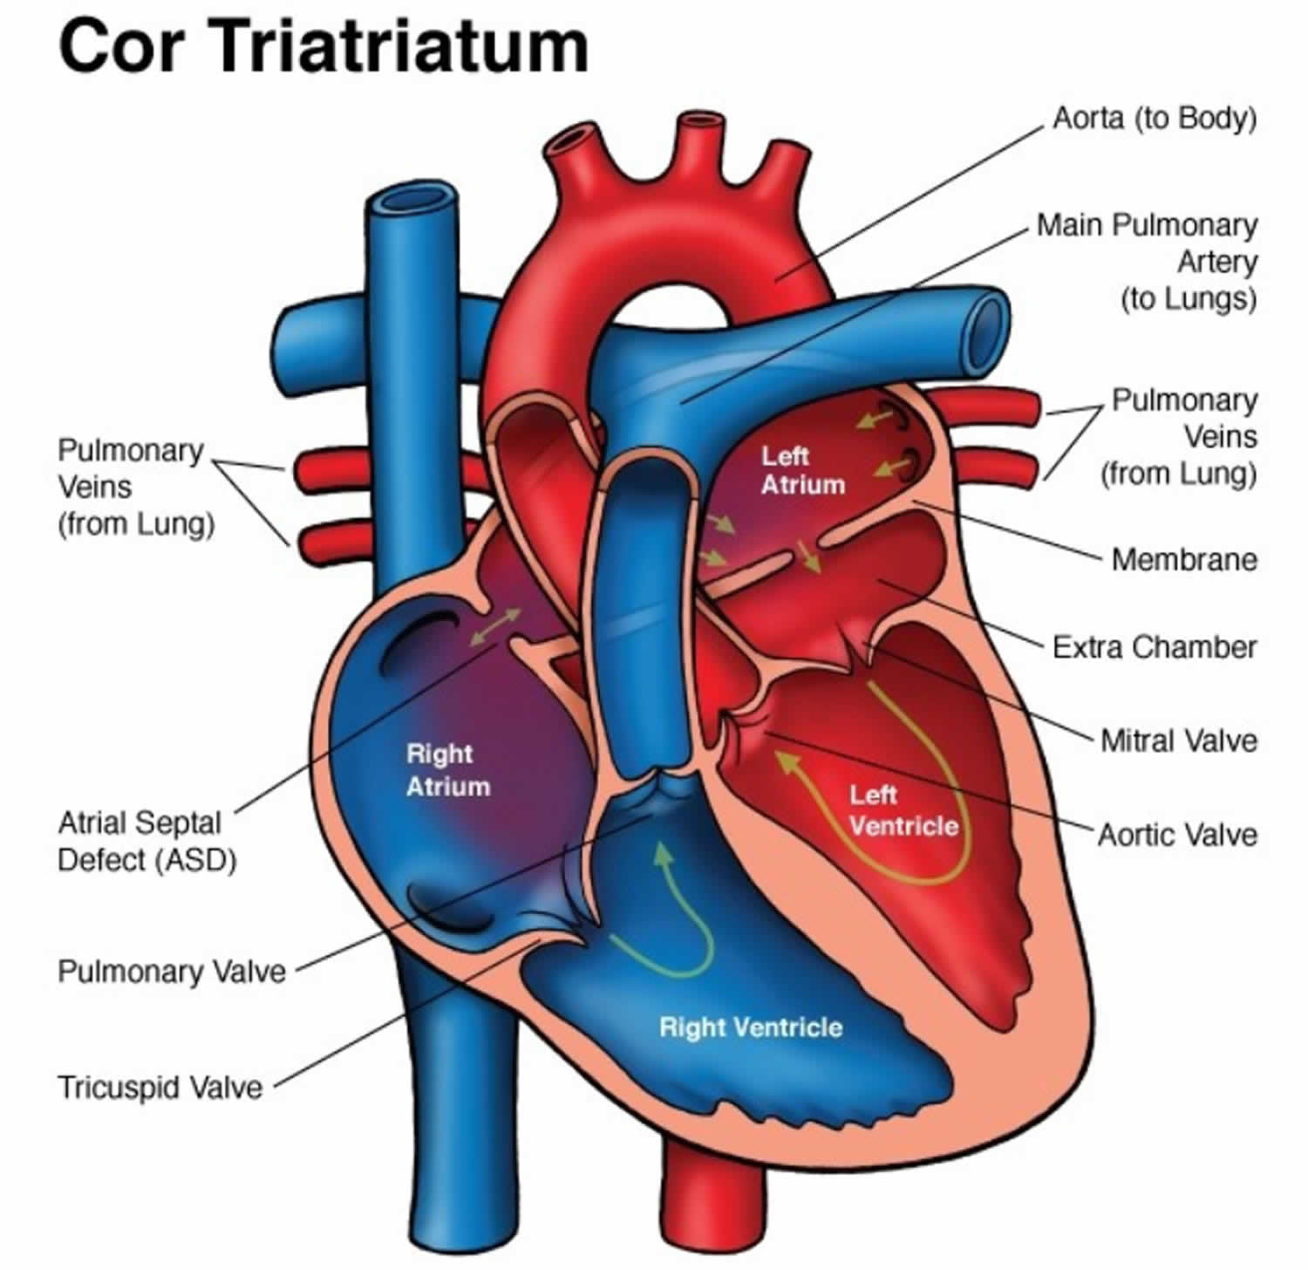
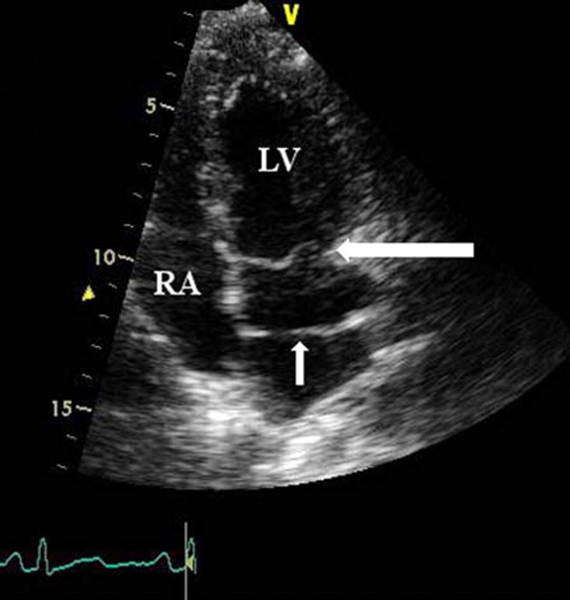
Cor triatriatum
A rare congenital cardiac anomaly in which the atrium is divided into 2 by a fibromuscular septum.
Daniel Murphy, in Diagnosis and Management of Adult Congenital Heart Disease (Second Edition), 2011

Slide 3
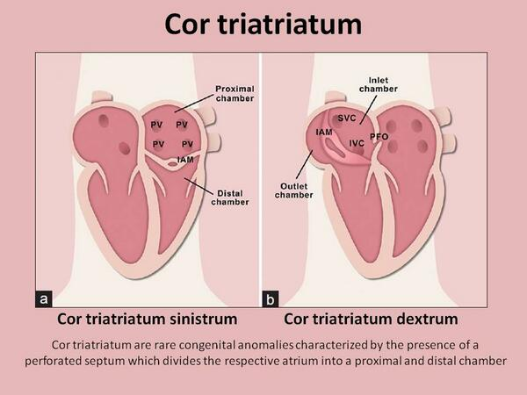

Slide 4
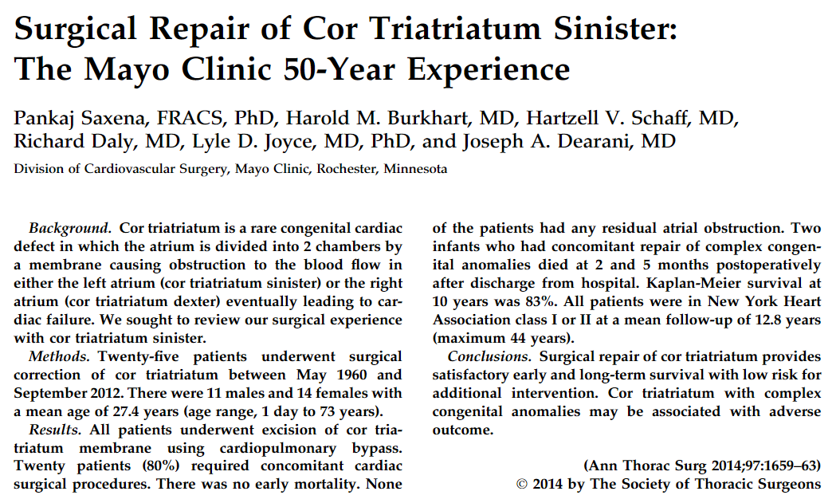
Cor triatriatum
25 cases since 1960!

Slide 5
Cor triatriatum and stroke
13 reported cases of stroke attributable to cor triatriatum
Possible mechanisms include:
  Increased prevalence of AF
  Cor triatriatum membrane itself causing blood flow disruption, stagnation, and thrombus formation
  ASD and PFO are common defects associated with cor triatriatum, known risk factors for paradoxical embolism

Slide 6
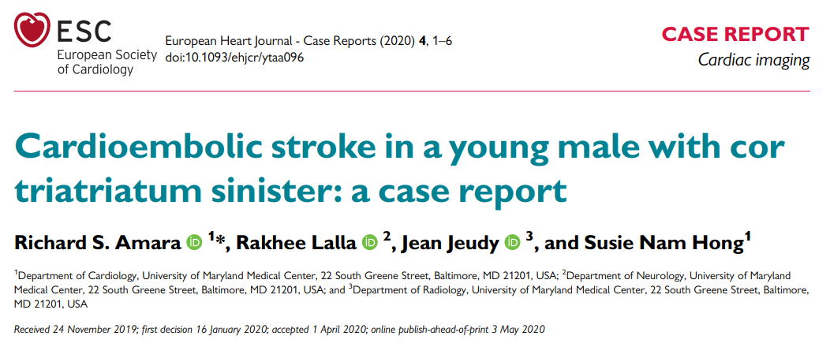
This patient had no evidence of transmembrane flow obstruction, blood stasis, thrombus, or evident AF, highlighting the surreptitious risk that cor triatriatum may play in embolic stroke.

Slide 7
Treatment options
No currently established guidelines for the management of cor triatriatum in the setting of embolic stroke.
Options include surgical membrane resection, therapeutic anticoagulation, and/or closure of an associated ASD or PFO.
In cases with hemodynamically significant transmembrane flow obstruction and associated heart failure, membrane resection is clearly appropriate.

