Slide 1
Should patients with infective endocarditis have earlier surgical intervention?
Arooshi Kumar
10/7/2021

Slide 2
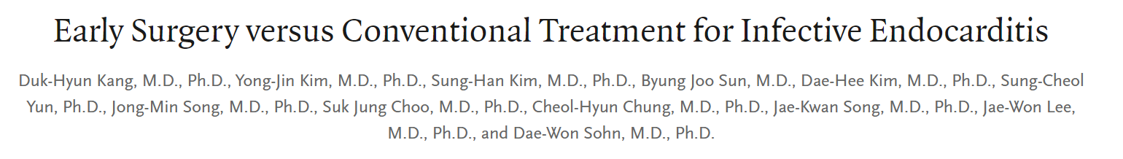
Study compared clinical outcomes of early surgery and conventional treatment in patients with IE.
Randomly assigned patients with left-sided IE, severe valve disease, and large vegs to early surgery (37 patients) or conventional treatment (39).
The primary end point was a composite of in-hospital death and embolic events that occurred within 6 weeks after randomization.

Slide 3
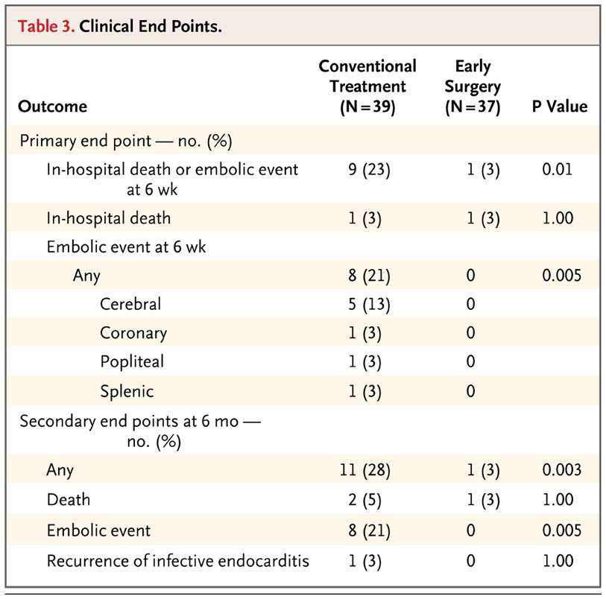

Slide 4
