Slide 1
Pembrolizumab for PML and Pembrolizumab-induced vasculitis
Jonah Zuflacht
10/14/2021

Slide 2
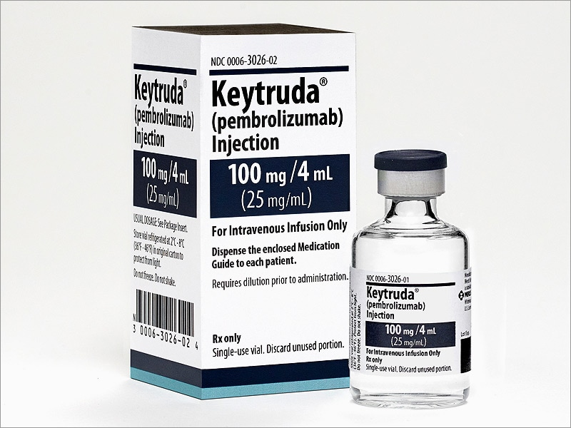
Pembrolizumab
A humanized monoclonal antibody that binds to lymphocyte programmed cell death protein 1 (PD-1) receptors, enhancing immune surveillance against tumor cells

Slide 3
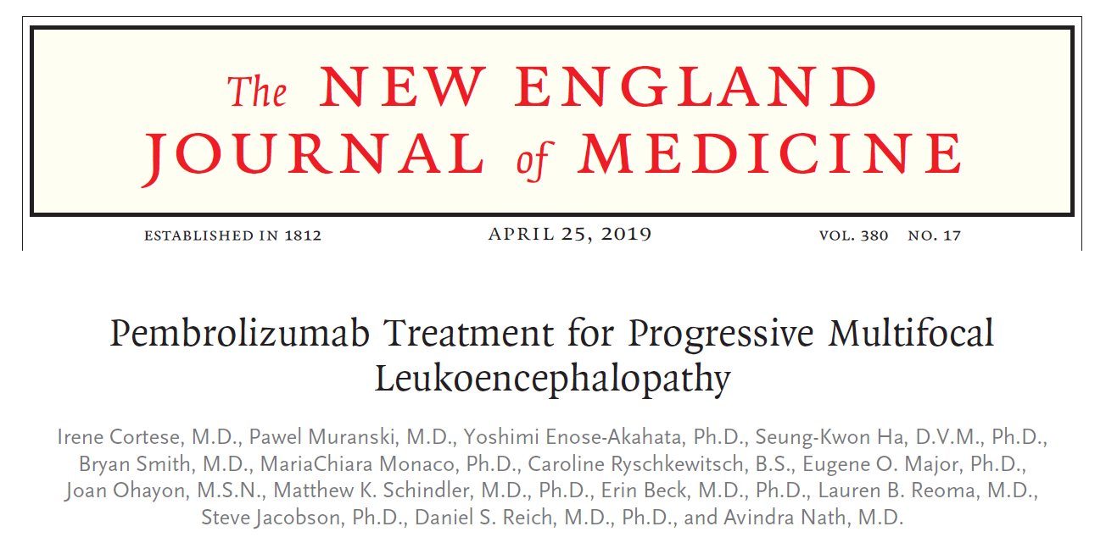

Slide 4
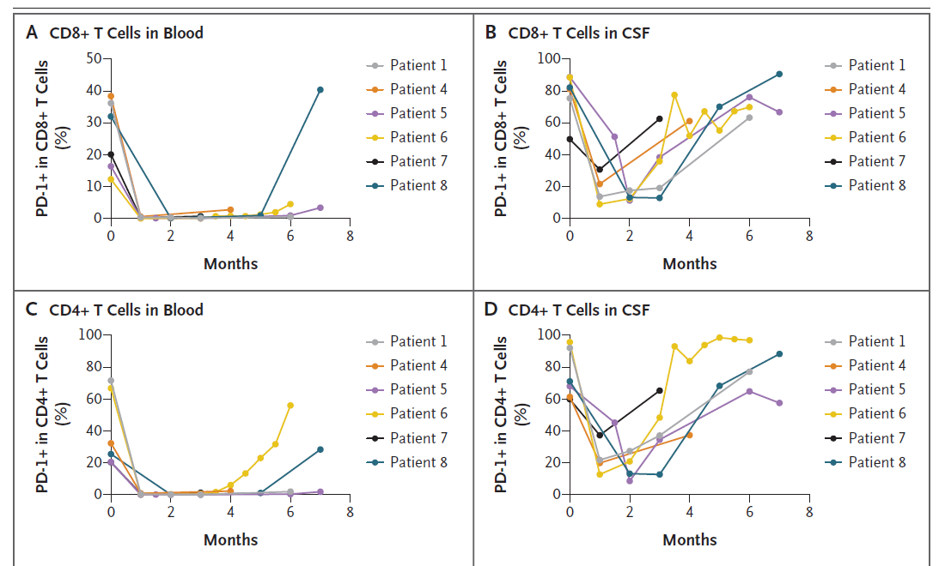
Five patients had clinical improvement or stabilization of PML accompanied by a reduction in the JC viral load in the CSF and an increase in in vitro CD4+ and CD8+ anti–JC virus activity. In the other three patients, no meaningful change was observed in the viral load or in the magnitude of antiviral cellular immune response, and there was no clinical improvement.

Slide 5
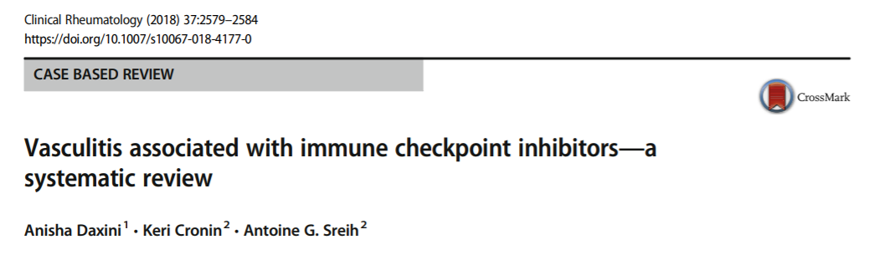
Pembrolizumab and vasculitis
There were 53 cases of vasculitis of which 20 were confirmed. The main reported type of vasculitis was large vessel vasculitis and vasculitis of the central and peripheral nervous system. All cases resolved with either holding the immune checkpoint inhibitors and/or administering glucocorticoids. There were 4 cases of PACNS.

Slide 6

