Slide 1
DDAVP for Antiplatelet-Associated ICH
Jonah Zuflacht
10/21/2021

Slide 2
DDAVP aka Desmopressin
Notes:
An analog of vasopressin with very little vasopressor activity.
Stimulates endothelial cell release of large factor VIII, von Willebrand factor multimers, and may also increase platelet membrane glycoprotein expression, thereby promoting platelet adhesion
Shown to reduce bleeding time and normalize hemostasis in patients with uremic platelets undergoing surgery
Within healthy populations on aspirin/COX-1 inhibitors or ADP receptor inhibitors, DDAVP demonstrated an improvement in several tests of platelet function compared to those who received no reversal agents
DDAVP has also been shown to significantly reduce blood loss and improve thrombus formation in cardiac surgery patients exposed to aspirin pre-operatively

Slide 3
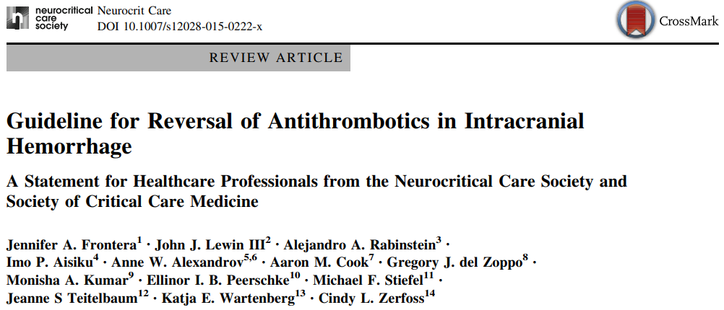
DDAVP aka Desmopressin
Because of the low risk of serious side effects, the relatively low cost, and the suggestion of benefit in aforementioned surgical trials, one can consider a single dose of DDAVP (0.4 mcg/kg) in intracranial hemorrhage patients exposed to antiplatelet agents
In patients deemed appropriate, DDAVP can be used in addition to platelet transfusion…

Slide 4
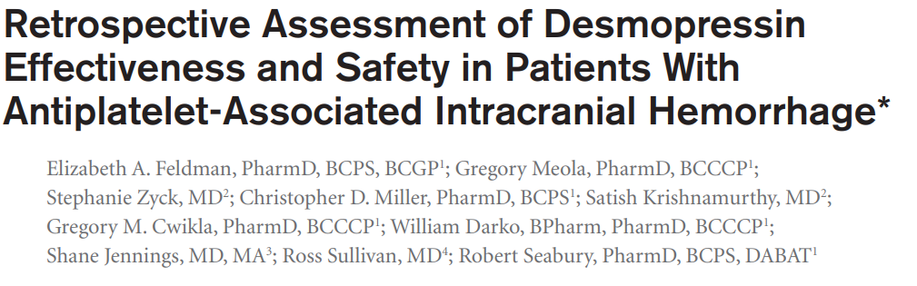
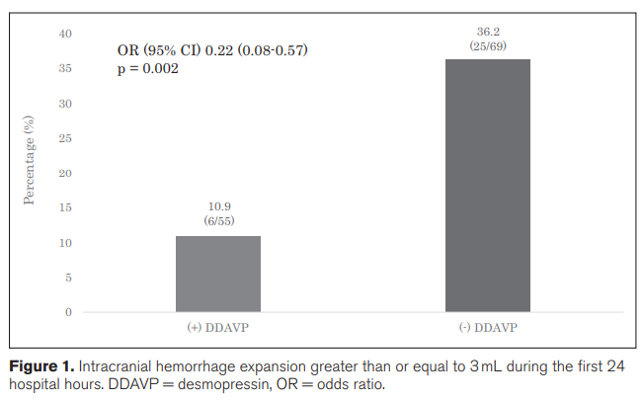

Slide 5
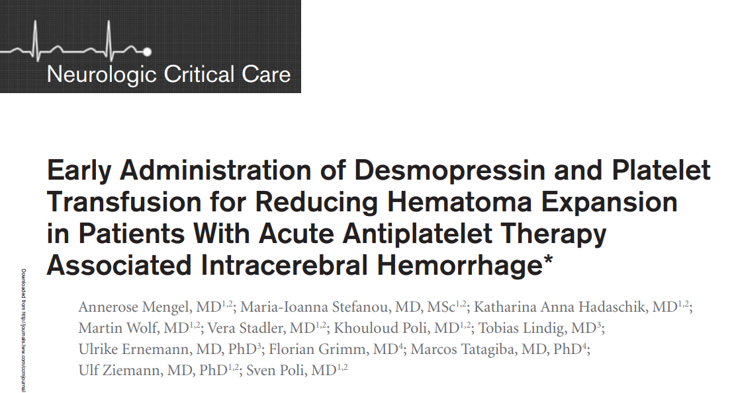

-A retrospective study to investigate the efficacy of DDAVP + PT in patients with AP-ICH admitted to the University Hospital of Tuebingen between 2006 and 2014, and were diagnosed with nontraumatic ICH
-Contrary to results of preclinical and clinical non-intracerebral hemorrhage studies, adjunct DDAVP showed no benefit in limiting hematoma expansion or improving functional outcome
Notes:
In line with the randomized Platelet Transfusion Versus Standard Care After Acute Stroke Due to Spontaneous Cerebral Hemorrhage Associated With Antiplatelet Therapy trial, there was no hemostatic efficacy of early platelet transfusion in intracerebral hemorrhage under antiplatelet treatment

Slide 6
