Slide 1
When are women most at risk for thrombotic events in pregnancy and postpartum?
Emily Grodinsky
2/18/21

Slide 2
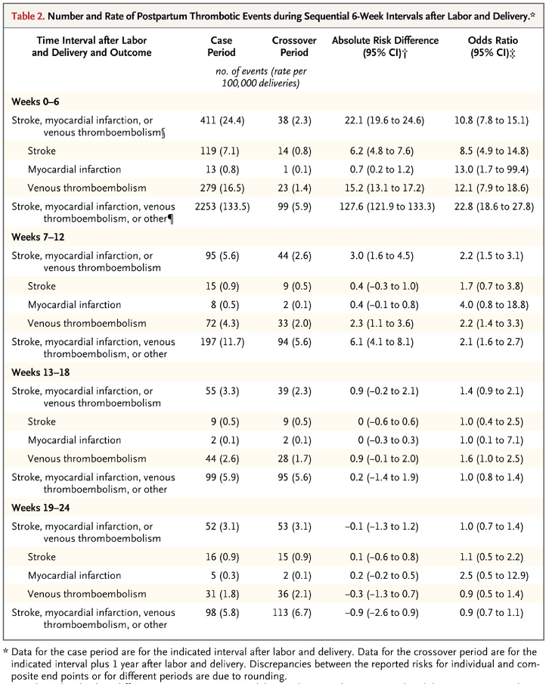
Women hospitalized from 1/2005-6/2010
Looked at first 24 weeks after delivery and those same women over 24 weeks 1 yr later
Approx 1.7 million women
  720 venous thromboembolism cases
  248 stroke cases
  47 MI cases
Risk highest in the first 6 weeks (absolute risk difference 22.1, OR 10.8)
Still a significant increase up to 12 weeks, though less from 7-12 weeks

Slide 3
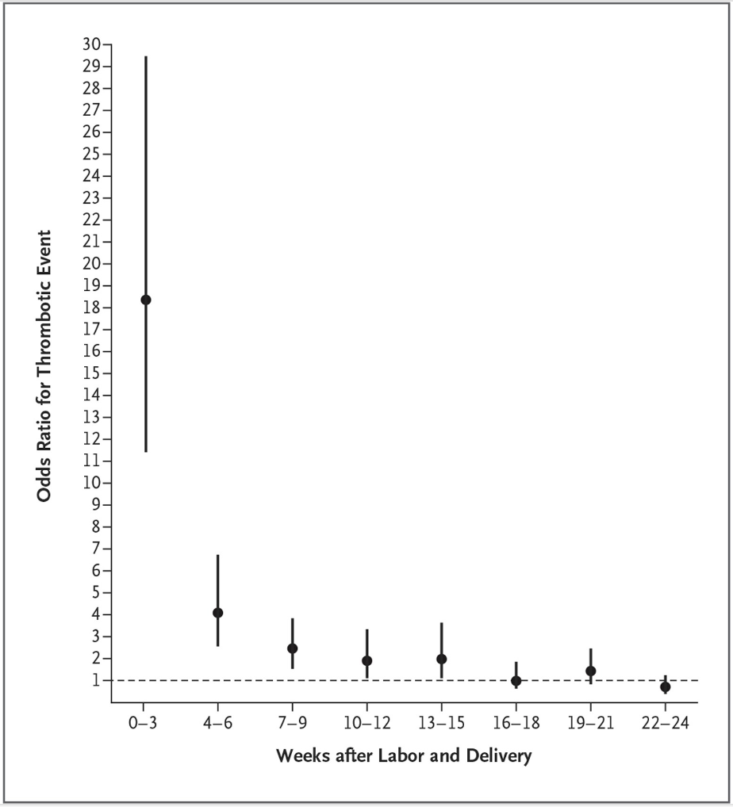
In 3-week increments, risk remained elevated up to 13-15 weeks after delivery, but not from 16-18 weeks and onwards after delivery (OR 1.0, 95% CI 0.6-1.8)
Kamel, Hooman, et al. "Risk of a thrombotic event after the 6-week postpartum period." New England Journal of Medicine 370.14 (2014): 1307-1315.

Slide 4
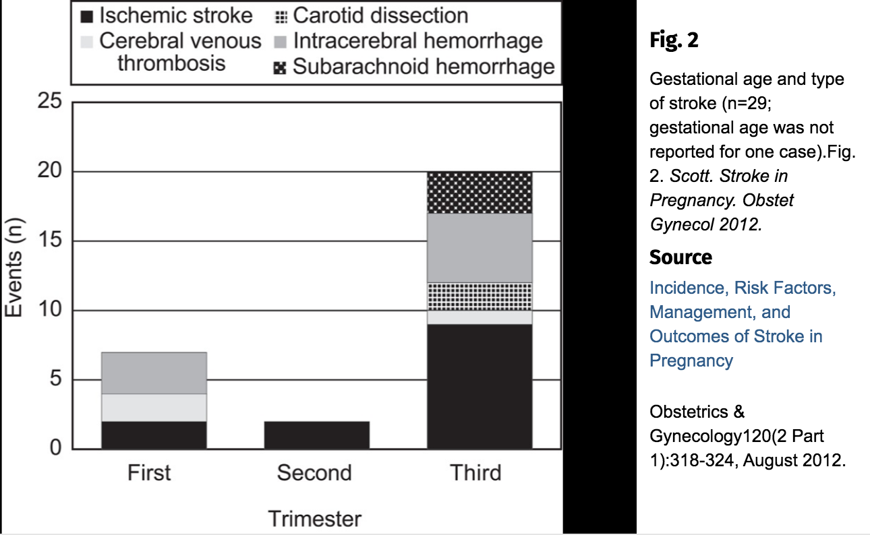
Notes:
UK Obstetric Surveillance System
During the period October 2007 to March 2010, there were 30 confirmed cases of antenatal stroke in an estimated 1,958,203 women delivering

Slide 5
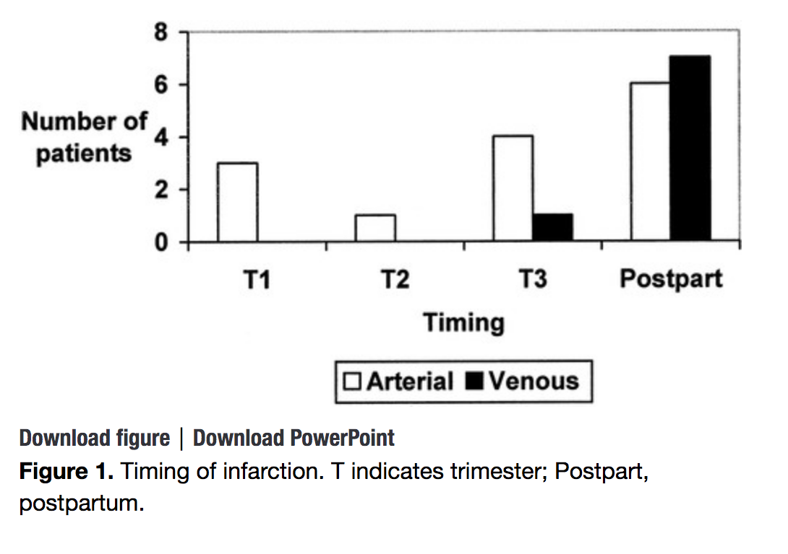
Looked at 50,711 deliveries during 1980-1997 at Toronto Hospital, identified patients using ICD-9 codes
Jaigobin, Cheryl, and Frank L. Silver. "Stroke and pregnancy." Stroke 31.12 (2000): 2948-2951.

Slide 6
DVT in pregnancy
5451 patients patients (2559 men and 2892 women) prospectively enrolled from 10/2001-3/2002 with US-confirmed DVTs
53 patients pregnant (34) or postpartum (19)
15 w/ DVT during first trimester
8 w/ DVT during second trimester
9 w/ DVT during third trimester
2 w/ DVT: trimester unknown
James, Andra H., Victor F. Tapson, and Samuel Z. Goldhaber. "Thrombosis during pregnancy and the postpartum period." American journal of obstetrics and gynecology 193.1 (2005): 216-219.

