Slide 1
What is the prognosis of cerebral venous sinus thrombosis?
Arooshi Kumar
August 2020

Slide 2
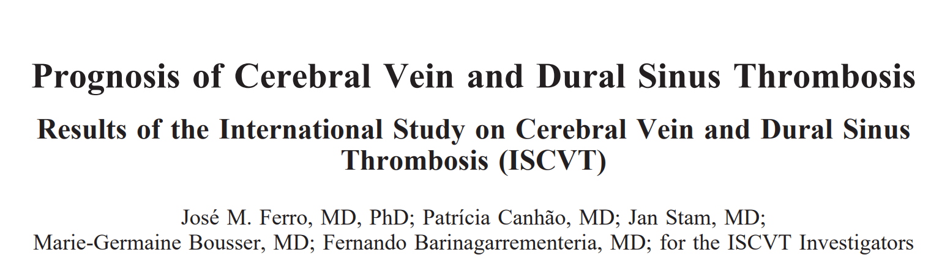

Slide 3
The Question
The natural history and long-term prognosis of cerebral vein and dural sinus thrombosis (CVT) have not been examined previously by adequately powered prospective studies
Prospective observational study where patients were followed up at 6 months and yearly thereafter.
Primary outcome was death or dependence contingent on mRS score
Follow Up
  6 months
  12 months
  Yearly

Slide 4
To Qualify for Study
Age > 15 years
Symptomatic SVT
  Imaging confirmed SVT
  Symptoms
    IIH associated
    Other
Commitment to follow up in 6 months
Outcome was classified according to the mRS
  Complete recovery (mRS 0 to 1)
  Partial recovery, independent (mRS 2)
  Dependent (mRS 3 to 5)
  Death (mRS 6)

Slide 5
Results Overview
624 adults enrolled from 21 countries
Median time from symptoms onset to diagnosis was 7 days (mean = 18.3; SD = 59.4 days).
143 patients (22.9%) presented with isolated intracranial hypertension
  Headache 88.8%
  Any seizure 39.3%
  Any paresis 37.2%
  Papilledema 28.3%
83 (13.9%) had a GCS score of between 9 and 13, and 31 (5.2%) were comatose (GCS 9).

Slide 6
Results Overview
98.7% of the patients were followed up
Median hospital stay was 17 days (mean=20.4, SD=4.3)
Thirty-day case fatality was 3.4% (21 cases)
Superior sagittal sinus thrombosis in 313 patients (62%)
~ 80% of patients were treated with therapeutic anticoagulation
13 patients (2.1%) of patients treated with local endovascular therapy
Median length of follow-up was 16 months (mean=8.6, SD=11.1)

Slide 7
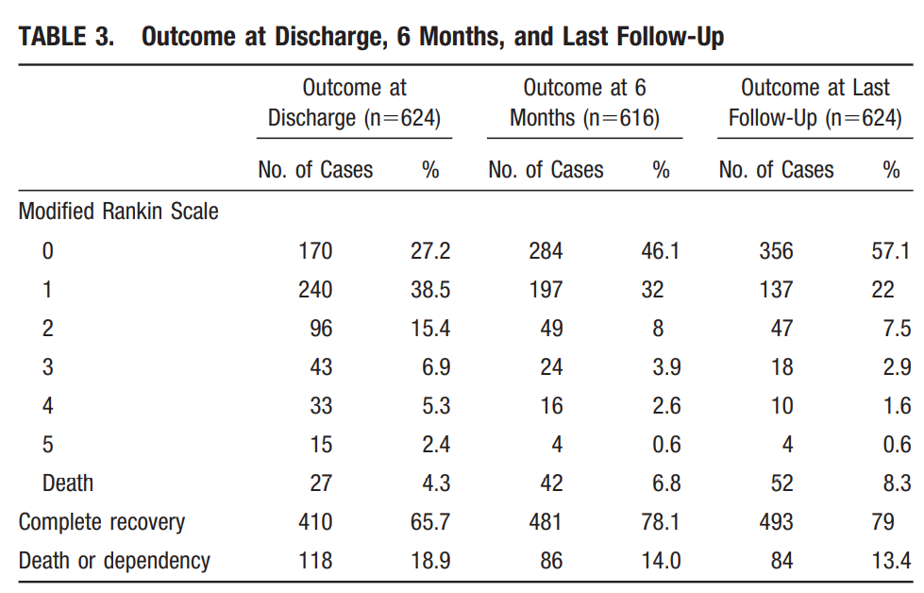

Slide 8
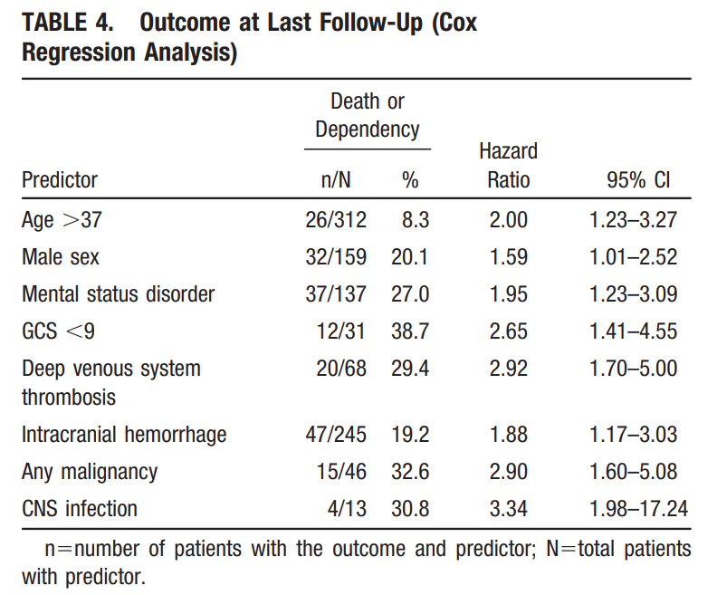

Slide 9
