Slide 1
What is the distribution of Lp(a) in the general population?
Ossama Khazaal
6/3/2021

Slide 2
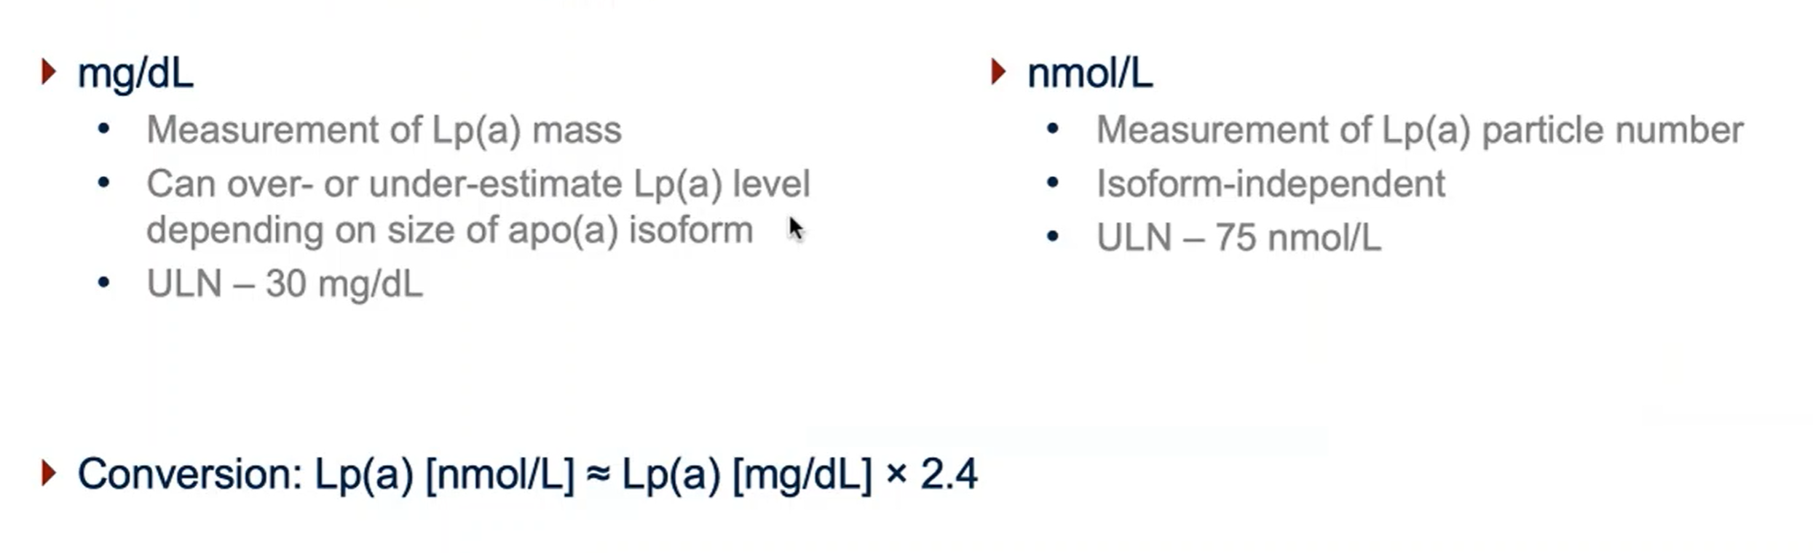
Lp(a) Measurement

Slide 3
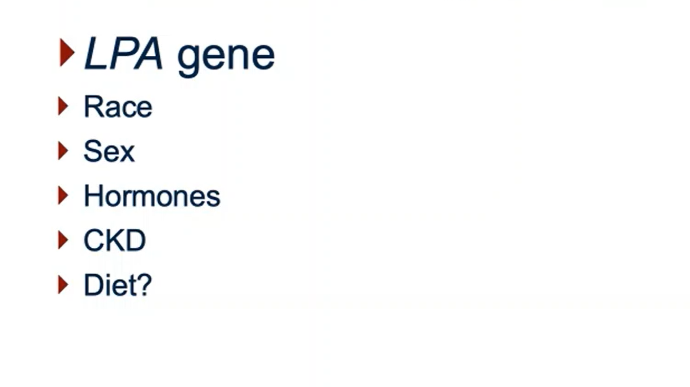
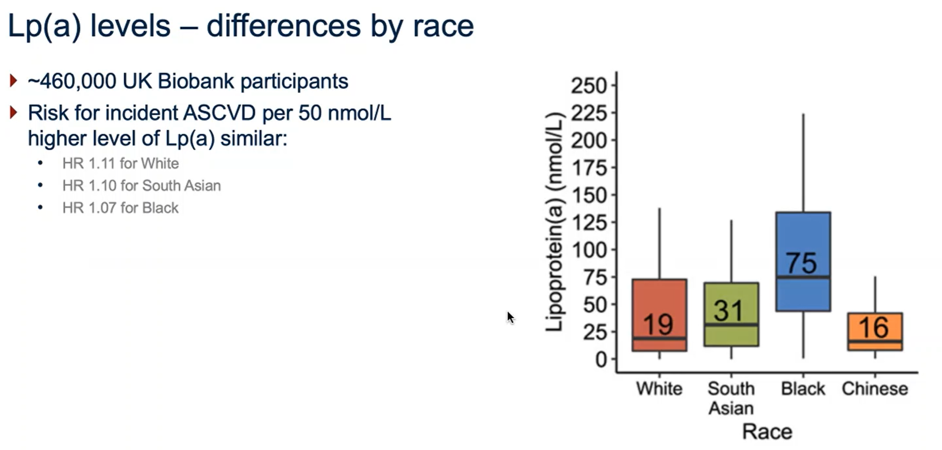
What determines Lp(a) levels?

Slide 4
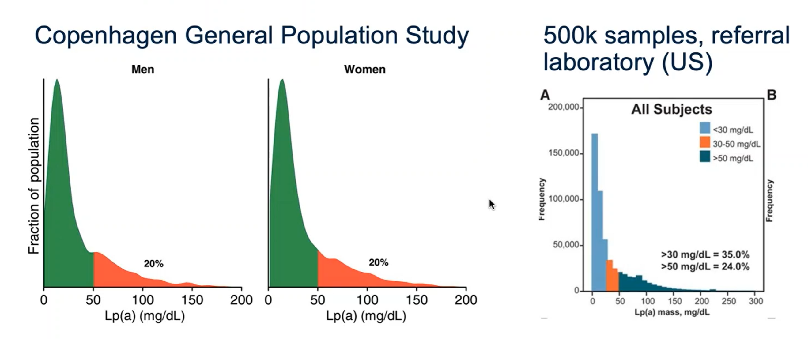
Population prevalence of high Lp(a)

Slide 5
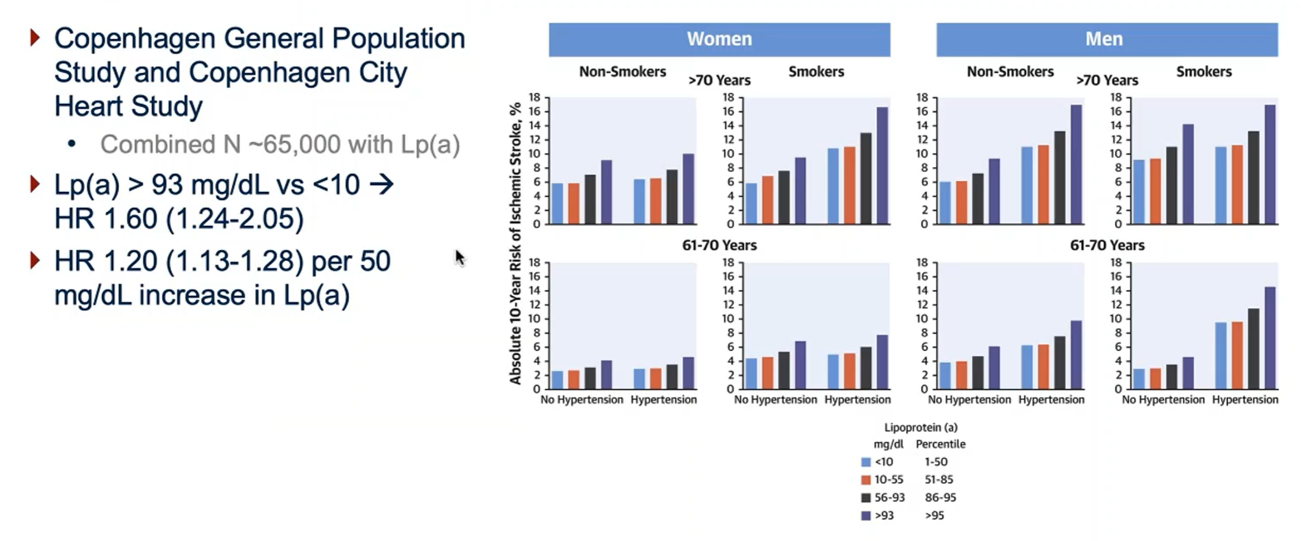
Lp(a) and stroke in the Copenhagen population study

