Slide 1
What are neurovascular complications of intracranial hypotension?
Emily Grodinsky
June 17, 2021

Slide 2
General complications/symptoms
Positional headache (resolves lying down)
Parkinsonism
Coma
Neck pain
Hearing issues
Diplopia
On imaging:
Brain sagging
Pachymeningeal enhancement
Pituitary hyperemia
Notes:
Schievink, Wouter I., and Menahem Marcel Maya. "Cerebral venous thrombosis in spontaneous intracranial hypotension." Headache: The Journal of Head and Face Pain 48.10 (2008): 1511-1519.

Slide 3
Neurovascular complications
Subdural hematoma
CVST/SAH (seem to be very rare – case reports)
Stroke

Slide 4
CVST
7-year study (2008) with 141 patients with spontaneous intracranial hypotension from CSF leak; 3 patients also had CVST
  None of the patients had risks for CVST
  All had intracranial hypotension symptoms and then diagnosed with CVST (2 had findings of CVST on imaging at the time of intracranial hypotension sx, 1 after 2 weeks)
Case series of 3 patients with CVST and intracranial hypotension (2017)
Notes:
Schievink, Wouter I., and Menahem Marcel Maya. "Cerebral venous thrombosis in spontaneous intracranial hypotension." Headache: The Journal of Head and Face Pain 48.10 (2008): 1511-1519.
Sinnaeve, Leen, Ludo Vanopdenbosch, and Koen Paemeleire. "Association of cerebral venous thrombosis and intracranial hypotension: review of 3 cases." Journal of Stroke and Cerebrovascular Diseases 26.8 (2017): e165-e169.

Slide 5
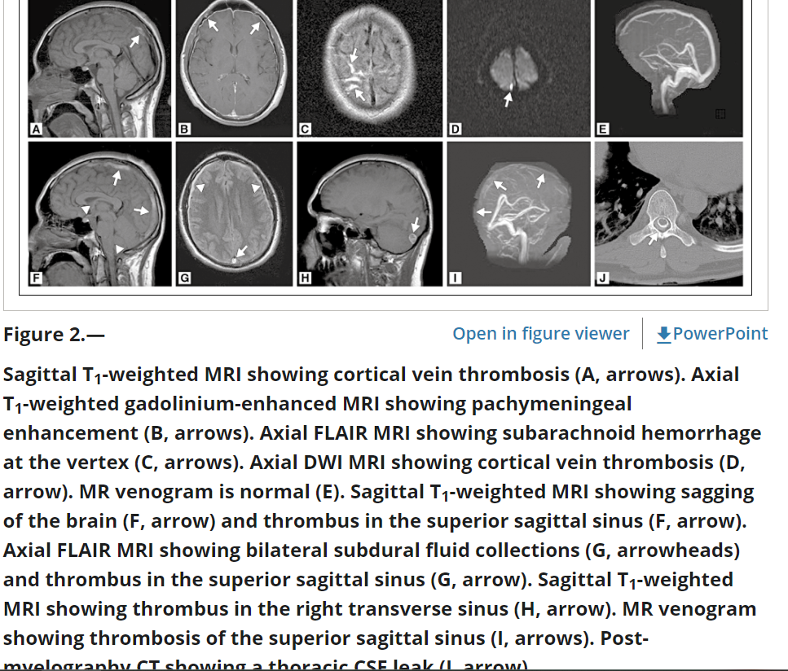
Notes:
Schievink, Wouter I., and Menahem Marcel Maya. "Cerebral venous thrombosis in spontaneous intracranial hypotension." Headache: The Journal of Head and Face Pain 48.10 (2008): 1511-1519.

Slide 6
Stroke
Case series (2013) with 2 patients with spontaneous intracranial hypoTN and multiple arterial strokes
  1 had bilateral SDH, brain sag, had lower cervical leak on CT myelogram then had a coma -> bilateral evacuations -> then immediate postop CT w/ b/l PCA strokes
  1 had bilateral SDH and effacement of basilar cisterns -> bilateral evacuations -> lethargy -> MRI with new pontine/midbrain strokes
Both in context of SDH/mass effect and evacuation for such
Notes:
Schievink, Wouter I. "Stroke and death due to spontaneous intracranial hypotension." Neurocritical care 18.2 (2013): 248-251.

