Slide 1
What do RCTs tell us about treating carotid dissection?
Arooshi Kumar
August 2021

Slide 2
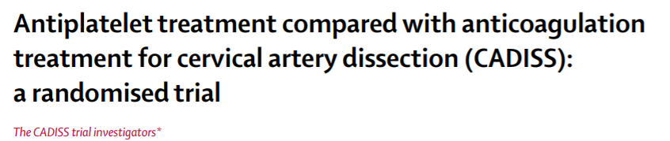
Lancet Neurology 2015

Slide 3
The Overview
Question: Both antiplatelet drugs and anticoagulant drugs are used to reduce risk of stroke in patients with extracranial and vertebral aa dissection but whether one treatment strategy is more effective than the other is unknown.
Method: 250 patients (118 had carotid dissection and 132 had vertebral arterial dissection) were randomized to antiplatelet (aspirin/dipyridamole/clopidogrel) vs anticoagulation (warfarin +/-heparin) within 7 days of sxs onset.
  The primary endpoint was ipsilateral stroke or death (any cause) within 3 months of randomization

Slide 4
Results
70% (174/250) male, mean age 49 (SD 12)
In the antiplatelet group (126 pts);
  22% received aspirin alone
  33% received clopidogrel alone
  1% received dipyridamole alone
  28% received aspirin and clopidogrel
  16% received aspirin and dipyridamole.
In the anticoagulant group (124 pts)
  90% patients received heparin and warfarin
  10% received warfarin alone

Slide 5
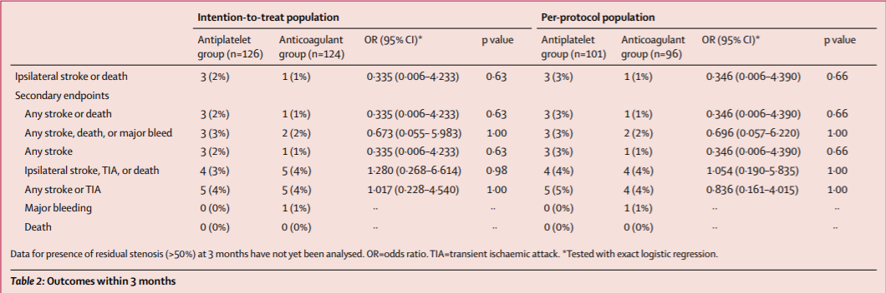
Results Overview

Slide 6
Limitations
Mean time to randomization was 3.65 days (too late for treatment)
Dx of recurrent stroke did not require imaging (clinical dx only) – maybe underestimated risk
Including TIA as qualifying index event
  Asymptomatic or artifactual dissections
Underpowered study

Slide 7
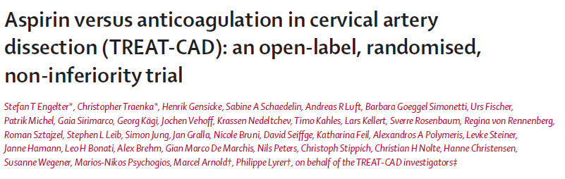
Lancet Neurology 2021

Slide 8
The Overview
Question: Study aimed to test the non-inferiority of aspirin to vitamin K antagonists in patients with cervical artery dissection.
Method: Multicenter, randomized, open-label, non-inferiority trial across Switzerland, Germany, and Denmark. They randomly assigned patients who had symptomatic, MRI-verified, cervical artery dissection within 2 weeks before enrollment, to receive either aspirin 300 mg once daily or a vitamin K antagonist (phenprocoumon, warfarin, acenocoumarol; target international normalized ratio [INR] 2·0–3·0) for 90 days.
The primary endpoint was a composite of clinical outcomes (stroke, major hemorrhage, or death) and MRI outcomes (new ischemic or hemorrhagic brain lesions) in the per-protocol population, assessed at 14 days (clinical and MRI outcomes) and 90 days (clinical outcomes only).

Slide 9
Results
56% male, mean age 46.7 (SD 10.2)
194 patients enrolled
  100 (52%) were randomly assigned to the aspirin group
  94 (48%) to the vitamin K antagonist group (78 received phenprocoumon, 12 acenocoumarol, and four coumadin).
    51 (54%) of 94 patients received heparin or low-molecular-weight heparin followed by a vitamin K antagonist, whereas 43 patients (46%) received a vitamin K antagonist only.
21 (11%) of 194 patients did not meet criteria for per-protocol analysis, including 14 patients who crossed over to the other treatment group.

Slide 10
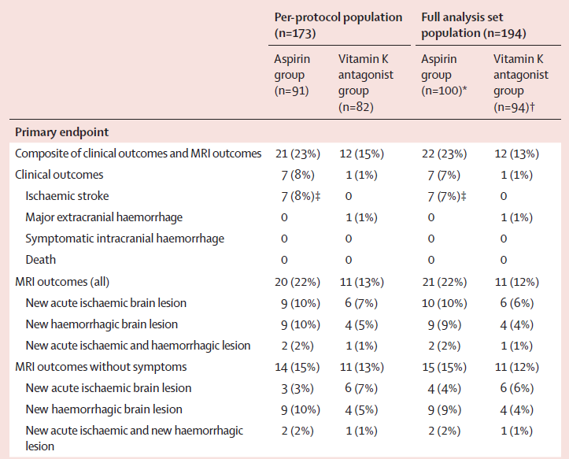
Non-inferiority of aspirin would be shown if the upper limit of the two-sided 95% CI of the absolute risk difference between groups was less than 12% (non-inferiority margin).
The observed absolute difference in the primary endpoint rate between groups was 8% (95% CI –4 to 21; non-inferiority p=0·55
Thus, non-inferiority of aspirin was not demonstrated

