Slide 1
Can high HDL be associated with a paradoxical increased risk of atherosclerotic disease
Fellow’s name: Judy Dawod
Date: 2/4/2021

Slide 2
Background
The Framingham Risk Calculator, HDL-C levels ≥ 60 mg/ dL inform the health care provider that ASCVD risk factor calculations can be reduced by 1, concluding that HDL-C levels above this cut point are cardioprotective
This has changed recently

Slide 3
Observational studies
(Cardiovascular Health in Ambulatory Care Research Team [CANHEART]) Examined the association of fasting cholesterol with cause-specific mortality in a large observational cohort (n = 631,762) of subjects living in Ontario, Canada, who were between the ages of 40 and 105 years without pre-existing CVD conditions
Observed a U-shaped association of HDLC with CVD and non-CVD mortality

Slide 4
CANHEART
men with low HDL-C ≤ 30 mg/dL had an increased CVD mortality (HR 1.81, CI 1.45–2.25), cancer mortality (HR 1.61, CI 1.32–1.97), and other mortality HR (HR 2.01, CI 1.63–2.47) compared with the reference group (HDL-C 41–50 mg/dL)
men with HDL-C > 90 mg/dL also showed significantly increased risk (HR 1.72, CI 1.103–2.682) for non-CVD death
Women with low HDL-C ≤ 30 mg/dL had an increased CVD (HR 2.26, CI 1.56–3.29), cancer mortality (HR 1.96, CI 1.43–2.69), and other mortality risk (HR 2.86, CI 2.17– 3.76) compared with the reference group (HDL-C 51–60 mg/ dL)
Women with HDL-C > 90 mg/dL had an increased risk for non-CVD death (HR 1.32, CI 1.01–1.71)

Slide 5
Copenhagen studies
Copenhagen Heart Studies, investigators examined the association of HDL-C with all-cause, CVD, and non CVD mortality in two large prospective studies, the Copenhagen City Heart Study and the Copenhagen General Population Study (combined total of 52,268 white men and 64,240 white women of Danish ancestry)
Observed a similar pattern of a U-shaped association of HDL-C to mortality
The HDL cholesterol concentration associated with the lowest risk of all-cause mortality was 73 mg/dL for men, and 93 mg/dL for women

Slide 6
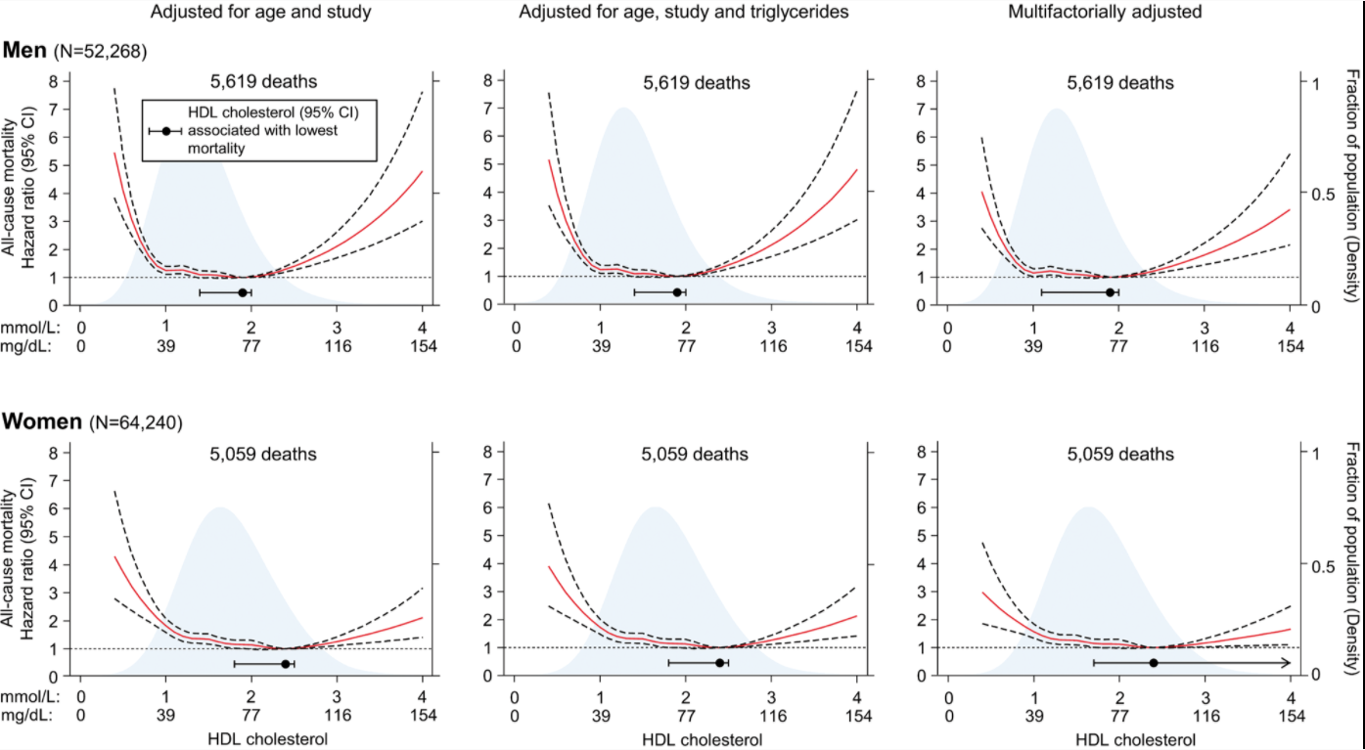
Copenhagen studies

Slide 7
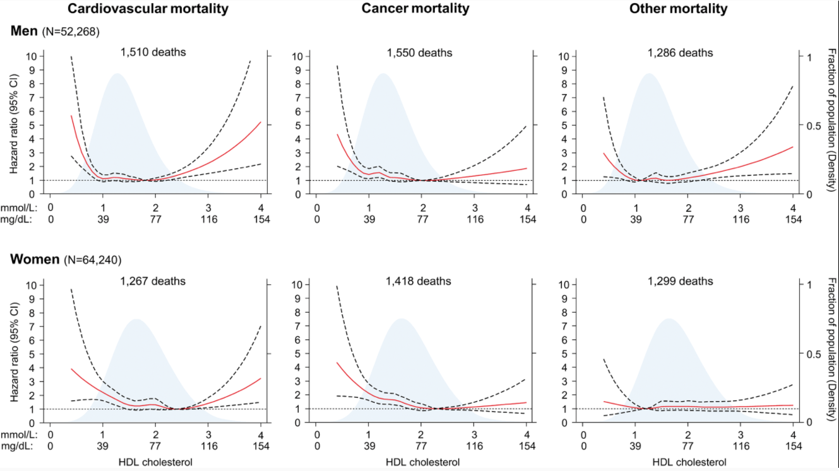

Slide 8
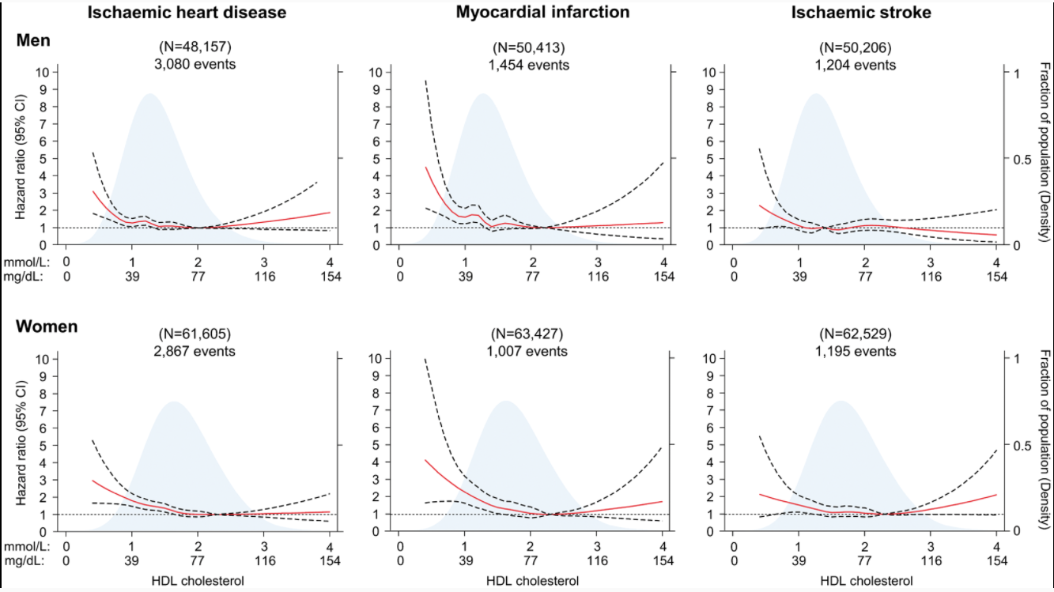

Slide 9
Copenhagen studies
Extreme HDL-C:
HR for CVD mortality was 2.53 in men and 2.89 in women
HR for Cancer mortality was 1.76 in men and 1.33 in women
HR for other mortality was 1.90 in men and 1.51 in women
No significant increase or decrease in risk for CVD outcomes (myocardial infarction [MI], ischemic CVD, and ischemic stroke) was found in subjects with extreme HDL-C levels

Slide 10
Mechanism
Currently unknown
Some hypotheses about

Slide 11
Genetic studies
Genetic association studies failed to show that genetic etiologies of high HDL-C significantly reduced risk for myocardial infarction (MI), while hepatocyte nuclear factor-4 (HNF4A) was significantly associated with high HDL-C and increased MI risk. Candidate gene studies have identified scavenger receptor B class I (SCARB1) and lymphocyte activation gene-3 (LAG3) as genes significantly associated with high HDL-C and increased MI risk.

