Slide 1
Does the location of ICH within the pons (dorsal vs ventral) predict etiology of the bleed?
Emily Grodinsky
11.26.2020
Short answer is, it’s unclear. Here’s what I found that was relevant:

Slide 2

27 patients from a memory clinic in Korea who had been diagnosed with vascular dementia and had a history of HTN; nearly ½ were smokers, approx ¼ had DM
Looked at microhemorrhage distribution in the pons using GRE (1.5T MR)
None of these patients had ICH, were on anticoagulants, had recent trauma/surgery, h/o systemic cancer; excluded those with cortical microhemorrhages in CAA pattern
They considered these to be hypertensive pontine microhemorrhages
No one had scans “consistent with vascular malformation” although MRA/DSA weren’t done

Slide 3
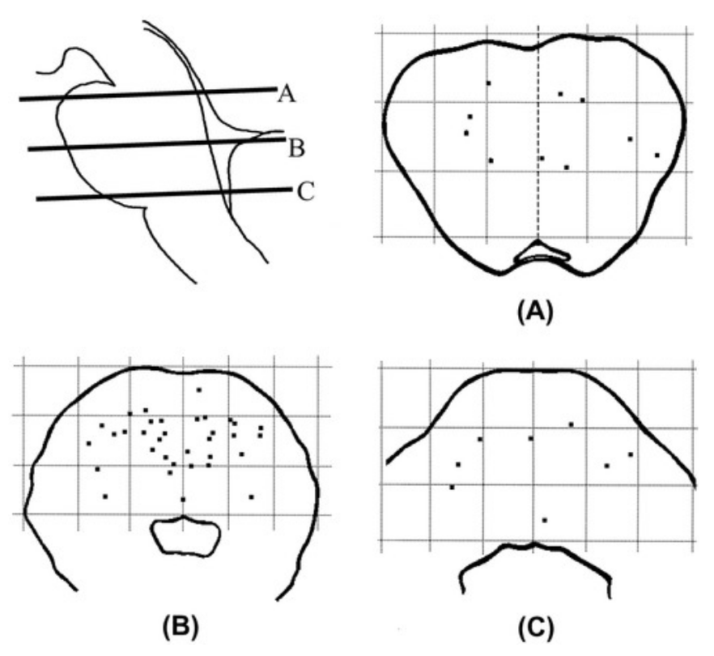
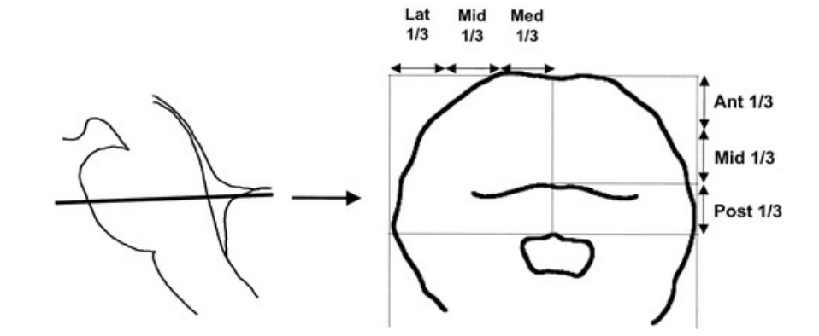
Results
19% in upper pons, 15% lower, 65% middle (p=0.000)
87% lesions in basis pontis and 13% in tegmentum; 84% of basis pontis lesions were in the dorsal half
R=L

Slide 4
