Slide 1
What is the evidence for intervention to treat carotid near-occlusion?
Daniel Cristancho, MD, MBE
September 17, 2020

Slide 2
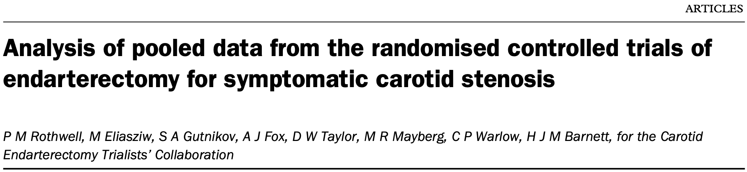
262 patients with near-occlusion
  ECST and NASCET
A trend towards benefit with surgery at 2-years (ARR 5.6%, p=0.19)
Notes:
“The risk of stroke for medically-treated patients with near-occlusion was lower than in patients with severe stenosis without near-occlusion; this lowered risk is probably due to good collateral circulation, but effect of endarterectomy has not been established...analysis of the long-term effect of surgery in this group showed no significant benefit.”

Slide 3
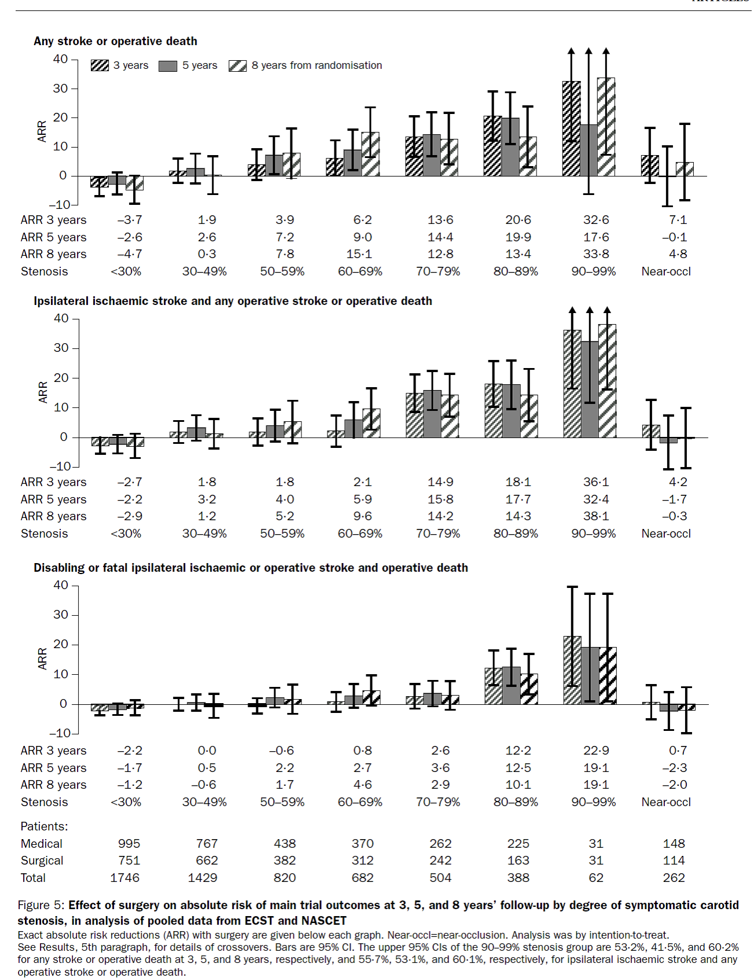

Slide 5
Other Considerations
Observational data suggest outcomes between CEA and CAS seem comparable
Differences in near occlusion with versus without full collapse
  Conflicting data regarding which group is higher risk for recurrent, 28-30-day stroke
Varying medical therapy strategies

