Slide 1
What is the role of HIV Vasculopathy in stroke?
Ossama Khazaal
12/17/2020

Slide 2
Causes of stroke in HIV
Cerebral infections
Cardiac embolism (mainly infective and non infective endocarditis)
Prothrombotic states
Substance abuse
HIV associated vasculopathy
Accelerated athero

Slide 3
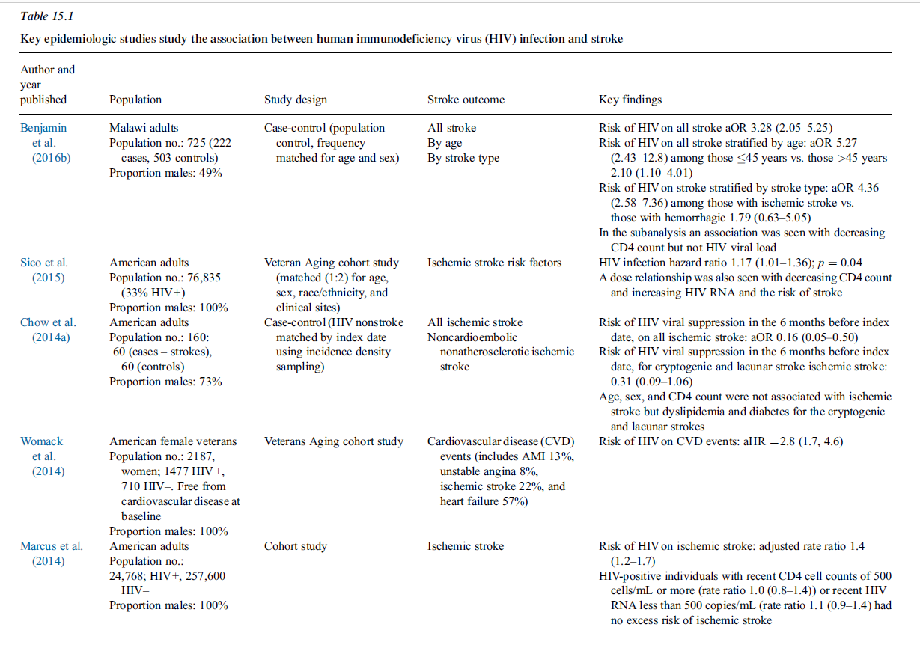

Slide 4
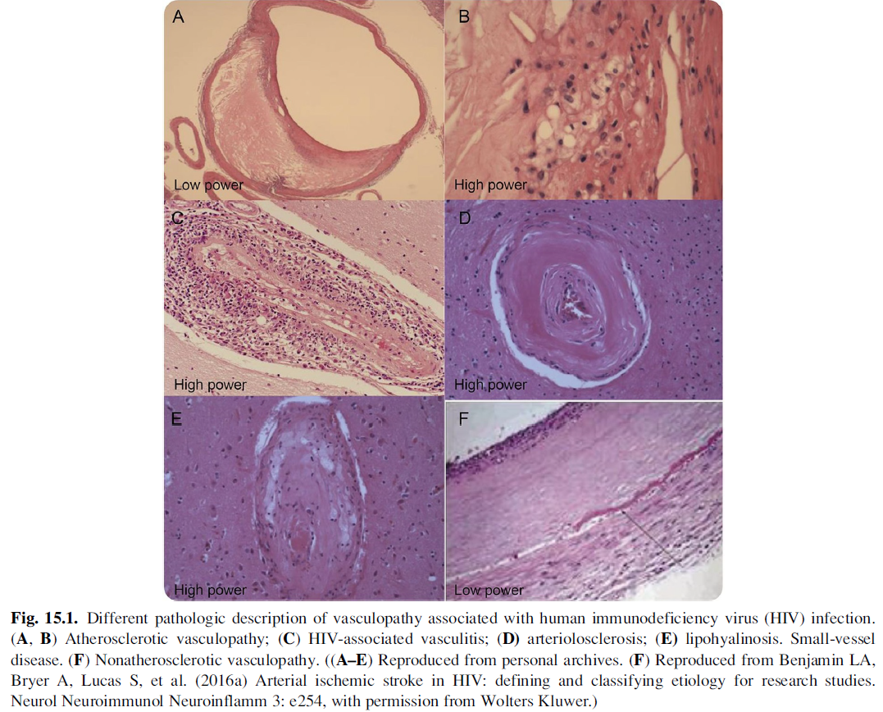
HIV Vasculopathy

Slide 5
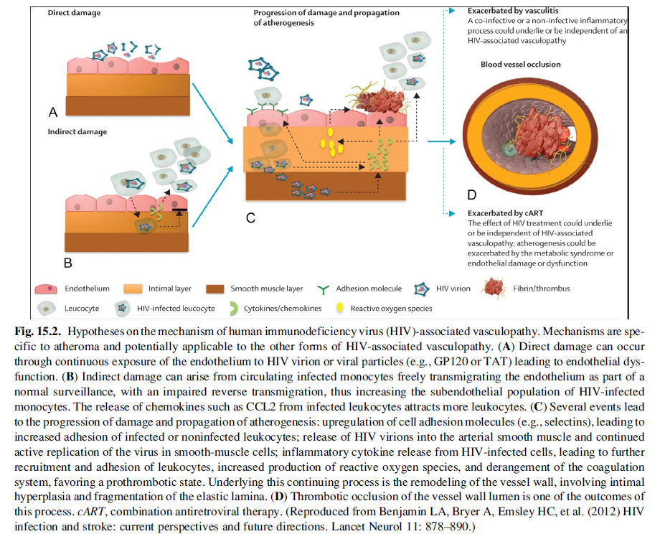
Hypothesized Mechanisms

Slide 6
Small vessel vasculopathy
Autopsy data
Infection of endothelial cells with consequent breakdown of the BBB?
Hyaline small vessel wall thickening, perivascular space dilatation, rarefaction and pigment deposition with vessel wall mineralization and occasional perivascular inflammatory cell infiltrates.
Seen in young patients without traditional vascular risk factors
Similar changes to those with arteriosclerosis seen in elderly hypertensive and diabetic patients

Slide 7
Large and medium vessel vasculopathy
Cerebral aneurysmal arteriopathy in childhood AIDS
  Typically seen in children 2-12 yo
  Fusiform dilatation of the arteries of Circle of Willis with sparing of the leptomeningeal and intraparenchymal arteries and arterioles.
  Vascular pathology with medial fibrosis with loss of muscularis layer, destruction of the internal elastic lamina and intimal hyperplasia
  No evidence of HSV, VZV, and CMV
  Usually appears as “healed vasculitis”

Slide 8
Large and medium vessel vasculopathy
Vasculopathy seen in adults
  Multiple reports with saccular aneurysms and SAH in patients with HIV
  Occlusive disease with other systemic arteries also involved
  Possibly infectious or of immune complex origin with leukocytoclastic vasculitis of the vasa vasorum or periadventitial vessels? Postulated mechanisms:
    Acute phase with vasculitis and resultant ischemia
    Chronic phase with healed/healing and less obvious vasculitis leading to weakening of vessels and aneurysmal formation

