Slide 1
How often does FMD involve the extra- versus intracranial circulation versus other areas (renal arteries, coronaries, etc)?
Emily Grodinsky
9.24.2020

Slide 2
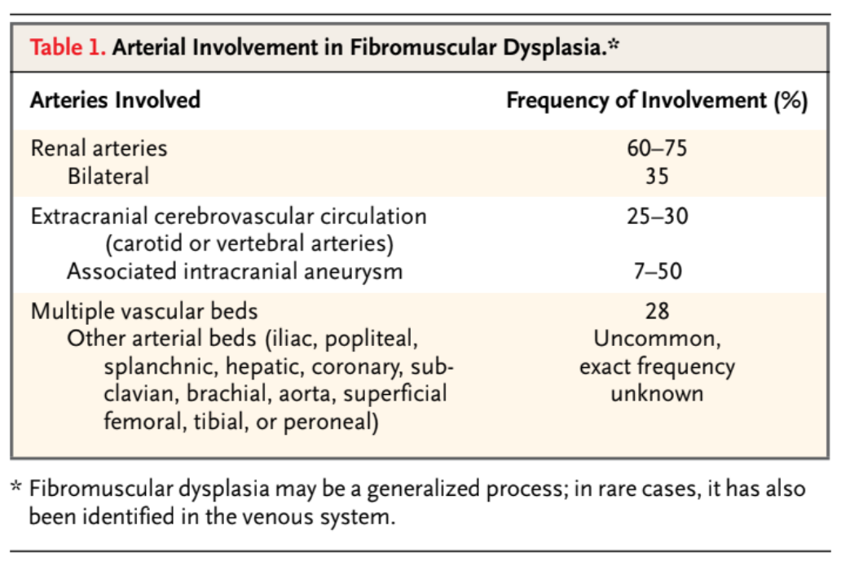
Briefly, what / where is FMD?
Non-inflammatory, non-atherosclerotic, idiopathic vascular disease
Usually affects the middle or distal parts of ICAs, verts, renal arteries (vs. athero: usually proximal portion of vessels).

Slide 3
More details on FMD
Types of FMD: based upon in which arterial layer (intima, media, adventitia) the lesion is predominantly found; medial is most common
Common complications: aneurysms and dissections (including coronary artery).
Symptoms that are common: hypertension, headache, pulsatile tinnitus, dizziness, neck pain.

Slide 4
Intracranial vs extracranial FMD
Best data is from FMD registration (included 9 states in US, 447 cases)
  Renal arteries (80%)
  Extracranial carotid (74%)
  Vertebral (37%)
  Intracranial carotids (17%)
Intracranial FMD often co-exists with extracranial and can appear with intracranial aneurysms

Slide 5
Classically taught as a disease of young women but…
Renal artery FMD: most commonly women 15-50 years old
Cerebrovascular FMD: average age ~50 years; majority ~C1-C2 levels; also female predominance
~15% of patients with FMD are >64 at the time of diagnosis of FMD (tend to be less symptomatic)

Slide 6
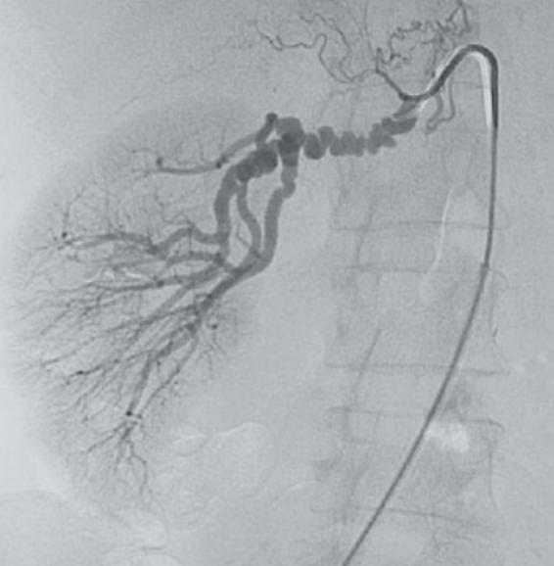
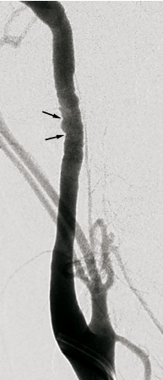
Examples of renal artery and ICA FMD

