Slide 1
What is the reliability of non-invasive imaging for detection of dAVF?
Daniel Cristancho, MD, MBE
October 1, 2020

Slide 2
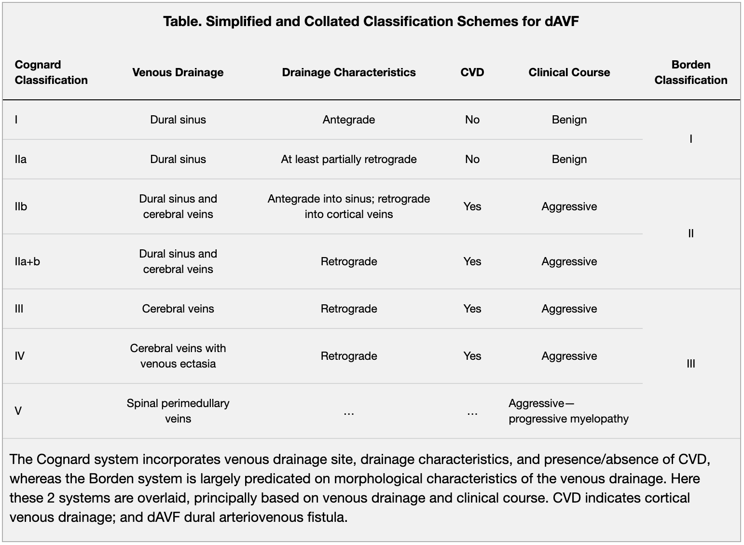
Chen et al. Stroke. 2018
Notes:
Intracranial dAVFs are anomalous interconnections between dural venous sinuses or cortical veins and dural arteries without a capillary nidus. Although the absolute incidence is unknown, dAVFs account for 15% of intracranial vascular lesions.
The Borden classification system stratifies lesions on the basis of the site of venous drainage and the presence or absence of CVD.
The Cognard classification is based on the direction of dural sinus drainage, the presence or absence of CVD, and venous outflow architecture (nonectatic cortical veins, ectasia cortical veins, or spinal perimedullary veins).
The risk of conversion is low, having only been reported in 2% of low-grade lesions.19 Cases of spontaneous thrombosis/resolution of DAVFs have also been reported. Any change in a patient’s symptoms can reflect exacerbations of the venous drainage pattern and prompt further imaging work-up.

Slide 3
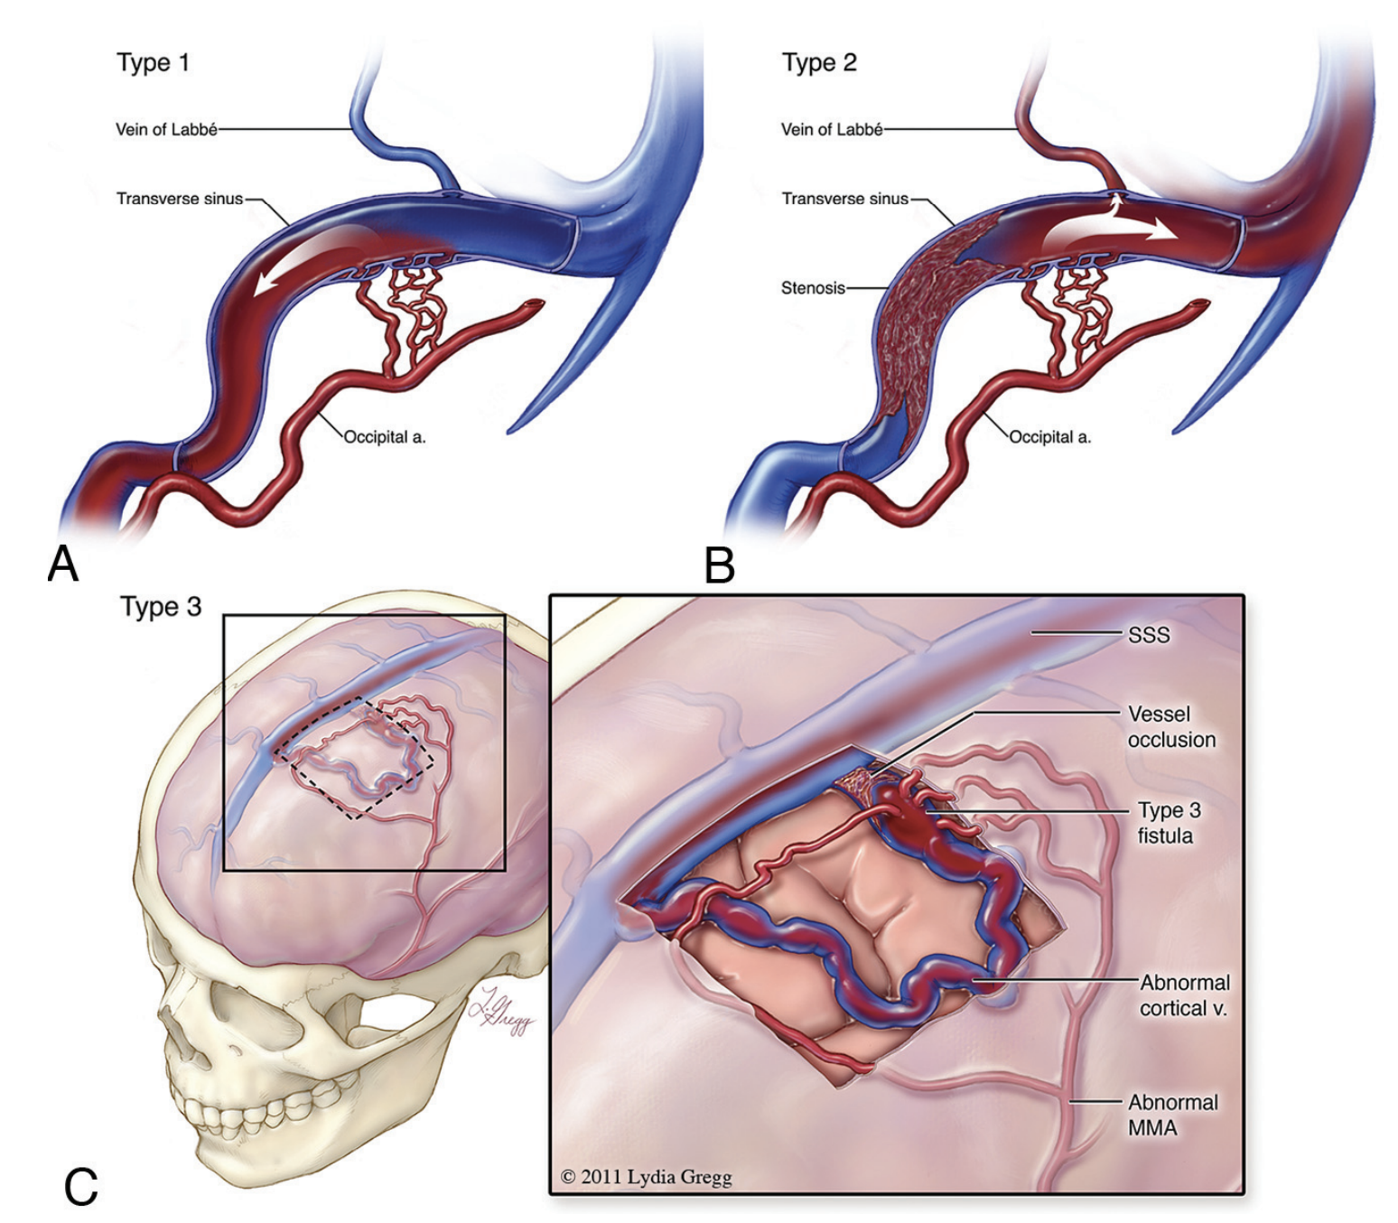
Ghandi et al. AJNR. 2012
Notes:
Schematic overview of the Borden system of classification for DAVFs.
A, Type 1 fistula with multiple communications between the occipital artery and transverse sinus. Note antegrade flow and no cortical venous reflux.
B, Type 2 lesions are associated with cortical venous reflux. This illustration demonstrates the presence of a transverse sinus fistula with stenosis of the distal transverse and proximal sigmoid sinuses. There is retrograde blood flow into the proximal transverse sinus and the cortical vein.
C, Type 3 fistulas represent communication between the meningeal arteries and cortical vein (or an isolated segment of venous sinus). In this schematic drawing, the cortical vein harboring the fistula near the frontal convexity is tortuous and has multifocal stenoses in its pathway

Slide 4
Clinical Symptoms
Typically present in the fifth and sixth decade of life
Clinical symptoms are variable and largely depend on the the location and associated edema from the pattern of venous drainage
Common Symptoms
  Pulsatile tinnitus, cranial nerve palsies, and proptosis
Aggressive Symptoms
  Signs of intracranial hypertension (including papilledema, hydrocephalus, and seizures), parkinsonism, cerebellar symptoms, apathy, failure to thrive, and cranial nerve abnormalities
Cognard et al. Radiology. 1995
Cohen et al. The Laryngoscope. 2009
Ghandi et al. AJNR. 2012
Chen et al. Stroke. 2018
Notes:
Pulsatile tinnitus is a common symptom that results from increased blood flow through the dural venous sinuses, particularly in relation to transverse and sigmoid sinus lesions.
Cavernous sinus DAVFs can present with ophthalmoplegia, proptosis, chemosis, retro-orbital pain, or decreased visual acuity.
Unexplained subarachnoid or lobar hemorrhages should prompt consideration of a DAVF in the differential diagnosis.

Slide 5
Diagnostics
Noncontrast CT: limited use
MRI (specifically T2): large arterialized veins presenting as flow voids, edema from retrograde leptomeningeal venous drainage, dilated vessels, venous pouches, vascular enhancement, and signs of venous hypertension in high-grade lesions
CTA: sensitivity 15.4%
MRA: sensitivity 50%
  Poor negative predictive value
Cerebral Angiogram: gold standard
Cohen et al. The Laryngoscope. 2009
Ghandi et al. AJNR. 2012
Notes:
CT is limited to identifying intracranial hemorrhage and edema due to venous congestion. Specifically dAVF should be suspected with atypical hemorrhage locations.
Signs of venous hypertension in high-grade lesions: white matter hyperintensity, intracranial hemorrhage, or venous infarction.
Type I and II lesions may reveal flow-void clustering, engorged ophthalmic veins, or proptosis, whereas aggressive type II or III lesions are more likely to show dilated vessels, prominent vascular enhancement,1 and hemorrhage.
Only 37% of Cognard V dAVFs will show flow voids, with sensitivity increasing to 76% when contrast MRI is utilized

