Slide 1
Does the number of microhemorrhages help discriminate between amyloid angiopathy and amyloid angiitis?
Daniel Cristancho, MD, MBE
Fall 2020

Slide 2
Terminology
Cerebral amyloid angiopathy
Inflammatory cerebral amyloid angiopathy
  Cerebral amyloid angiopathy-related inflammation (CAA-RI)
  Amyloid-beta related angiitis (ABRA)
Primary angiitis of the central nervous system (PACNS)
Notes:
Martucci, M., Sarria, S., Toledo, M. et al. Cerebral amyloid angiopathy-related inflammation: imaging findings and clinical outcome. Neuroradiology 56, 283–289 (2014). https://doi.org/10.1007/s00234-014-1330-6
Only 20% of ABRA patients had evidence of hemorrhage on MRI
Scolding NJ, Joseph F, Kirby PA, Mazanti I, Gray F, Mikol J, Ellison D, Hilton DA, Williams TL, MacKenzie JM, Xuereb JH, Love S. Abeta-related angiitis: primary angiitis of the central nervous system associated with cerebral amyloid angiopathy. Brain. 2005 Mar;128(Pt 3):500-15. doi: 10.1093/brain/awh379. Epub 2005 Jan 19. PMID: 15659428.
“However, multiple lobar microbleeds present on gradient-echo sequences are hallmarks of I-CAA. Their association with ABRA remains understudied.”
Moussaddy A, Levy A, Strbian D, Sundararajan S, Berthelet F, Lanthier S. Inflammatory Cerebral Amyloid Angiopathy, Amyloid-β–Related Angiitis, and Primary Angiitis of the Central Nervous System. Stroke. 2015;46:e210–e213. doi: 10.1161/strokeaha.115.010024

Slide 3
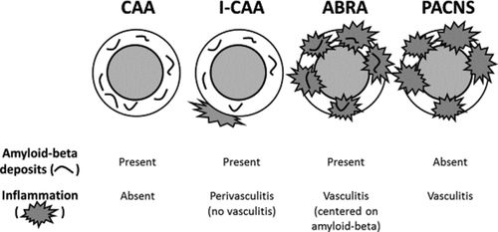
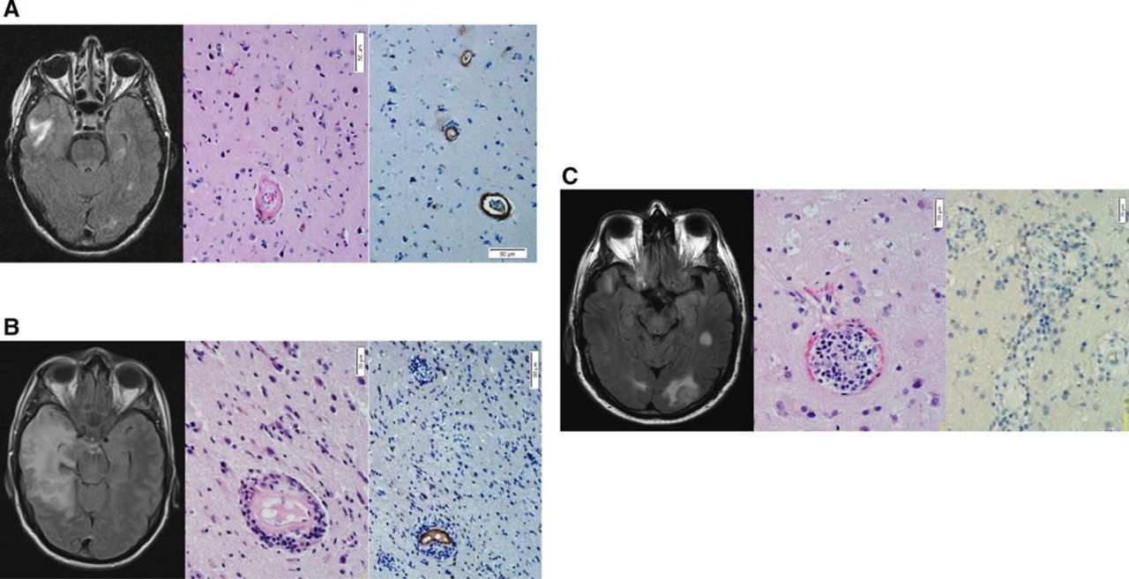
Moussaddy et al. Stroke. 2015
Notes:
Moussaddy A, Levy A, Strbian D, Sundararajan S, Berthelet F, Lanthier S. Inflammatory Cerebral Amyloid Angiopathy, Amyloid-β–Related Angiitis, and Primary Angiitis of the Central Nervous System. Stroke. 2015;46:e210–e213. doi: 10.1161/strokeaha.115.010024

Slide 4
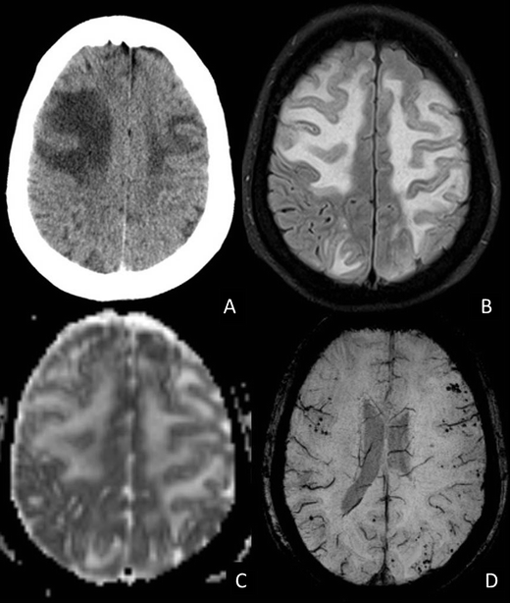
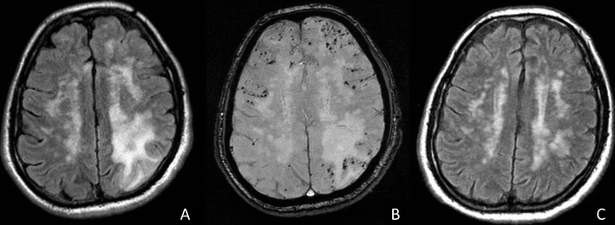
Martucci et al. Neuroradiology. 2014
Notes:
Martucci, M., Sarria, S., Toledo, M. et al. Cerebral amyloid angiopathy-related inflammation: imaging findings and clinical outcome. Neuroradiology 56, 283–289 (2014). https://doi.org/10.1007/s00234-014-1330-6

Slide 5
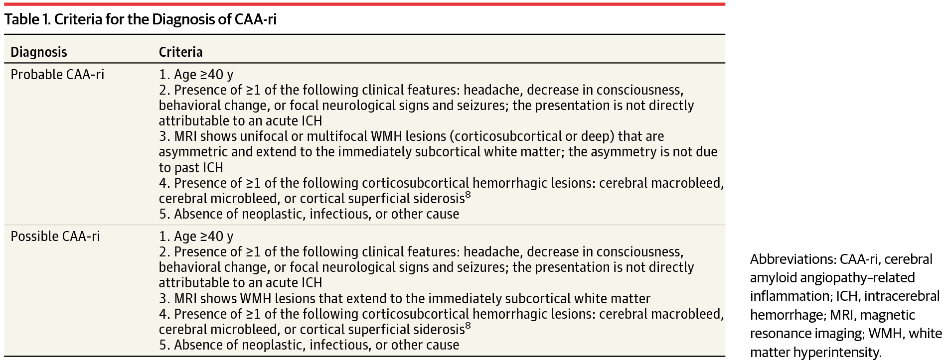
Moussaddy et al. Stroke. 2015
Notes:
Moussaddy A, Levy A, Strbian D, Sundararajan S, Berthelet F, Lanthier S. Inflammatory Cerebral Amyloid Angiopathy, Amyloid-β–Related Angiitis, and Primary Angiitis of the Central Nervous System. Stroke. 2015;46:e210–e213. doi: 10.1161/strokeaha.115.010024

Slide 6
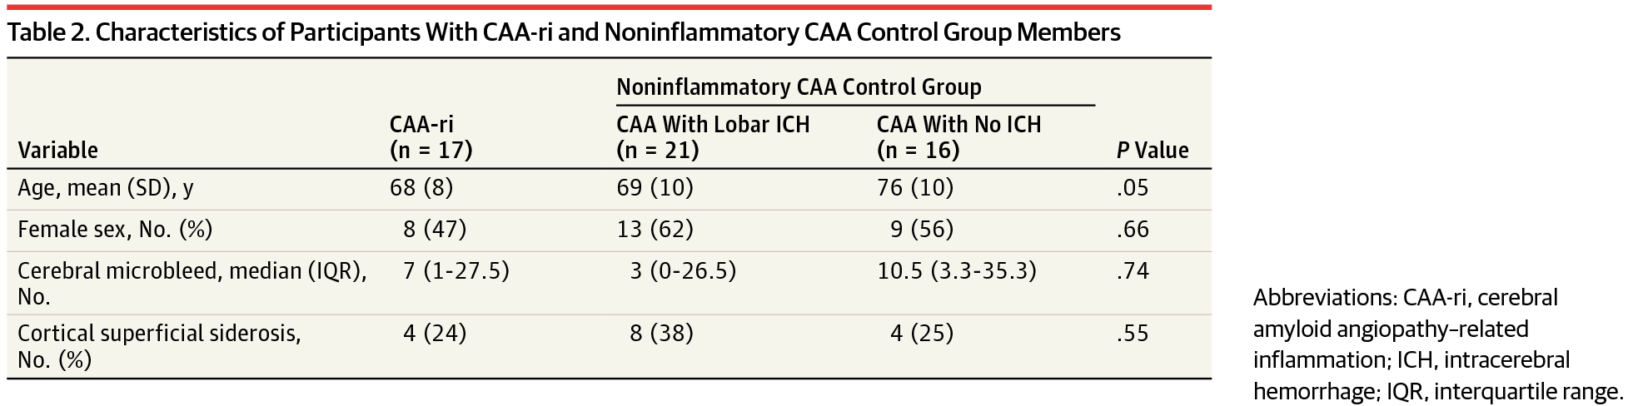
Moussaddy et al. Stroke. 2015
Notes:
Moussaddy A, Levy A, Strbian D, Sundararajan S, Berthelet F, Lanthier S. Inflammatory Cerebral Amyloid Angiopathy, Amyloid-β–Related Angiitis, and Primary Angiitis of the Central Nervous System. Stroke. 2015;46:e210–e213. doi: 10.1161/strokeaha.115.010024

