Slide 1
Which types of vasculitis lead to aortitis?
Emily Grodinsky
11.5.2020

Slide 2
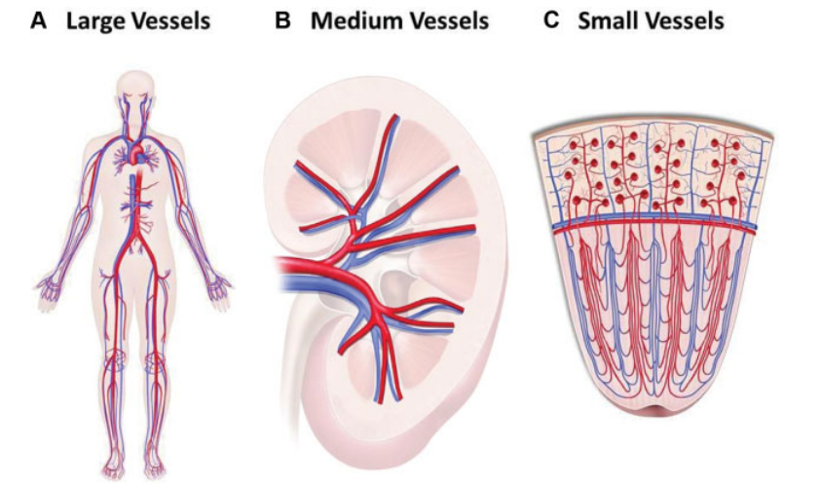
Categorizing vessels by size

Slide 3
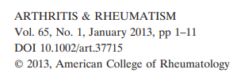
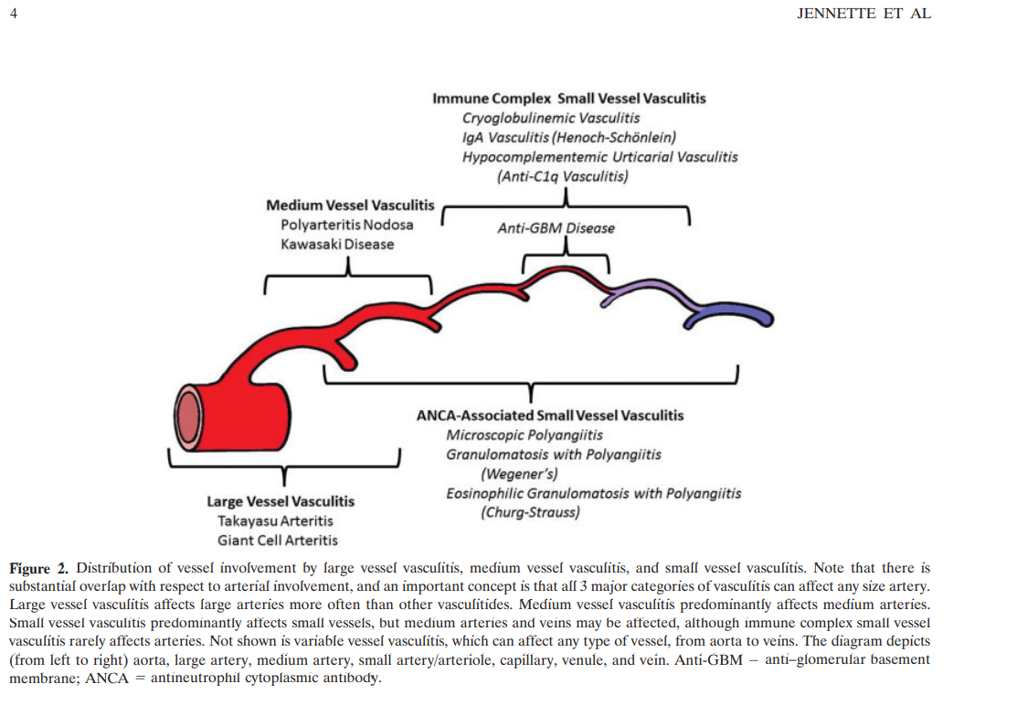

Slide 4
More on primary vasculitidities
Even diseases like GCA/Takayasu arteritis have significant effects from the smaller vessels (e.g., ophthalmic or retinal arteries in GCA leading to significant morbidity, despite not being “large vessels”)
Large vessel vasculidities have a predilection for well-developed wall layers like the elastic layer, found in large/medium arteries
Variable vessel vasculitis:
Behcets
Cogan’s syndrome (ocular inflammation, inner ear disease)
Ultimately, vessels of any size can be affected in any vasculitic process

Slide 5
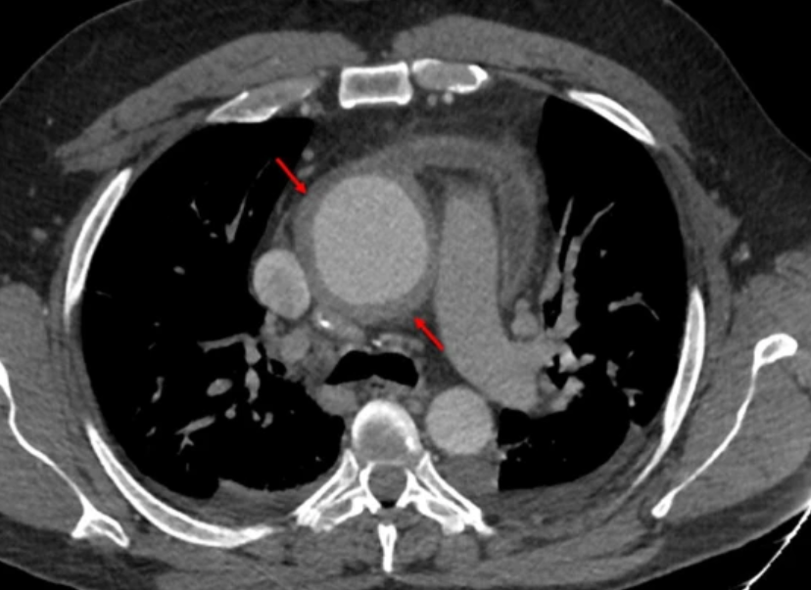
ANCA-vasculitis aortitis -- rare but has been reported

Slide 6
Aortitis in non-primary vasculitis processes
IgG4-related systemic disease (aortitis suspected to occur in 10-30% of patients w/ this disease)
Relapsing polychondritis
Systemic Lupus Erythematosus
Systemic infections (e.g., syphilis, tuberculosis)

