Slide 1
What is the risk of ICH recurrence in patients with cerebral amyloid angiopathy?
Ossama Khazaal
10/8/2020

Slide 2
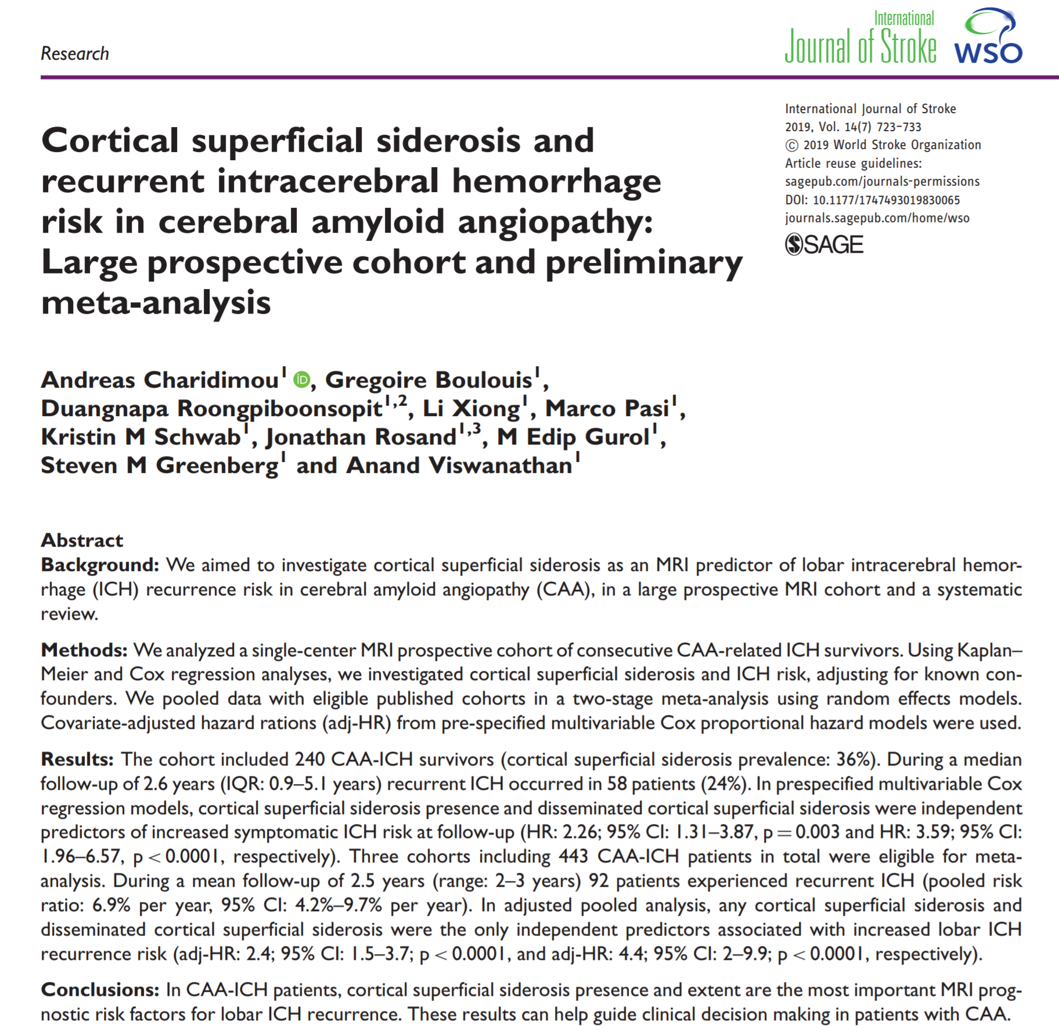
Single center MRI prospective cohort of consecutive CAA ICH survivors
2003-2012 at MGH
Spontaneous sx lobar ICH
Definite, probable or possible CAA
META:
  3 cohorts total 443 CAA-ICH patients
  Mean f/u of 2.5y

Slide 3
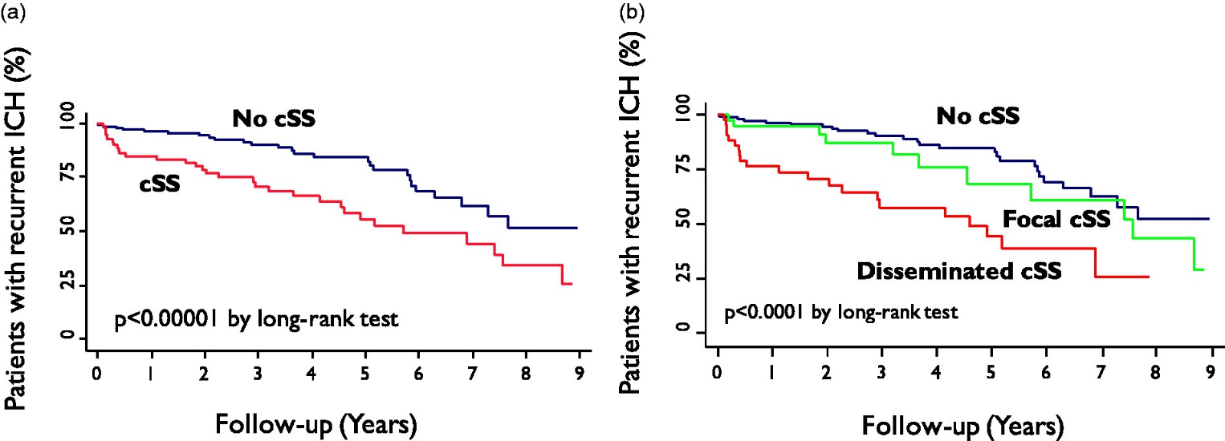
Figure 1. Time to recurrent symptomatic lobar intracerebral hemorrhage (ICH) during follow-up in our cohort. Kaplan–Meier estimate curves of progression to recurrent ICH (a) CAA patients with vs. without any cSS and (b) according to cSS burden (i.e. none, focal, disseminated). Testing of significance is by the log-rank test.
Article Copyright © 2019 Authors, Source DOI: 10.1177/1747493019830065. See content reuse guidelines at: sagepub.com/journals-permissions

Slide 4
Results
240 patients (cSS prevalence 36%)
Median follow up of 2.6 years recurrence was seen in 58 patients (24%)
cSS and diss SS were independent predictors of recurrent ICH (HR 2.26 and 3.59)
Meta:
92 had recurrent ICH (pooled risk ratio of 6.9%/year, 95% CI:4.2-9.7%)

Slide 5
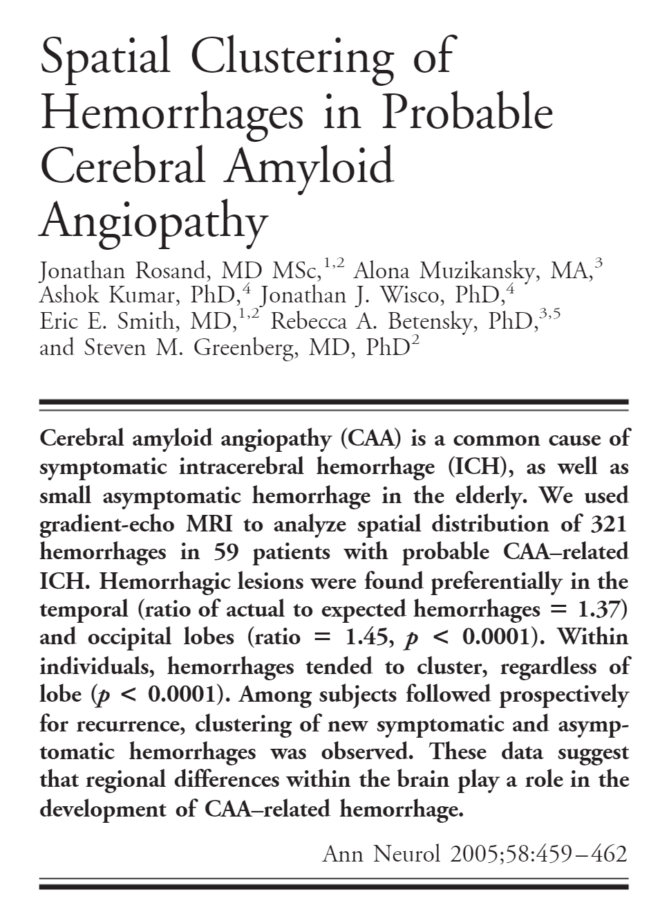
59 patients with probable CAA-ICH
MRI to analyze special distribution of 321 ICHs
Lesions preferentially found in temporal and occipital lobes
Hemorrhages tended to cluster, regardless of the lobe
Recurrent hemorrhages (23 patients had recurrence) also tended to cluster whether symptomatic or asymptomatic

