Slide 1
What are the Classic Imaging Findings of Air Embolism?
Daniel Cristancho, MD, MBE
October 29, 2020

Slide 2
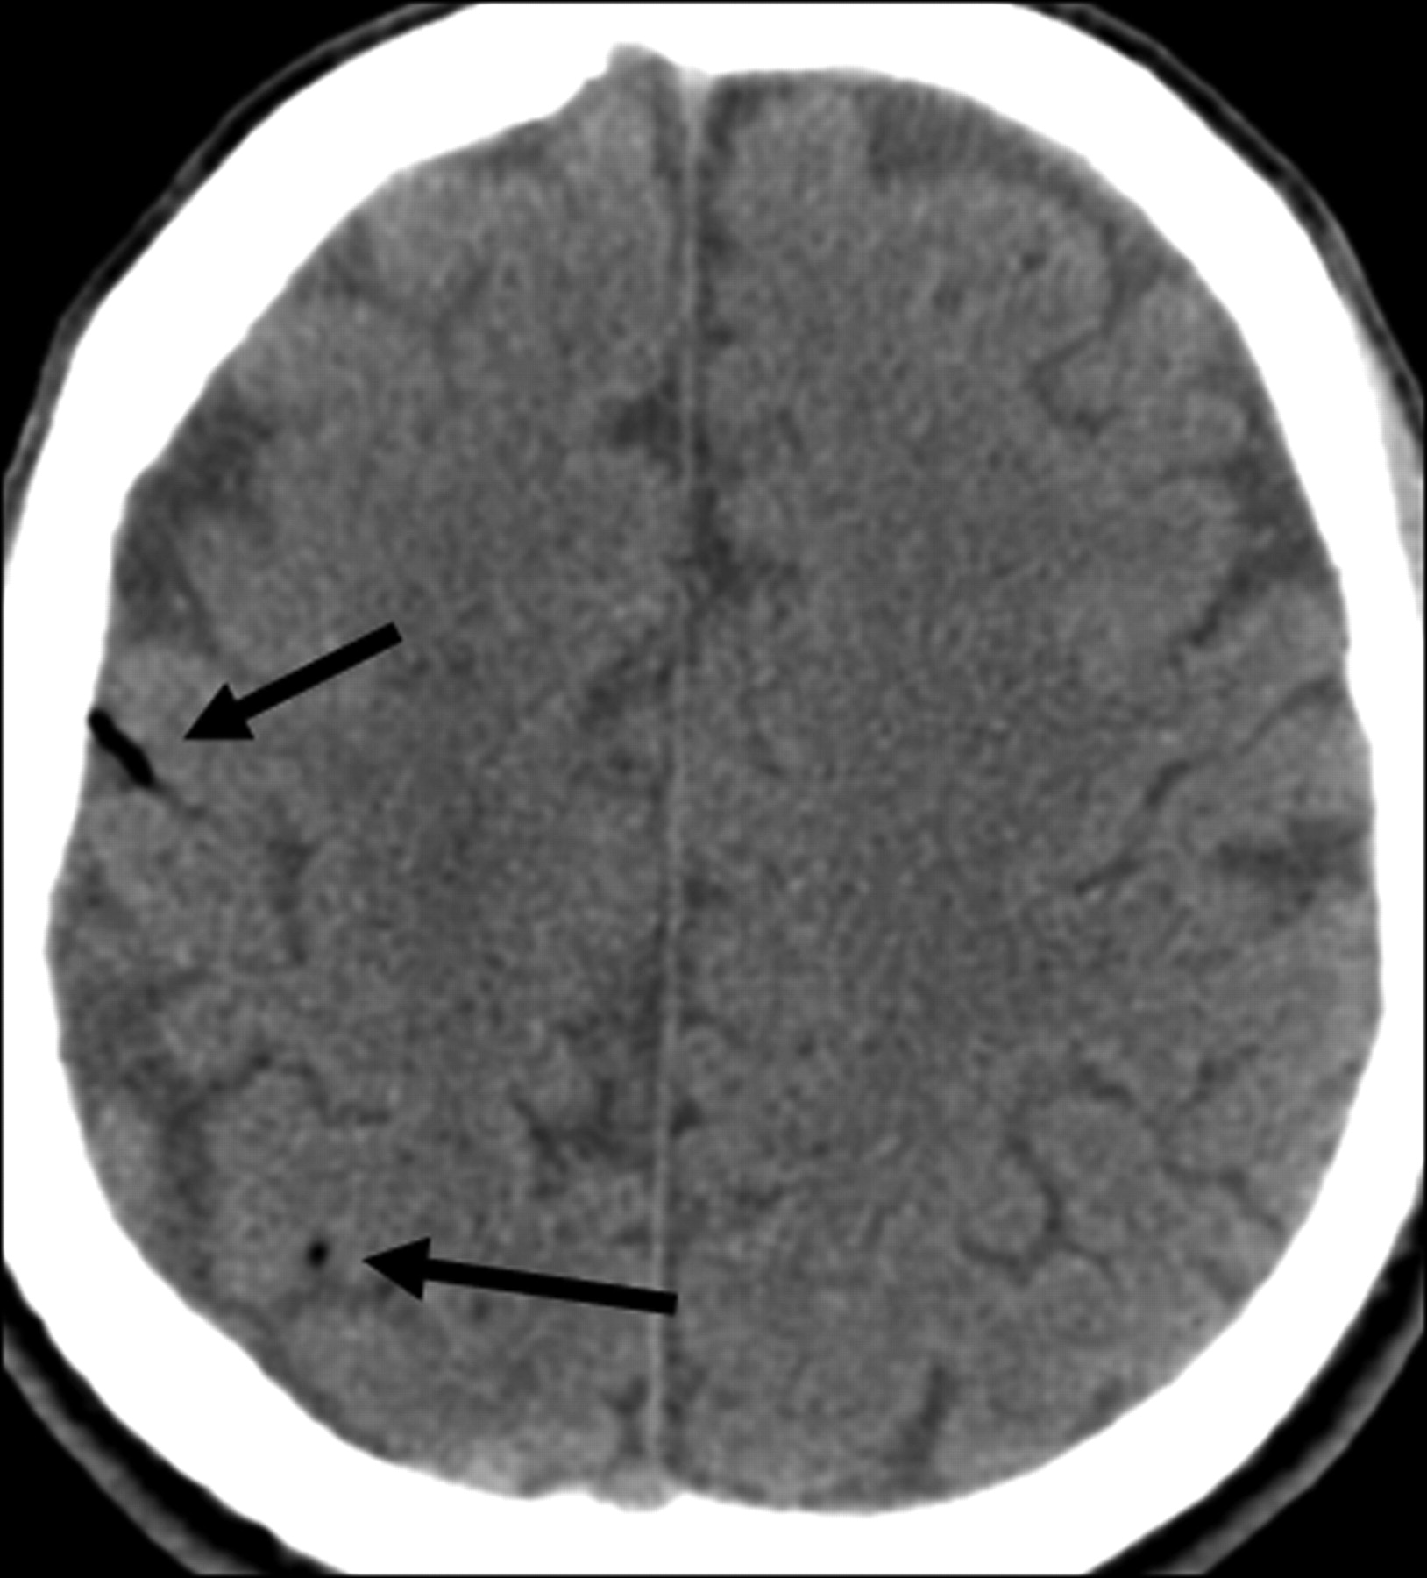
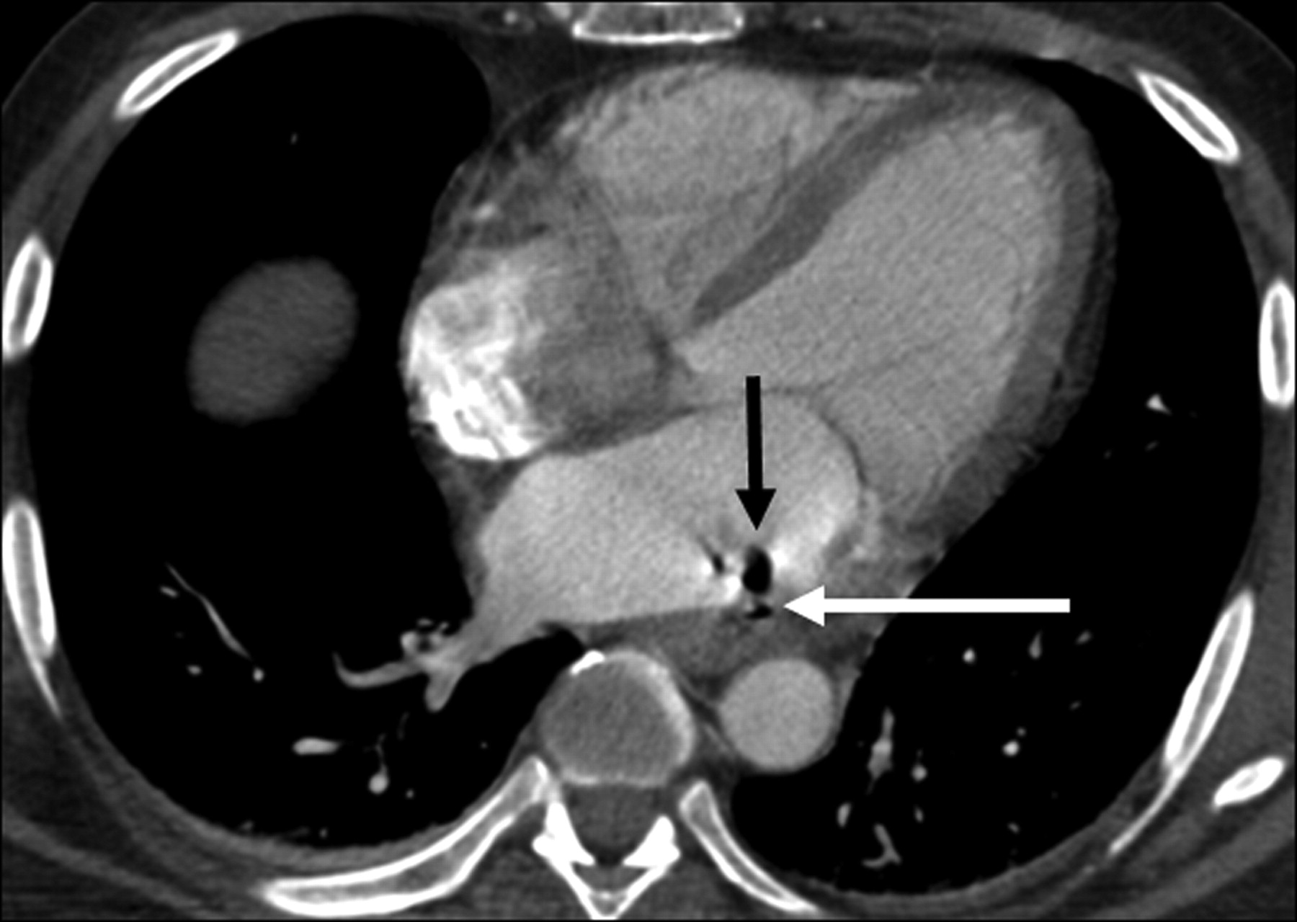
Lempel JK, Jozwik B, Manfredi C et-al. Cerebral air embolism: a result of atrioesophageal fistula. AJNR Am J Neuroradiol. 2012;33 (3): E40-1. doi:10.3174/ajnr.A3001
Notes:
Symptoms may include dizziness, anxiety, fear of death, dyspnea, chest pain, and sudden loss of consciousness.
Above: Head CT showed curvilinear areas of very low attenuation (−600 HU) within several cerebral sulci, suggesting air emboli
The classic course of arterial air emboli is to enter the first major branch off the aorta, the innominate artery, and to proceed to the right carotid circulation.
Jensen ME, Lipper MH. CT in iatrogenic cerebral air embolism. AJNR Am J Neuroradiol 1986; 7: 823– 27

Slide 3
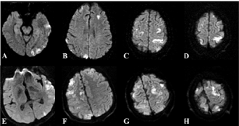
Caulfield AF, Lansberg MG, Marks MP et-al. MRI characteristics of cerebral air embolism from a venous source. Neurology. 2006;66 (6): 945-6. doi:10.1212/01.wnl.0000203117.20406.eb

Slide 4
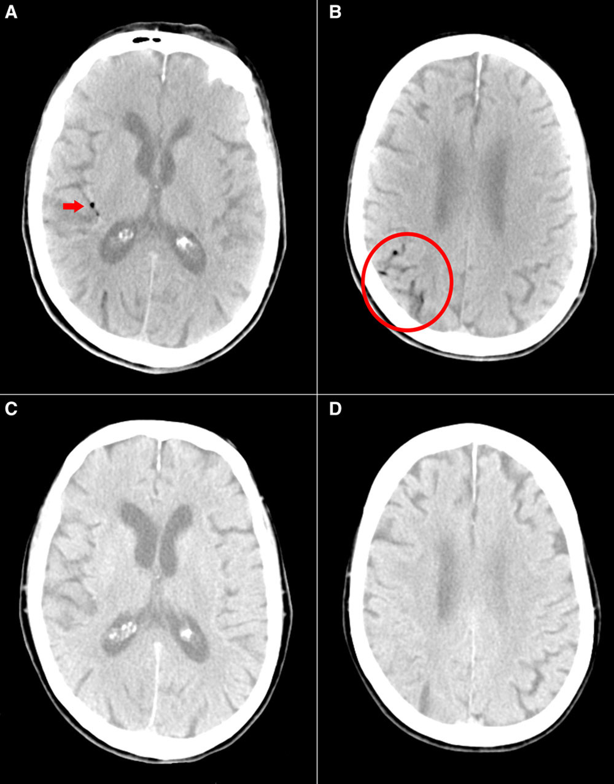
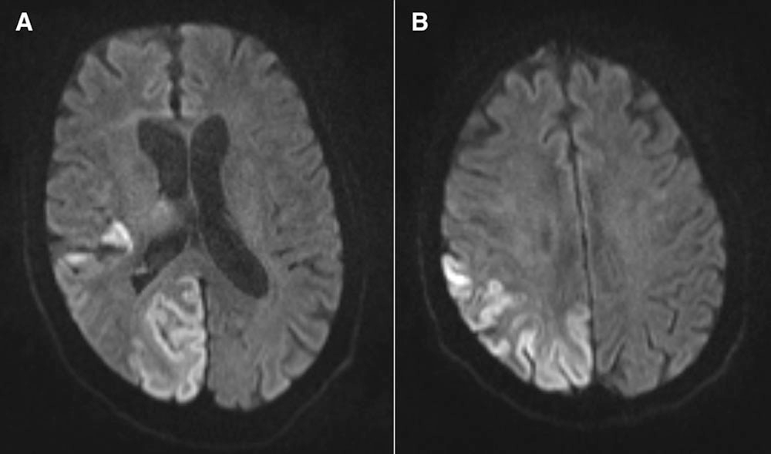
Chuang DY, Sundararajan S, Sundararajan VA, Feldman DI, Xiong W. Accidental Air Embolism: An Uncommon Cause of Iatrogenic Stroke. Stroke. 2019;50:e183–e186.
https://doi.org/10.1161/STROKEAHA.119.025340
Notes:
Figure 1. Air embolism: Noncontrast computed tomography (CT) head scan performed immediately after intravenous line placement and acute onset of seizure showed air in the right parieto-occipital sulci, as well as the Sylvian fissure (A, arrow and B, circle). Repeat CT head 5 h after symptom onset showed sulcal effacement and resolution of air emboli in the right parieto-occipital region (C and D). Images have been windowed to best show the air.
Figure 2. Diffusion-weighted imaging sequences of noncontrast magnetic resonance imaging brain 22 h after symptom onset showed diffusion restriction in right occipital and temporal lobes (A and B).

